Slide 1
Radiological Category:
Ultrasound
Principal Modality (1):
Principal Modality (2):
Ultrasound
MR
Case Report # 0847
Submitted by:
David M. Sada, M.D.
Faculty reviewer:
Eduardo Matta, M.D
Date accepted:
04 January 2012

Slide 2
Case History
31 year old female at 19 weeks gestation with complaints of spotting is referred for ultrasound workup including fetal anatomic survey.

Slide 3
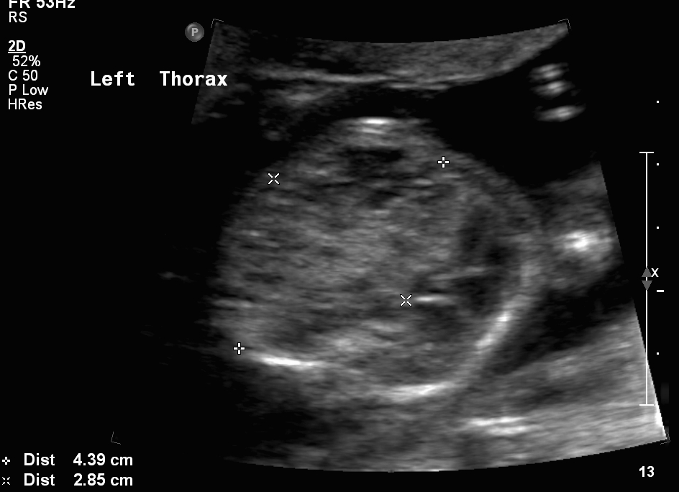
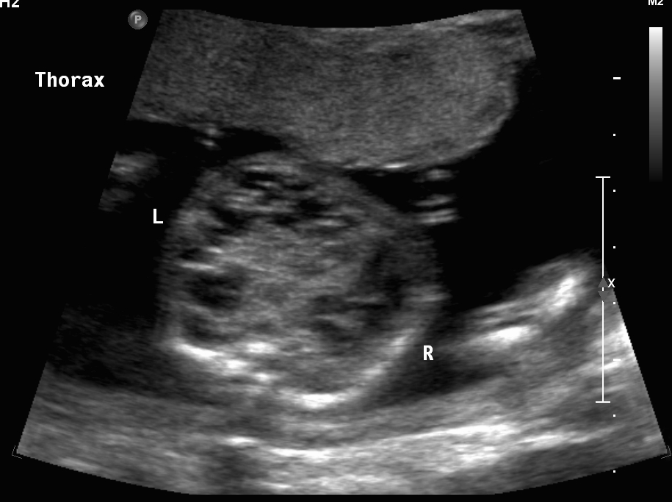
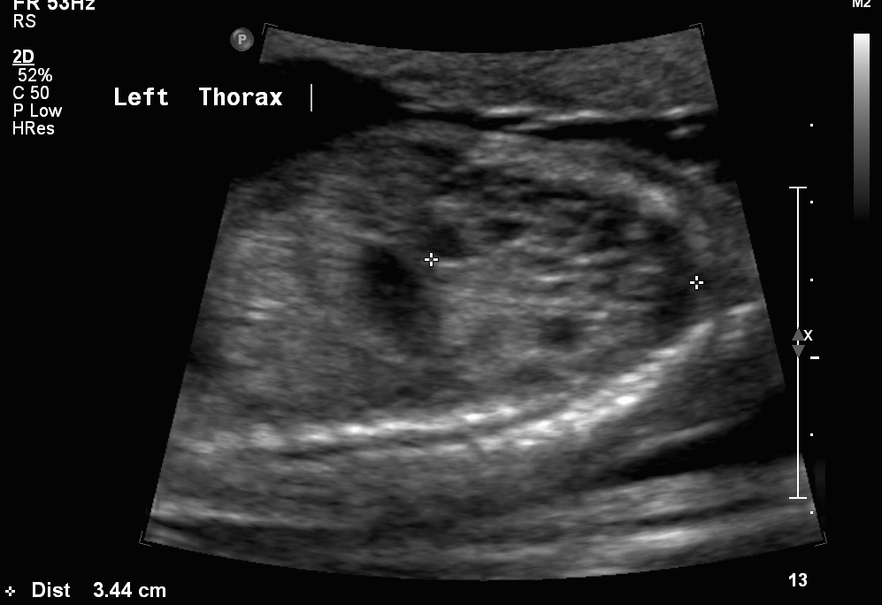
Radiological Presentations

Slide 4
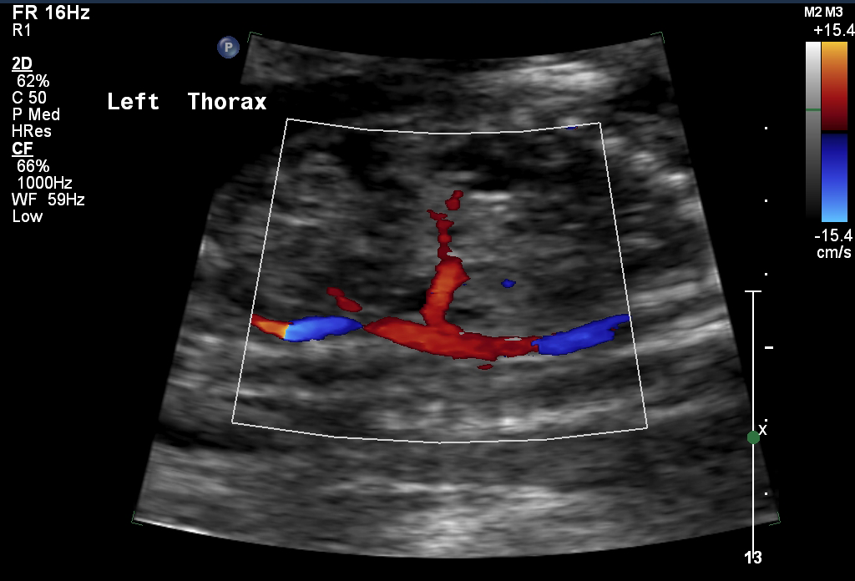
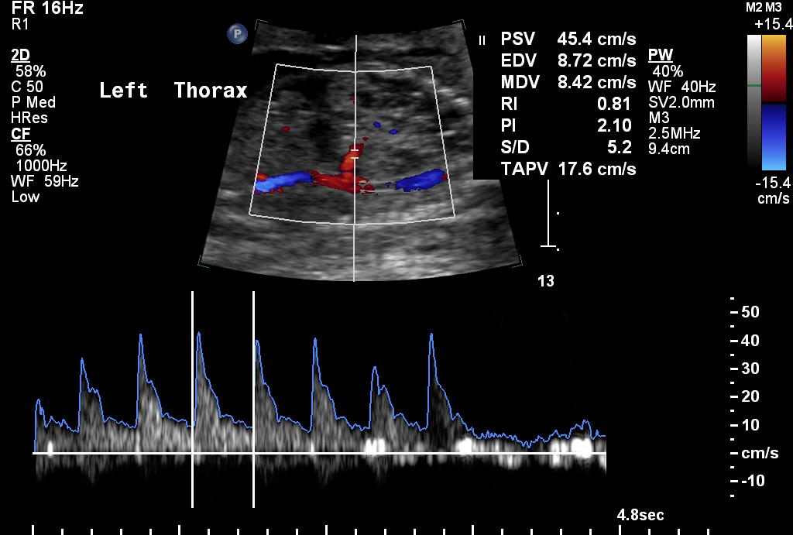
Radiological Presentations

Slide 5
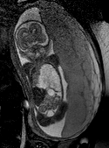
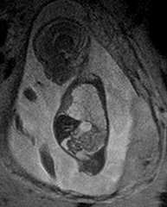
Radiological Presentations
BTFE Axial
T2 Sagittal
BTFE Coronal
T2 Axial

Slide 6
Test Your Diagnosis
Which one of the following is your choice for the appropriate diagnosis? After your selection, go to next page.
Congenital Pulmonary Airway Malformation
Bronchopulmonary Sequestration
Bronchogenic Cyst
Bronchial Atresia
Congenital Diaphragmatic Hernia

Slide 7
Ultrasound examination demonstrates a large heterogeneous left intrathoracic mixed solid and cystic mass, which abuts the left hemidiaphragm. Color Doppler evaluation identifies a vessel with arterial waveform which appears to arise from the descending thoracic aorta, feeding this mass. MR demonstrates similar findings, although the feeding artery was not able to be identified.
Findings and Differentials
Findings:
Differentials:
CPAM
Bronchopulmonary Sequestration
CPAM – Bronchopulmonary Sequestration Hybrid

Slide 8
Discussion
Although CPAM (Congenital Pulmonary Airways Malformation) and sequestration are congenital lung tumors classically described as having distinct embryology, pathology and natural history, occasionally lung masses may demonstrates features of both.
In this case, we see a mass that has both cystic and solid components, and appears heterogeneous on ultrasound, which strongly suggests CPAM, as sequestration would generally present as a homogenous echogenic mass. However, the mass is situated in the lower lobe abutting the diaphragm, and color Doppler clearly demonstrates a feeding artery which arises from the systemic arterial system, the descending thoracic aorta, which is the hallmark of bronchopulmonary sequestration.
In 1996, UCSF and CHOP conducted an evaluation of 130 fetal lung lesions, and fo these 130, 6 were found on pathology to actually be hybrids of both CPAM and Bronchopulmonary sequestration.
The following slides discuss CPAM and bronchopulmonary sequestration further individually.

Slide 9
Discussion
Congenital Pulmonary Airways Malformation (previously termed Congenital Cystic Adenomatoid Malformation) is a proliferation of polypoid glandular lung tissue without normal alveolar differentiation.
CPAM is categorized into 3 types. Type I is macrocystic, with large cysts measuring greater than 2 cm. Type II is also macrocystic, but with more solid component, and smaller cysts, measuring less than 2 cm. Type III is microcystic and no discernible individual cysts can be identified on imaging.
On antenatal ultrasound, they present as an echogenic solid and/or cystic mass in the fetal thorax, often causing mediastinal shift, as was seen in this case. They may be associated with fetal hydrops or polyhydramnios.
CPAMs tend to regress over time, but if they do not, they can be treated surgically later.
If a CPAM causes compression of the contralateral lung and subsequent fetal hydrops, this is associated with high mortality, and fetal surgery may be needed, or aspiration of the dominant cyst.

Slide 10
Discussion
Bronchopulmonary sequestration is a congenital area of abnormal lung that does not connect to the bronchial tree or pulmonary arteries. The arterial supply is typically from a systemic source off of the descending aorta as seen in this case.
There are two types: intralobar and extralobar. Intralobar sequestrations have venous drainage into the inferior pulmonary vein. Extralobar has systemic venous drainage. The venous drainage was not able to be delineated in this case.
On antenatal ultrasound, an echogenic homogeneous lung mass is identified. There is also Doppler demonstration of systemic arterial supply, which we saw in this case.
Fetal MR demonstrates a homogenous mass with high T2 signal, and systemic arterial supply may sometimes be demonstrated on MR, but was not in this case.

Slide 11
CPAM – Bronchopulmonary Sequestration Hybrid
Diagnosis

Slide 12
Cass DL et al. Cystic Lung Lesions with Systemic Arterial Blood Supply: A Hybrid of Congenital Cystic Adenomatoid Malformation and Bronchopulmonary Sequestration. J Ped Surg, Vol 32, No & (Jul), 1997: pp. 986-990. Donnelly L. Pediatric Imaging: The Fundamentals. Saunders-Elsevier © 2009. pp. 36-40. Middleton W et al. Ultrasound: The Requisites. 2nd edition. Mosby-Elsevier © 2004. pp. 424-426.
References

