Slide 1
Radiological Category:
Pediatric
Principal Modality (1):
Principal Modality (2):
Conventional Radiography
Case Report # 0848
Submitted by:
David M. Sada, M.D.
Faculty reviewer:
Susan Greenfield, D.O.
Date accepted:
04 January 2012

Slide 2
Case History
Term 15 day old female with left lower leg deformity.

Slide 3
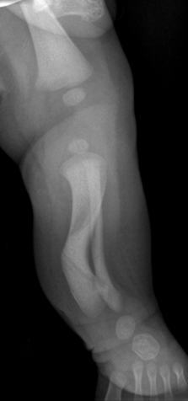
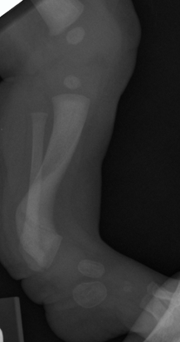
Radiological Presentations

Slide 4
Test Your Diagnosis
Which one of the following is your choice for the appropriate diagnosis? After your selection, go to next page.
Congenital Fetal Bowing
Neurofibromatosis
Physiologic Bowing
Blount Disease
Fibrous Dysplasia
Rickets

Slide 5
Posteromedial bowing of the left tibia and fibula with mild diaphyseal broadening without otherwise apparent metaphyseal, cortical or medullary abnormality. Calcaneovalgus deformity of left foot.
Findings and Differentials
Findings:
Differentials:
Congenital Fetal Bowing
Neurofibromatosis
Physiologic Bowing
Rickets
Fibrous Dysplasia

Slide 6
Discussion
This is a case of congenital fetal bowing, where bowing of the bones is caused by abnormal intrauterine or fetal positioning.
Congenital bowing is nearly always convex posteromedially, and rarely laterally. In this case we seen posterior bowing certainly and slight medial bowing. Calcaneovalgus deformity of the ipsilateral foot and diaphyseal broadening can often also be seen as in this case.
This tends to resolve on its own over time, and protective bracing can be used to treat this. Resolution occurs most rapidly during the first year of life, but children with congenital bowing should be followed up periodically till skeletal maturity, to identify cases with residual bowing, ankle deformity, muscle weakness, and limb length inequality as active surgical intervention may be needed to correct these problems.

Slide 7
Discussion
The fact that the bones are bowed posteromedially, a hallmark of congenital fetal bowing, distinguishes this from Neurofibromatosis. Neurofibromatosis may have a similar appearance, but would demonstrate anterolateral bowing instead.
Rickets can cause generalized bowing, as well, but there are no metaphyseal abnormalities seen in this case, such as fraying or flaring, and changes at sites of rapid growth are characteristic of Rickets.
Fibrous Dysplasia can have bowed bones as well, but we do not see any medullary space widening, endosteal scalloping, coarse or obliterated trabeculation, nor the lytic, ground-glass and/or sclerotic appearances characteristic of fibrous dysplasia.
Physiologic Bowing is also known as developmental bowing, and would not be expect in a neonate. It is seen typically in early walkers and heavier children, and is manifested by exaggerated varus angulation when younger than 2 years old.

Slide 8
Congenital Fetal Bowing
Diagnosis

Slide 9
Anton, CG. Bowing Bones. StaDX: ExDDx. Accessed Jan 4 2012. Shah, HH et al. Congenital posteromedial bowing of the tibia: a retrospective analysis of growth abnormalities of the leg. J Pediatr Orthop B. 2009 May; 18(3): 120-8
References

