Slide 1
Radiological Category:
Neuroradiology
Principal Modality (1):
Principal Modality (2):
MR
Case Report # 0861
Submitted by:
Logan Boatman, M.D.
Faculty reviewer:
Eliana Bonfante, M.D.
University of Texas Medical School at Houston
Date accepted:
15 February 2012

Slide 2
Case History
Sixteen month old male with recent diagnosis of developmental delay (failure to meet developmental milestones after twelve months) presents with 4-5 month history of episodic tremors. Episodes typically occur after waking from sleep, involve shaking both arms and legs, and last 30-60 seconds. No loss of consciousness but there is a post-episode “glazed over” period lasting 5-10 minutes. No bowel or bladder incontinence, no eye rolling, and no tongue biting. Episodes occur 4-5 times a week.
Additional physical findings include a tendency to fall backwards from a seated position over the past week, drooping eyelids, lateral deviation of the right eye and worsening sleepiness throughout the day.
No recent illnesses, fevers, or past hospitalization.
Available lab values are normal.

Slide 3
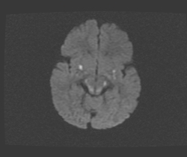
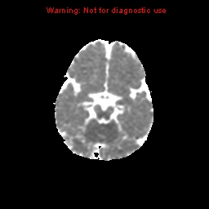
Radiological Presentations
MRI Axial DWI

Slide 4
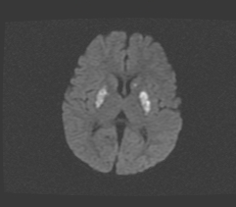
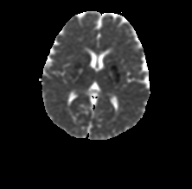
Radiological Presentations
MRI Axial DWI
MRI Axial ADC

Slide 5
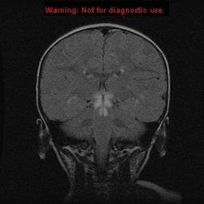
Radiological Presentations
MRI Coronal FLAIR

Slide 6
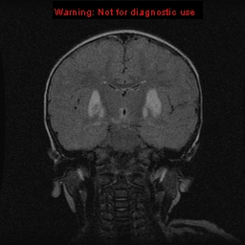
Radiological Presentations
MRI Coronal FLAIR

Slide 7
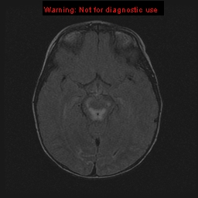
Radiological Presentations
MRI Axial FLAIR

Slide 8
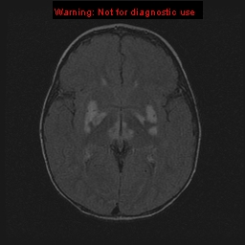
Radiological Presentations
MRI Axial FLAIR

Slide 9
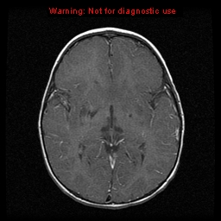
Radiological Presentations
MRI Sagittal T1 Post Contrast

Slide 10
Test Your Diagnosis
Which one of the following is your choice for the appropriate diagnosis? After your selection, go to next page.
Childhood stroke/ischemia
Mitochondial Encephalopathy, Lactic Acidosis, Stroke-like episodes (MELAS)
Wilson Disease
Leigh Syndrome

Slide 11
T2 FLAIR hyperintensities in the bilateral basal ganglia, thalami, periaqueductal gray matter, and left medulla oblongata. Some of these hyperintensities correspond to areas of restricted diffusion and some of them do not, suggesting the combination of acute and chronic process.
Findings and Differentials
Findings:
Differentials:
Childhood stroke/ischemia
Mitochondial Encephalopathy, Lactic Acidosis, Stroke-like episodes (MELAS)
Wilson Disease
Leigh Syndrome

Slide 12
Discussion
Childhood stroke/hypoxia:
The gradual onset of the patient’s symptoms and the absence of a traumatic event makes asphyxia or hypotensive cerebral infarct unlikely. Profound hypoxia characteristically presents as restricted diffusion with matching low ADC in the ventrolateral thalamus and/or the posterior internal capsule.
Multiple embolic strokes could also be a consideration, but the symmetric bilateral involvement of the lentiform nuclei and periaqueductal gray matter make an embolic etiology less likely.
Mitochondial Encephalopathy, Lactic Acidosis, Stroke-like episodes (MELAS):
This disease characteristically demonstrates increased T2/FLAIR intensity in the putamina that may be asymmetric or unilateral. Stroke-like findings, especially in the parietooccipital region, in a nonvascular territory may also be seen. Restricted diffusion may be present in the acute phase.
This disease typically presents in childhood/early adulthood (mean age onset of 15 years) with lactic acidosis, seizures, and stroke-like episodes. In this case, the patient’s lactate was not elevated.

Slide 13
Discussion
Wilson Disease:
This disease can also demonstrate increased T2/FLAIR intensity in the lentiform nuclei, caudate nuclei, and thalami. Increased T2 signal may also be present in the periaqueductal gray matter, pontine tegmentum, and cerebral or cerebellar white matter. Decreased ADC values may be present immediately after the onset of symptoms.
Wilson disease, related to poor copper metabolism, can cause liver disease as early as 8 years of age, but rarely demonstrates neurodegenerative symptoms before the 2nd decade of life.
Leigh Syndrome:
As demonstrated in this case, the most characteristic finding in Leigh syndrome is increased T2/FLAIR signal in the periaqueductal gray matter and putamina. T2/FLAIR may also be seen in the caudate heads, globus pallidi, and thalami. Less frequent foci can include the cerebral or cerebellar white matter, spine, and gray matter. Decreased diffusion with matching on ADC map is present in acute foci. Enhancement is rare. The lesions are typically hypointense on T1 imaging. MR spectroscopy can also be performed and demonstrates increased choline, decreased NAA, and the presence of lactate.

Slide 14
Discussion
Leigh Syndrome:
Also known as subacute necrotizing encephalomyelopathy, Leigh syndrome is caused by genetic mutations involving mitochondrial DNA, specifically the electron transport chain. As in all mitochondrial disorders, the phenotypic penetrance is variable and the relationship between mitochondrial dysfunction and neurodegenerative changes is not fully understood.
Leigh syndrome typically occurs in 1 in 32,000 children under the age of 6 and is the most common mitochondrial disease in this age group. The disease typically presents with developmental delay and onset of dysfunctions related to the brain stem and basal ganglia such as ataxia, ptosis, and opthalmoplegia as demonstrated by this case. Seizure activity, also in this case, is an additional feature of the disease. Most cases present by the age of 2 years and have no gender or ethnic predilection.
There is no cure for the disease, but the use of quinone derivatives and vitamins as well as decreasing systemic stressors such as illness may decrease acute episodes. The prognosis for patients affected by Leigh Syndrome is poor and results in progressive neurodegeneration with eventual childhood respiratory failure and death.

Slide 15
Leigh Syndrome
Diagnosis

Slide 16
References
Barkovich, AJ. Leigh Syndrome. www.statdx.com.
Kartikasalwah, AL. Leigh syndrome: MRI findings in two children. Biomedical Imaging and Interventional Journal 2010; 6(1): e6.
Lebre, AS et al. A common pattern of brain MRI imaging in mitochondrial diseases with complex I deficiency. Journal of Medical Genetics 2011; 48: 16-23.
Lee HF et al. Leigh Syndrome: clinical and neuroimaging follow-up. Pediatric Neurology 2009; 40(2): 88-93.

