Slide 1
Radiological Category:
Neuroradiology
Principal Modality (1):
Principal Modality (2):
MR
Case Report # 0862
Submitted by:
Logan Boatman, M.D.
Faculty reviewer:
Clark Sitton, M.D.
University of Texas Medical School at Houston
Date accepted:
15 February 2012

Slide 2
Case History
70-year-old female with small cell lung cancer one year ago, status post chemotherapy and radiation therapy, in remission.
10 days ago, patient started to have progressively worsening weakness and numbness in the bilateral lower extremities, left more than right. The patient is still able to stand, but strength and mobility are decreased.
Denies headache, hearing loss, blurry vision or other neurological symptoms.
Physical exam reveals intact cranial nerves. Muscle strength 3 out of 5 in the left lower extremity and 4 out of 5 in the right lower extremity. Normal light touch sensation. Deep tendon reflexes 3+ symmetric bilateral patellar.
Lab values are normal.

Slide 3
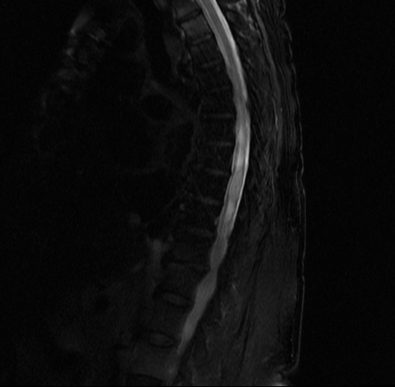
Radiological Presentations
MRI Sagittal T2

Slide 4
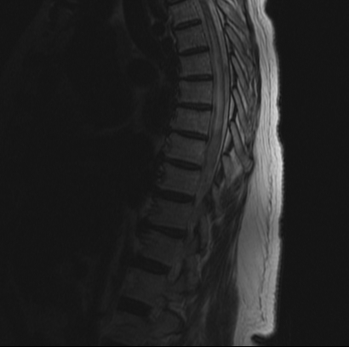
Radiological Presentations
MRI Sagittal FLAIR

Slide 5
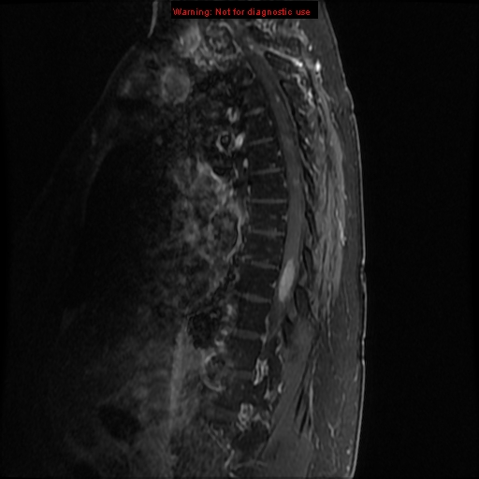
Radiological Presentations
MRI Sagittal T1 Post Contrast

Slide 6
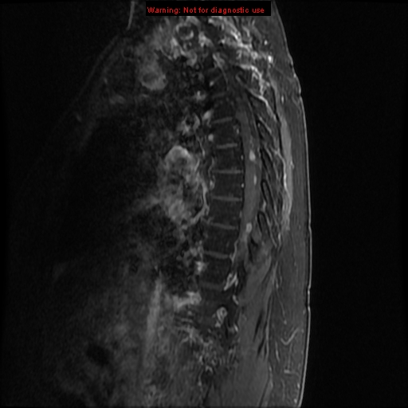
Radiological Presentations
MRI Sagittal T1 Post Contrast

Slide 7
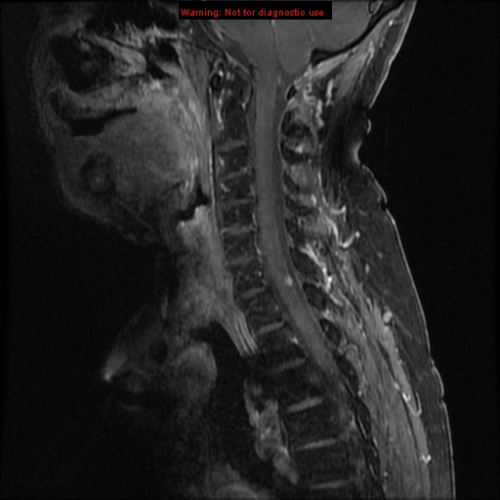
Radiological Presentations
MRI Sagittal T1 Post Contrast

Slide 8
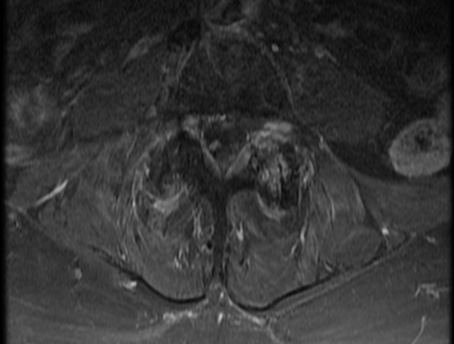
Radiological Presentations
MRI Axial T1 Post Contrast

Slide 9
Test Your Diagnosis
Which one of the following is your choice for the appropriate diagnosis? After your selection, go to next page.
Primary spinal cord tumor
Demyelinating disease
Transverse myelitis
Intramedullary spinal cord metastasis

Slide 10
MRI – Multiple focally enhancing lesions within the cord from the level of T1 through nerve roots of the cauda equina. The nerve root lesions are expansile. The largest of the spinal cord lesions at the T8 level measures 2.5 cm in length. There is associated T2/FLAIR hyperintensity from T4 through T8 suggesting cord edema.
Findings and Differentials
Findings:
Differentials:
Primary spinal cord tumor
Demyelinating disease
Transverse myelitis
Intramedullary spinal cord metastasis

Slide 11
Discussion
Primary spinal cord tumor:
Primary cord tumors such as astrocytoma, ependymoma, hemangioblastoma, or neurofibroma could demonstrate similar parenchymal enhancement and cord edema seen here. A primary tumor, however, would be unlikely to present with multiple foci as seen here.
Demyelinating disease:
Multiple sclerosis typically appears as “flame shaped” T2 lesions in the dorsal spinal cord. These lesions may be multifocal, and while they cause cord edema, it is typically less than expected for a cord metastasis. Enhancement of MS lesions is variably homogeneous or ring shaped during the acute or subacute phase. It would be unlikely to have multiple synchronously enhancing lesions as in this case.
Transverse myelitis:
Idiopathic transverse myelitis typically appears as a peripherally enhancing lesion in the central spinal cord measuring greater than two vertebral segments in length. There is usually smooth cord expansion with high T2 signal intensity surrounding a central dot representing gray matter with surrounding edema. They most commonly occur in the thoracic spine.

Slide 12
Discussion
Intramedullary spinal cord metastasis:
Spinal cord metastases are characterized by focal enhancing lesions with marked surrounding edema. These lesions may be expansile and can rarely demonstrate low T2 signal if the metastasis is hemorrhagic. As in this case, numerous well circumscribed enhancing lesions within the cord parenchyma strongly suggests the diagnosis especially with a history of prior malignancy. Metastases may occur at any level, but are less common in the conus medullaris and cauda equina.
Spinal metastases are rare but have a very poor prognosis with median survival time of only 6 months. Lung and breast are the two most common primary malignancies respectively. Clinical symptoms typically involve progressive weakness, pain, and loss of bowel and bladder control. Hemi-paralysis with contralateral deficits in pain and temperature sensation, the Brown-Sequard syndrome, has also been described with spinal cord metastasis.
Optimal management of the lesions is complex and greatly aided by early diagnosis and surgical resection. Radiation therapy may also be used in the presence of multiple lesions.

Slide 13
Intramedullary spinal cord metastasis.
Diagnosis

Slide 14
References
Aryan, HE et al. Intramedullary spinal cord metastasis of lung adenocarcinoma presenting as Brown-Sequard syndrome. Surgical Neurology 2004, 61, 72-76.
Brant-Zawadzki, M. Mestastases, Spinal Cord. www.statdx.com.
Dam-Hieu, P et al. Retrospective study of 19 patients with intramedullary spinal cord metastasis. Clinical Neurology and Neurosurgery 2009, 111, 10-17.
Potti, A et al. Intramedullary spinal cord metastases (ISCM) and non-small cell lung carcinoma (NSCLC): clinical patters, diagnosis and therapeutic considerations. Lung Cancer 2001, 31, 319-323.

