Slide 1
Radiological Category:
Neuroradiology
Principal Modality (1):
Principal Modality (2):
CT
MRI
Case Report # 0867
Submitted by:
Ravinder Singh Legha, M.D.
Faculty reviewer:
Emilio Supsupin, M.D
Date accepted:
15 February 2012

Slide 2
Case History
60 year-old male status post multiple motor vehicle collisions with multiple orthopedic injuries with mental status change after ORIF.

Slide 3
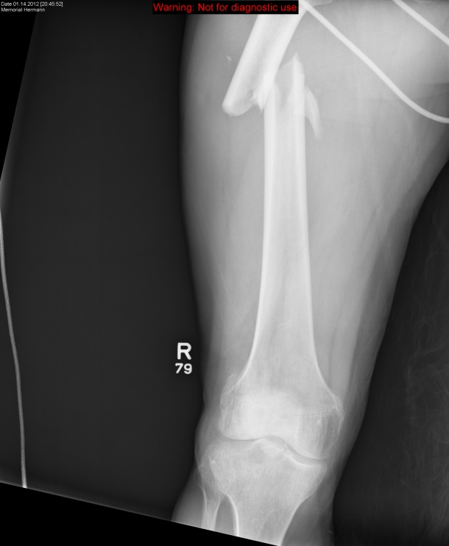
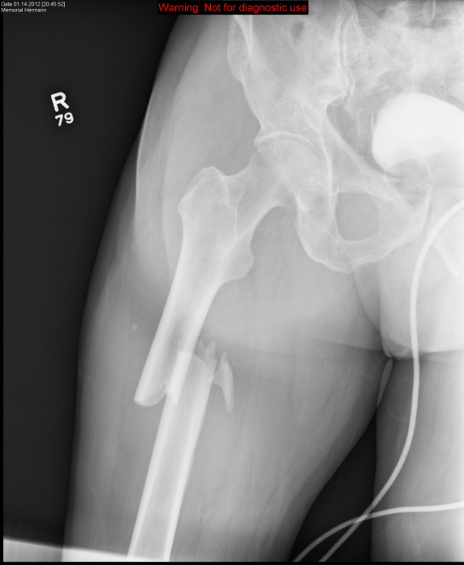
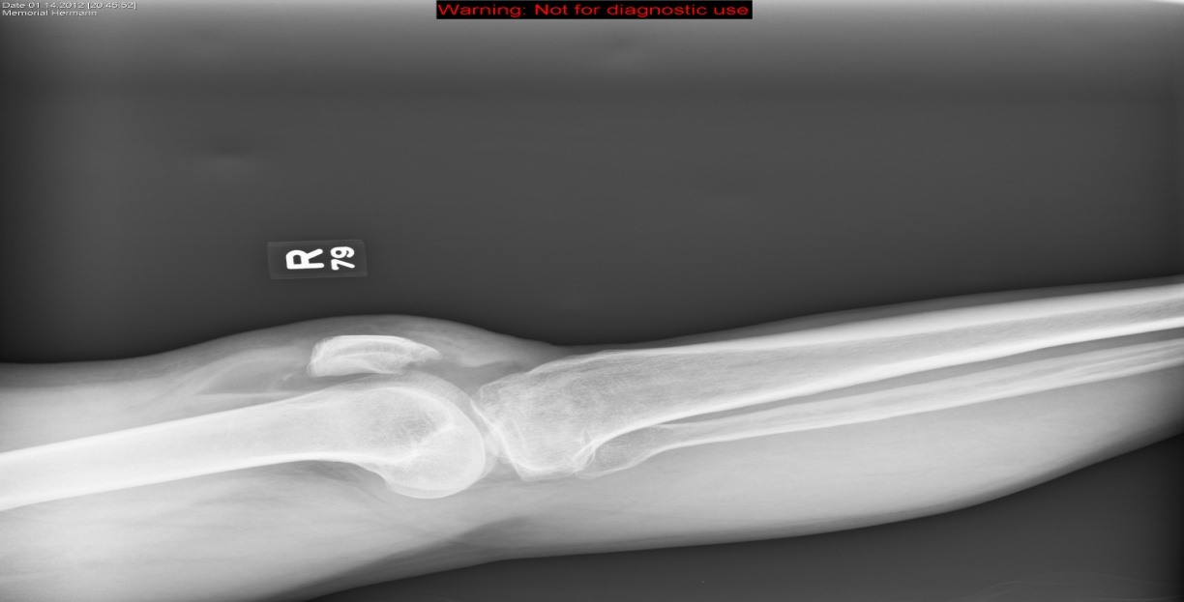
Radiological Presentations: Initial Presentation.

Slide 4
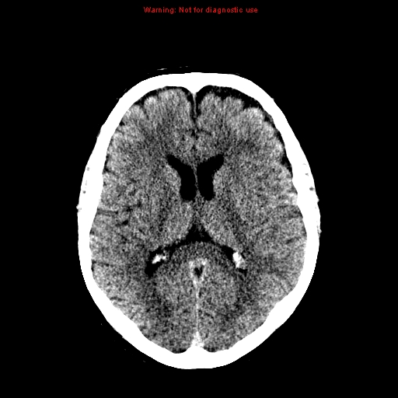
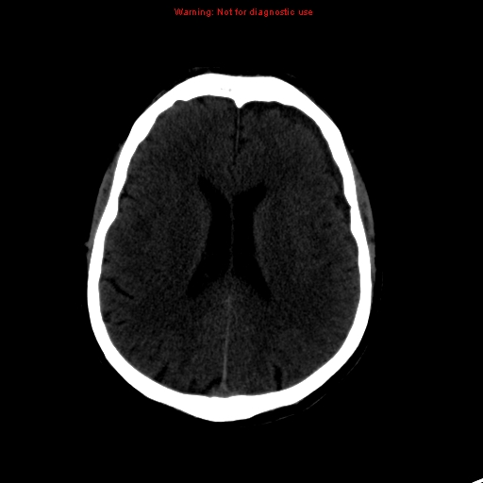
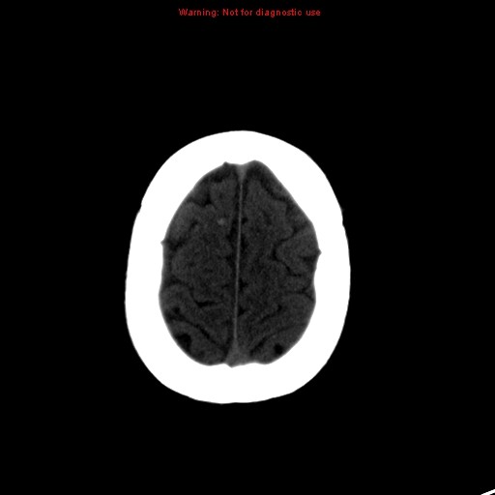
Radiological Presentations: Initial presentation

Slide 5
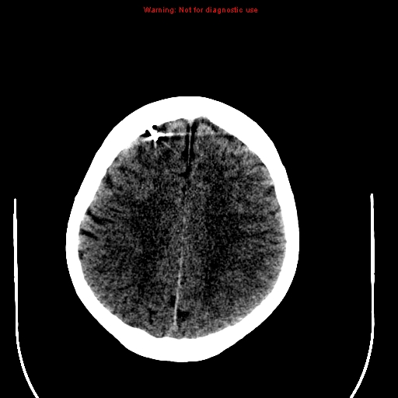
Radiological Presentations: post ORIF

Slide 6
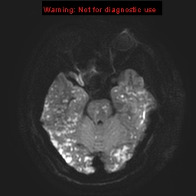
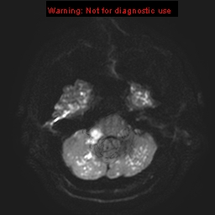
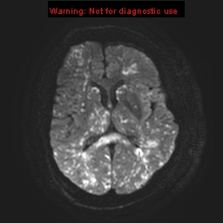
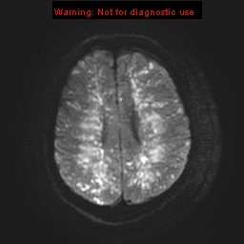
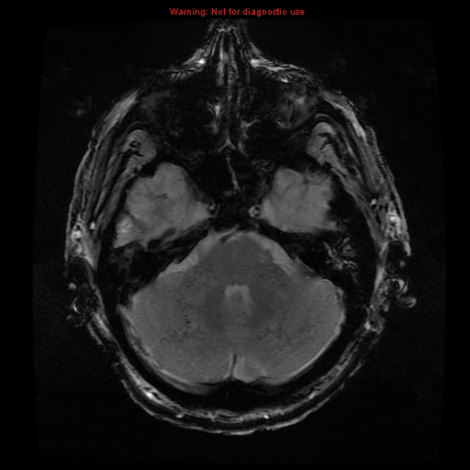
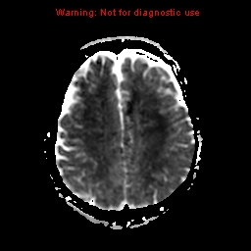
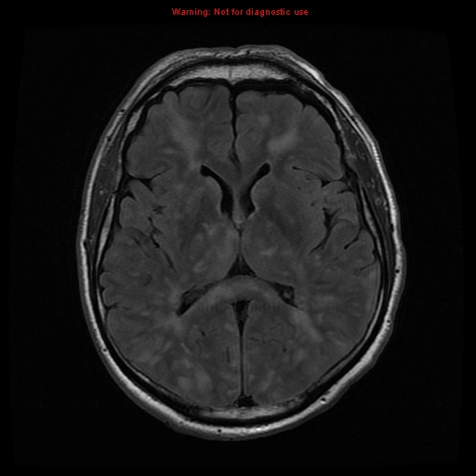
Radiological Presentations: post ORIF

Slide 7
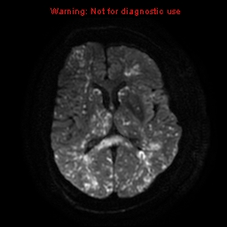
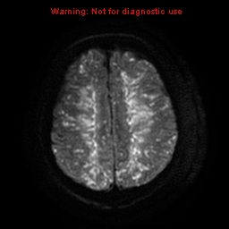
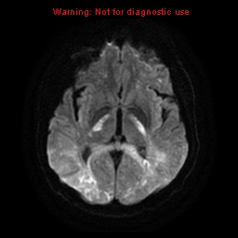
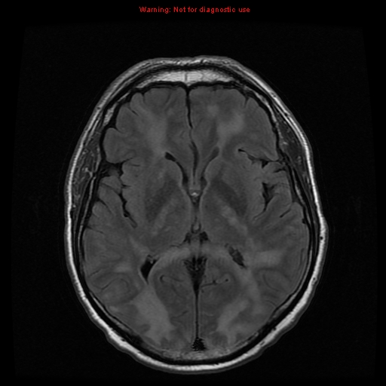
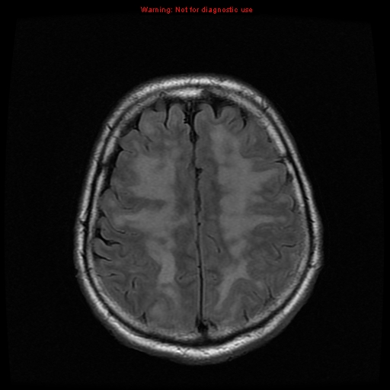
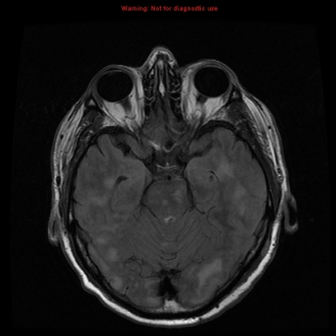
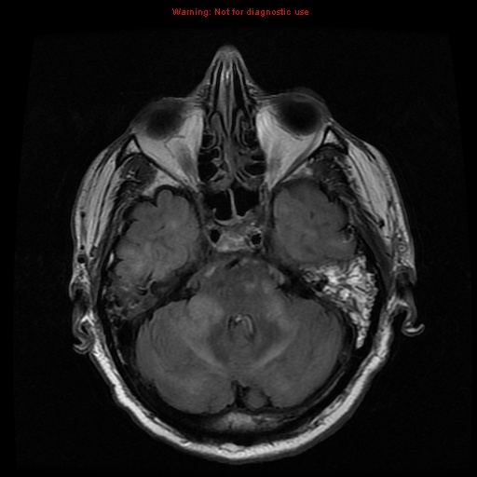
Radiological Presentations: Follow up MRI

Slide 8
Test Your Diagnosis
Which one of the following is your choice for the appropriate diagnosis? After your selection, go to next page.
Acute cerebral ischemia/infarction
Acute hypertensive encephalopathy (PRES)
Vasculitis
Fat emboli with infarction

Slide 9
-Radiographs: Comminuted right femoral diaphyseal fracure with posterior and medial displacement. Fracture through the distal femoral intercondylar notch. Medial/Lateral tibial plateau fractures. Comminuted patellar fractures. Lipohemarthrosis. -Initial brain CT: Punctate focus of increased attenuation at the gray-white interface in the right superior frontal gyrus represents shearing injury. Small left frontal low-attenuation subdural collection without significant mass effect represents subdural fluid collection. -Follow up brain CT: Intracranial pressure monitor placement in right frontal lobe with pneumocephalus. No change in injuries.
Findings and Differentials
Findings:
:

Slide 10
-MRI 4 days later: Diffuse punctate and conglomerate T2 FLAIR signal abnormalities with corresponding DWI restricted diffusion involving the cortex of the bilateral occipital and temporal lobes. Additional involvement of periventricular white matter, basal ganglia, splenium of the corpus callosum, and bilateral cerebellar hemispheres. Susceptibility artifact in bilateral cerebellar hemispheres. -Findings represent extensive infarcts involving the entire brain, brainstem, and corpus callosum with cerebellar microhemorrhages. -Follow up MRI: Symmetric increased T2 signal in expected location of corticospinal tracts and cerebellar peduncles represents wallerian degeneration. Expected evolution of extensive infarcts with more pronounced petechial hemorrhages.
Findings and Differentials
Findings:
Differentials:
Acute cerebral ischemia
PRES
Vasculitis
Fat emboli with cerebral infarction

Slide 11
Discussion
-Fat emboli with infarction: acute ischemia related to fat emboli with appropriate clinical history: long bone/pelvic fractures, cardiac surgery, joint replacement surgery.
-Imaging:
-Often mimics thromboembolic stroke. Commonly affects both gray and white matter. Ranges from puncate to large vascular territory. May:
-Affect deep & periventricular white matter or deep gray nuclei.
-Involve typical vascular territory.
-Mimic watershed infarct.
-NECT: typically no acute findings. Hypodense MCA sign related to fat within MCA is rare.
-T2/FLAIR MR: Multiple small, scattered hyperintense foci in WM/GM.
-T1 MR: Typically normal.
-DWI: Acute diffusion restriction.
-High resolution chest CT findings: bilateral ground glass opacities and thickening of interlobular septa.

Slide 12
Discussion
Differential Considerations:
-Acute cerebral ischemia/infarction:
-Wedge-shaped T2 hyperintensity in typical vascular territory. DWI restriction. PWI shows abnormal perfusion.
-Acute hypertensive encephalopathy, PRES:
-T2/FLAIR hyperintensity in cortex/subcortical WM of posterior circulation. May affect BG and thalami. Typically reversible.
-Vasculitis.
-Irregularity, stenosis, and vascular occlusion of 2nd and 3rd order arterial branches. T2/FLAIR subcortical and BG hyperintensities.
-Pathy enhancement is common. May see associated hemorrhage. May be DWI + in acute phase.

Slide 13
Fat embolism with cerebral infarction. -Incidence is 0.9 – 2.2% following bone fracture. Potentially life-threatening. -Fat emboli can pass through pulmonary vasculature without shunting lesions resulting in systemic embolization, most commonly brain and kidneys. -Presentation: -Fat embolism syndrome: pulmonary, CNS, and cutaneous manifestations. -Main criteria: hypoxia, AMS, petechiae. -Secondary signs: tachycardia, fever, anemia, thrombocytopenia. -Neurologic dysfunction varies from headache and confusion to encephalopathy with coma and seizures. -Many cases are subclinical and undiagnosed. -The patient suffered irreversible neurologic damage and expired.
Diagnosis

Slide 14
Bavetta S et al: Brain injury without head injury after multiple trauma. Brain Inj. 9(6): 635-9, 1995. Parizel PM et al: Early diagnosis of cerebral fat embolism syndrome by diffusion-weighed MRI (starfield pattern). Stroke. 32(12):2942-4, 2001. www.statdx.com Yousem DM et al: The Requisites: Neuroradiology. 3rd edition: 571-571, 2010.
References

