Slide 1
Radiological Category:
Neuroradiology
Principal Modality (1):
Principal Modality (2):
MRI
none
Case Report # 0873
Submitted by:
Justin Smith, M.D.
Faculty reviewer:
Leo Hochhauser, M.D
Date accepted:
Erase this and enter date accepted in format of: day month year
Example: 01 January 2002

Slide 2
Case History
52 year old white male with 2 month history of progressive left lateral occipital pain and progressive intermittent diplopia.

Slide 3
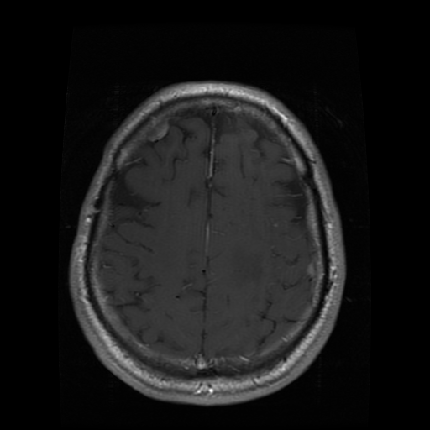
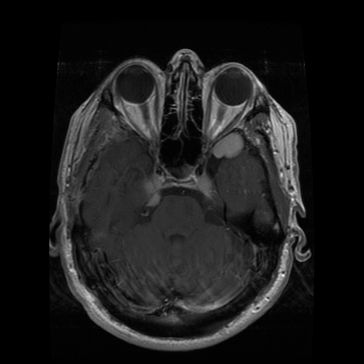
T1 Postcontrast MRI

Slide 4
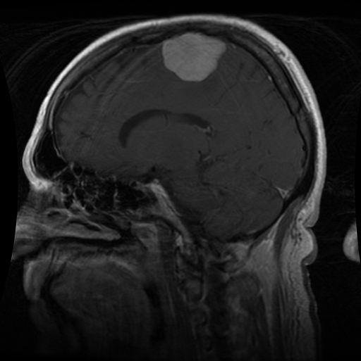
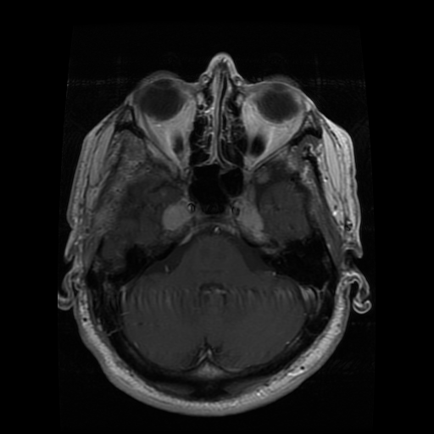
T1 Postcontrast MRI

Slide 5
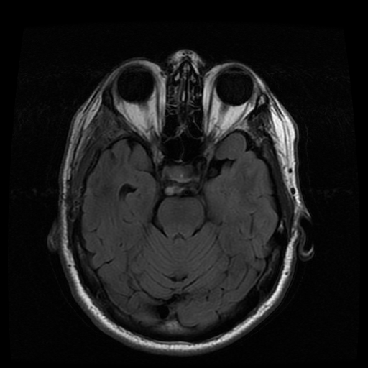
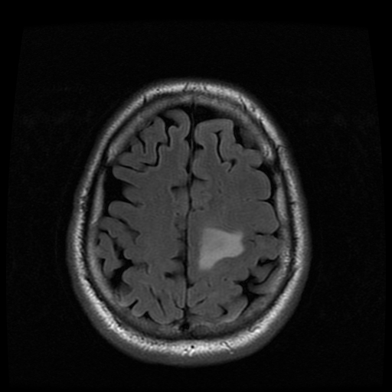
T2 FLAIR MRI

Slide 6
Test Your Diagnosis
Which one of the following is your choice for the appropriate diagnosis? After your selection, go to next page.
Mengiomatosis
Dural metatstatic disease
Rosai-Dorfman disease

Slide 7
Multiple homogeneously enhancing dural based extra-axial masses overlying the cerebral convexities as well as surrounding the sella and involving the cavernous sinus and Meckel’s cave.
Findings and Differentials
Findings:
Differentials:
Meningiomatosis
Dural metastatic disease
Rosai-Dorfman disease

Slide 8
Discussion
Rosai-Dorfman/Sinus Histiocytosis-
The disease is a rare, histiocytic lymphoproliferative disorder that is classified as an idiopathic histiocytosis. It most commonly affects otherwise healthy individuals in the first and second decades of life. The typical presentation (83%) is painless, bilateral, massive cervical adenopathy at the time of diagnosis; however, this is not necessary for the diagnosis.
Extranodal involvement is present in about 50% (including dural involvement). Isolated central nervous disease is very rare. May infiltrate brain with striking perilesional cerebral edema.

Slide 9
Discussion
Differentiating isolated dural involvement of Rosai-Dorfman from meningiomatosis is very difficult on imaging alone. Usually clinical history involving sex, age and possible elevation of ESR and/or CRP can help raise suspicion. Ultimately, however, biopsy is essential for diagnosis. Meningiomatosis has a high correlation with Neurofibromatosis 2, however, this patient did not exihibit other findings to suggest this chromosomal abnormality (ie. Vestibular schwannomas or ependymomas)
Dural metastases are usually present in the setting of known primary tumor and often have destruction of the adjacent calvarium.

Slide 10
Rosai-Dorfman (intracranial involvement only)
Diagnosis

Slide 11
Woodcock R, et al. Sinus Histiocytosis (Rosai-Dorfman Disease) of the Suprasellar Region: MR Imaging Findings—A Case Report. Radiology. 213:808-810. Kital R, Kazufumi S, Kubota T, et al. Meningeal sinus histiocytosis mimicking lymphoplasmacyte-rich meningioma. J Neurosurg 1996; 84:1051-1054.
References

