Slide 1
Radiological Category:
Vascular
Principal Modality (1):
Principal Modality (2):
CT
none
Case Report # 0884
Submitted by:
Jesse Proett, M.D.
Faculty reviewer:
Voon P Liaw, M.D
Date accepted:
March 7, 2012

Slide 2
Case History
CT chest performed on different dates. Contrast injected in right upper extremity IV and then left upper extremity IV.

Slide 3
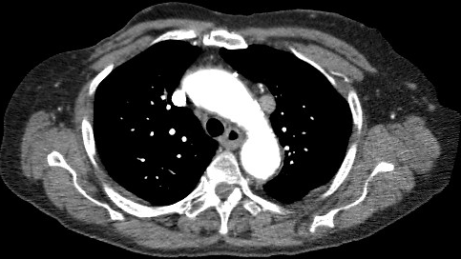
Radiological Presentations
Right side injection
Left side injection

Slide 4
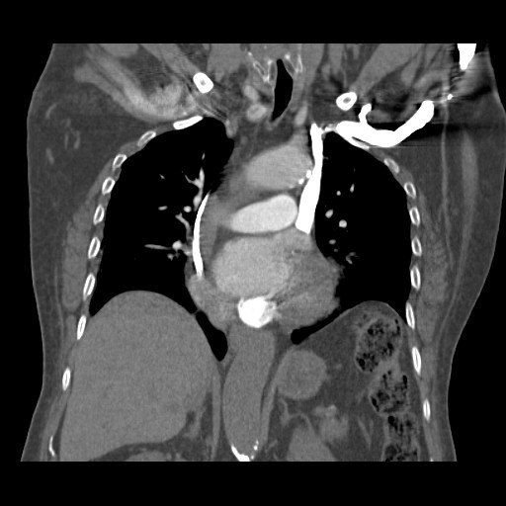
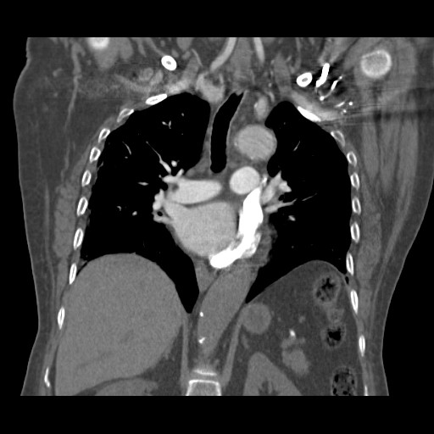
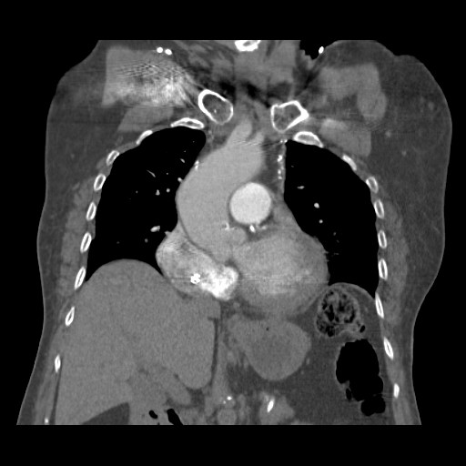
Radiological Presentations
Left injection
Right injection

Slide 5
Test Your Diagnosis
Which one of the following is your choice for the appropriate diagnosis? After your selection, go to next page.
Persistent Left Superior Vena Cava
Partial Anomalous Pulmonary Venous Return of Left Upper Lobe
Enlarged Left Superior Intercostal Vein

Slide 6
Tubular structure draping across the left mediastinum in the prevascular space lateral to the aorta, passing anterior to the right main bronchus and emptying into the coronary sinus. There are no feeding vessels from the lung. This vascular structure enhances intensely with IV contrast when injected from the left, but void of contrast when injected from the right. The left brachiocephalic vein is abscent.
Findings and Differentials
Findings:
Differentials:
Persistent Left Superior Vena Cava

Slide 7
Discussion
Persistent Left Superior Vena Cava (LSVC) is a normal anatomic variant occurring in 0.2-0.4% of patients. It is more prevalent in patients with congenital heart disease. There is no known genetic predisposition.
Etiology for LSVC stems from the persistence of the left common cardinal vein and sinus horn. It is sometimes associated with involution of right cardinal vein system.
Image findings include a vascular structure which courses along left side of mediastinum usually draining into coronary sinus. The course is lateral through the prevascular space and anterior to the left main bronchus. Majority are associated with an absent left brachiocephalic vein and are usually associated with a normal to decreased right SVC. The size of the LSVC is usually inversely related to the size of the RSVC. A minority of cases will have an absent right SVC.

Slide 8
Persistent Left Superior Vena Cava
Diagnosis

Slide 9
1. Raptopoulos V: Computed tomography of the superior vena cava. Crit Rev Diagn Imaging. 25(4):373-429, 1986 2. Huggins TJ et al: CT appearance of persistent left superior vena cava. J Comput Assist Tomogr. 6(2):294-7, 1982 3. Baron RL et al: CT of anomalies of the mediastinal vessels. AJR Am J Roentgenol. 137(3):571-6, 1981
References

