Slide 1
Special thanks to Dr Clement-Kruzel of MD Anderson Pathology for providing pathology images
Radiological Category:
MSK radiology
Principal Modality (1):
Principal Modality (2):
Radiograph
CT, MRI
Case Report # 0888
Submitted by:
Cantrell, Sarah M.D.
Faculty reviewer:
Surabhi, Venkateswar, M.D.
Date accepted:
15 March 2012

Slide 2
Case History
49yo radiation safety worker with PMH of gout and low back pain.

Slide 3
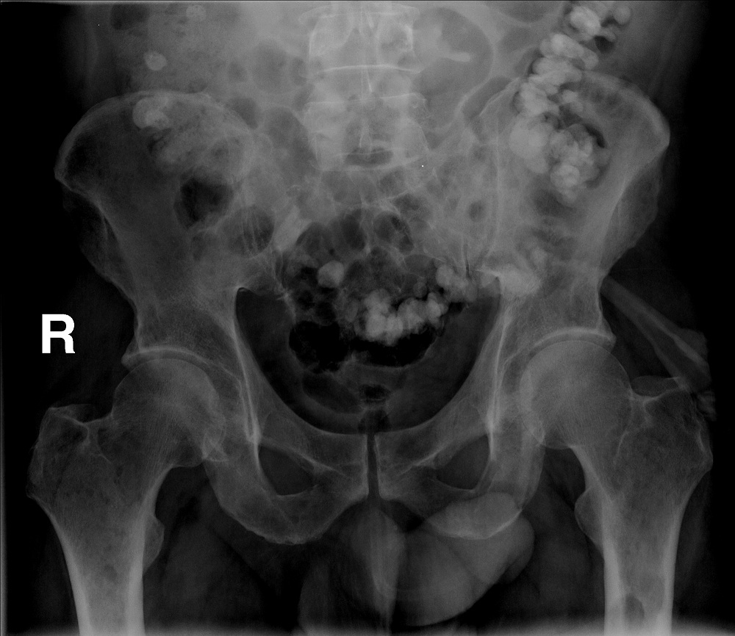
Radiological Presentations
AP radiograph of the pelvis

Slide 4
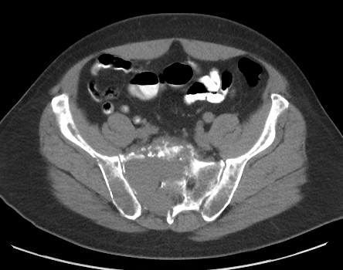
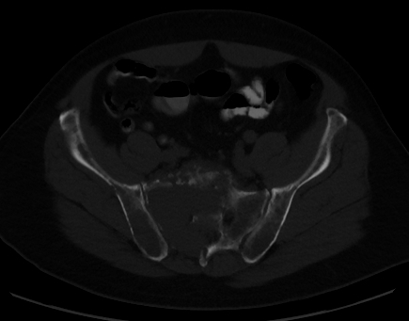
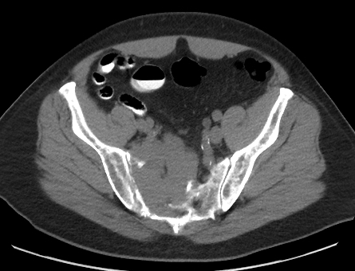
Radiological Presentations
B
A
C
D
A
Axial CT through pelvis and sacrum in bone (A,C) and soft tissue (B,D) windows

Slide 5
Test Your Diagnosis
Which one of the following is your choice for the appropriate diagnosis? After your selection, go to next page.
Plasmacytoma
Multiple Myeloma
Lymphoma
Lytic bone metastases
Chondrosarcoma

Slide 6
Findings
Initial read from outside institution:
AP radiograph of the pelvis demonstrates large lytic lesion of the sacrum without sclerotic margin or identifiable matrix

Slide 7
Findings
Further evaluation also revealed similar lytic lesions within the right femoral neck and left femoral metaphysis

Slide 8
Findings
A
B
Axial CT through pelvis and sacrum in bone (A,C) and soft tissue (B,D) windows demonstrates lytic lesion of the sacrum involving multiple neural foramina without sclerotic margin or identifiable matrix. There is associated soft tissue mass.
C
D
A

Slide 9
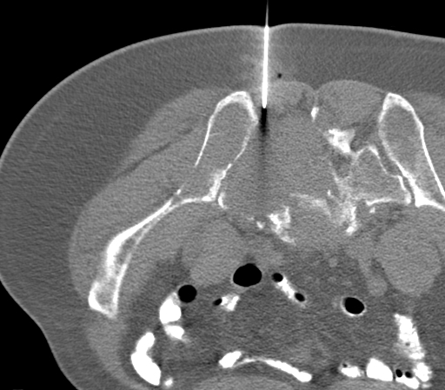
Discussion
Axial images of percutaneous biopsy of sacral mass performed in interventional radiology for purposes of obtaining tissue for diagnosis.

Slide 10
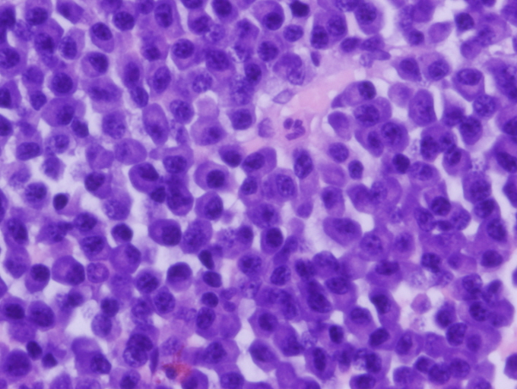
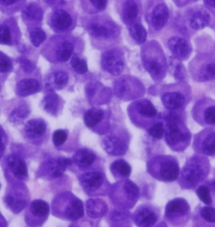
Discussion: Plasmacytoma
Diff quick from FNA of sacral lesion demonstrates sheets of plasma cells with characteristic basophilic cytoplasm and eccentric nuclei.
Further immunophenotyping with flow cytometry demonstrated atypical plasma cells positive for CD38, CD56, and CD138 with kappa light chain restriction.
Thank you to Dr Clement-Kruzel, MD Anderson Department of Pathology for providing histology

Slide 11
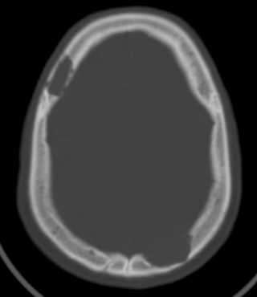
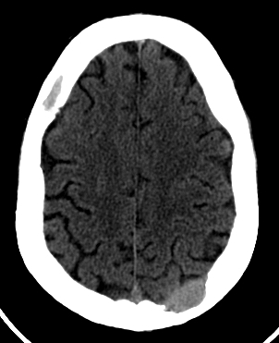
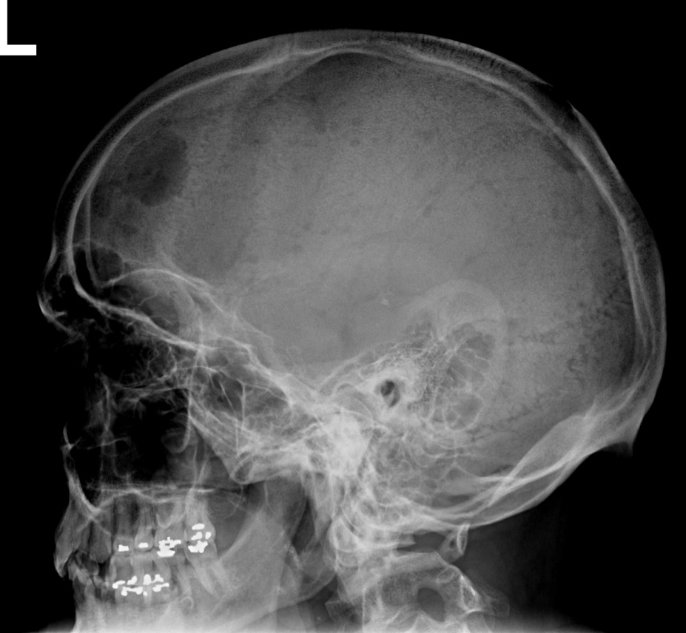
Discussion
Skull radiograph and CT head without contrast performed in the same patient 3 weeks post biopsy
Lateral skull radiograph demonstrates well circumscribed lytic skull lesion with “beveled-edge”
Axial noncontrast CT of the head demonstrates multiple punched out lytic skull lesions

Slide 12
Discussion: Multiple Myeloma
Definition
Monoclonal proliferation of plasma cells within bone marrow resulting in multifocal intramedullary lesions
Location:
Intramedullary
More commonly found in the axial skeleton
When the appendicular skeleton may be involved, proximal lesions are more common than distal lesions
Demographics
M>F
Wide age range: mid 40s-80s
Presentation
Painful skeletal lesion
Pathologic fracture
Kidney failure

Slide 13
Discussion: Multiple Myeloma
Radiographic:
Lytic lesion with bony destruction
No identifiable internal matrix or sclerotic margin
Cortical breakthrough frequently present
Endosteal scalloping is characteristic but may be more apparent on CT
CT
Soft tissue mass more conspicuous than on radiograph
Lytic lesion within intramedullary bone
Endosteal scalloping which is more easily recognized on CT
Cortical breakthrough frequently present
MR Findings:
T1WI: Low signal soft tissue mass within intramedullary bone
T1WI C+: Soft tissue mass demonstrates enhancement
STIR: Increased signal intensity
Whole body MR indicated to define extent of disease

Slide 14
Discussion: Plasmacytoma
Definition
Monoclonal proliferation of plasma cells
Occurs in the absence of multiple myeloma, however, multiple myeloma may develop following plasmacytoma
Intramedullary (solitary bone plasmacytoma) or extramedullary (extramedullary plasmacytoma)
Location:
Solitary bone plasmacytoma:
Most common sites pelvis and spine
Skull, proximal humerus, proximal femur
Extramedullary plasmacytoma:
most commonly in the upper aerodigestive tract with predilection for head and neck (approximately 80%)
upper digestive tract (approximately 17%)
urogenital tract, skin, lung and breast
Extramedullary plasmacytoma with known multiple myeloma
75-85% occur in soft tissues adjacent to axial skeleton
LN and spleen; rarely CNS and lung

Slide 15
Discussion: Plasmacytoma
Demographics
M>F
Solitary bone plasmacytoma: 50-54 yrs
Extramedullary plasmacytoma: 51-70 yrs
Presentation
Solitary bone plasmacytoma: pain, cord compression if present in spine
Extramedullary plasmacytoma: signs/symptoms of bleeding and/or obstruction of upper aerodigestive tract (epistaxis, nasal obstruction, hemoptysis, soar throat)
Extramedullary plasmacytoma with known multiple myeloma: fever, symptoms of infection; elevated LDH, decreased serum paraprotein, pancytopenia

Slide 16
Discussion: Plasmacytoma
Presentation
Solitary bone plasmacytoma: pain, cord compression if present in spine
Extramedullary plasmacytoma: signs/symptoms of bleeding and/or obstruction of upper aerodigestive tract (epistaxis, nasal obstruction, hemoptysis, soar throat)
Extramedullary plasmacytoma with known multiple myeloma: fever, symptoms of infection
Clinical course
Solitary bone plasmacytoma: frequently progress to multiple myeloma within 2-4 years
Extramedullary plasmacytoma: 70% do not progress to multiple myeloma, 1/3 will have local recurrence
Extramedullary plasmacytoma with known multiple myeloma:
10-15% of patients diagnosed with multiple myeloma demonstrate extramedullary plasmacytoma at diagnosis
5-10% of patients with multiple myeloma without extramedullary plasmacytoma at time of diagnosis will develop extramedullary plasmacytoma following treatment
Poor prognosis

Slide 17
Discussion: Plasmacytoma
Radiographic:
Solitary bone plasmacytoma
Lytic
No identifiable matrix
May demonstrate multiseptated/loculated appearance
Cortical break
CT:
Solitary bone plasmacytoma
Lytic lesion with cortical break and no identifiable matrix
Enhancing soft tissue mass
Extramedullary plasmacytoma:
Enhancing soft tissue mass, most often in head/neck
MR Findings: solitary bone plasmacytoma and extramedullary plasmacytoma:
T1WI: Low signal soft tissue mass
T1WI C+: Soft tissue mass demonstrates enhancement
T2: Intermediate signal soft tissue mass
Whole body MR indicated to define extent of disease and to rule out multiple myeloma

Slide 18
Discussion: Lymphoma
Definition:
Primary:
Single bone lesion +/- involvement of regional lymph nodes
Multiple bony lesions without lymph node involvement
Secondary:
Secondary involvement of bone from adjacent soft tissue lymphoma
Multiple regional/visceral lymph nodes positive for lymphoma with initial presentation for bony lesion
Location: long bones, flat bones
Demographics:
wide age distribution with peak incidence 50s-60s
M>F
Clinical Presentation:
most common presenting symptom is bone pain
rarely hypercalcemia or B symptoms (fever, night sweats)
Clinical course/prognosis
Overall excellent prognosis with overall 5 year survival reported up to 90%
Progression free survival at 5 years in approximately 45 % patients

Slide 19
Discussion: Lymphoma
Radiograph:
Permeative lesions, can present with no apparent radiographic abnormality except subtle endosteal thickening
Wide zone of transition
Lytic lesion without identifiable matrix
Cortical destruction may be subtle on radiograph
Lamellated periosteal reaction may be present
CT:
Differentiates primary verses secondary lymphoma of bone
Lytic lesion without identifiable matrix
May demonstrate radiographically occult sequestrum and cortical involvement
MRI:
T1: low signal intensity
T2: high signal intensity
Demonstrates transition between normal and abnormal marrow signal
Better demonstrates soft tissue component which may show heterogenous enhancement secondary to necrosis
Better delineation of primary multifocal osseous lymphoma which is characterized by low T1 signal intensity in serpigenous pattern and heterogenous T2 signal

Slide 20
Discussion: Chrondrosarcoma
Definition:
Malignant tumor of hyaline cartilage
May arise from cartilagenous lesion (osteochondroma, enchondroma) or de novo from normal bone
Location:
most commonly within the pelvis, specifically the iliac wing
Other common sites include the proximal femur, proximal humerus and distal femur
Metaphyseal location is characteristic
Demographics:
Peak incidence 50s-70s
M>F
Clinical Presentation:
most common presenting symptom is bone pain
Clinical course/prognosis
Ranges from 50-90% 5 year survival
Higher grade portends a worse prognosis

Slide 21
Discussion: Chrondrosarcoma
Radiograph and CT:
Primary chondrosarcoma
Medullary lesions within iliac wing, femoral metaphysis or proximal humerus
Lytic lesion, frequently with endosteal scalloping, without sclerotic margin
May cause cortical thinning/scalloping
No periosteal reaction
Rings and arcs are characteristic of chondroid matrix
Secondary chondrosarcoma
Within existing osteochondroma but with adjacent soft tissue mass, osseous destruction and obliteration of fat planes
MRI:
Primary chondrosarcoma
Imaging findings vary with grade of lesion
Endosteal scalloping, chondroid matrix and soft tissue mass are characteristic, found in >75% of lesions
T1WI: soft tissue mass is isointense to skeletal muscle; cartilagenous matrix demonstrates low T1 signal
T2WI: increased T2 signal within regions of chondroid matrix that demonstrate characteristic lobulations
FST1WI +C: Enhancement surrounding low intensity chondroid matrix
Secondary chondrosarcoma:
Cartilagenous matrix demonstrates decreased T1 and T2 signal
Prominent soft tissue mass with osseous destruction

Slide 22
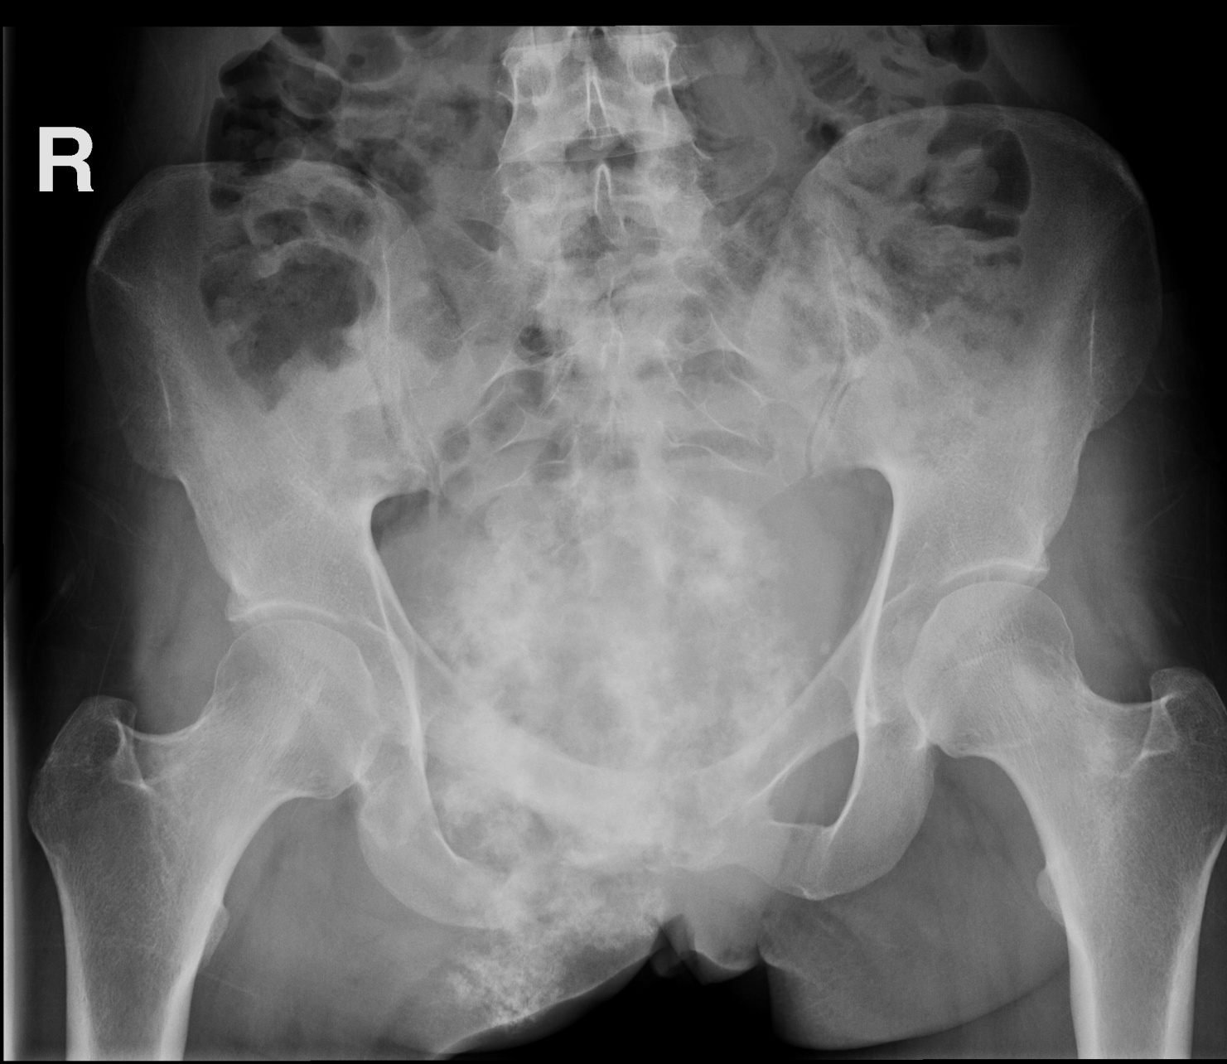
Discussion: Chondrosarcoma
AP radiograph of 23yoF with pelvic pain demonstrating 15cm lytic lesion of right inferior pubic ramus with bony destruction and “ring and arc” pattern of chondroid matrix
Notes:
lymphoma

Slide 23
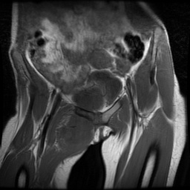
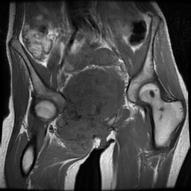
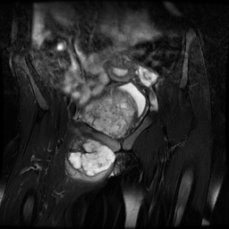
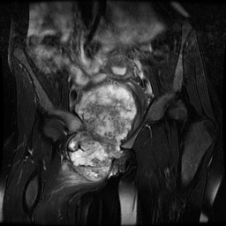
Discussion: Chondrosarcoma
MRI from the same patient
(A,B) T1W1 demonstrate low signal 15cm soft tissue mass arising from the right inferior pubic ramus, extending into the pelvis and crossing midline with bone destruction
A
A
B
(C,D) T2W1 demonstrate increased T2 signal with characteristic lobulated appearance of chondroid matrix arising from the right inferior pubic ramus
C
D
Notes:
lymphoma

Slide 24
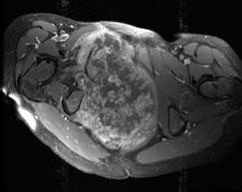
Discussion: Chondrosarcoma
Axial T1 fat-saturated post contrast images demonstrate contrast enhancement surrounding low signal intensity chondroid matrix within 15cm soft tissue mass arising from the right inferior pubic ramus
MRI from the same patient
Notes:
lymphoma

Slide 25
Discussion: Lytic Bone Metastases
Most frequently:
Breast
Lung
Renal cell carcinoma
Thyroid
Prostate metastases can be lytic, however the majority are sclerotic
Location overlaps with myeloma lesions including axial skeleton, proximal femur, proximal humerus and skull
Differentiation between lytic bone metastases and plasmacytoma/myeloma is made by histology

Slide 26
Plasmacytoma with Concurrent Multiple Myeloma
Diagnosis

Slide 27
References
Hanrahan CJ, Christensen CR, Crim JR. Current concepts in the evaluation of multiple myeloma with MR imaging and FDG PET/CT. Radiographics. 2010 Jan; 30(1): 127-42.
Krishnan A, Shirkhoda A, Tehranzadeh J, Armin AR, Irwin R, Les K. Primary bone lymphoma radiographic-MR imaging correlation. Radiographics. 2003 Nov-Dec; 23(6): 137-83; discussion 1384-7.
Llauger J, Palmer J, Amores S, Bague S, Camins A. Primary tumors of the sacrum: diagnostic imaging. AJR. 2000 Feb; 174 (2):417-24.
Moulopoulos LA, Granfield CA, Dimopoulos MA, Kim EE, Alexanian R, Libshitz HI, Extraosseous multiple myeloma imaging features. AJR. 1993 Nov; 161 (5): 1083-7.
Murphey MD, Flemming DJ, Boyea SR, Bojescul JA, Sweet DE, Temple HT. Enchondroma verses chondrosarcoma in the appendicular skeleton, differentiating features. Radiographics. 1998; Sept-Oct; 18 (5): 1213-37; quiz 1244-5.
Murphey MD, Walker EA, Wilson AJ, Kransdorf MJ, Temple HT, Gannon FH. From the archives of AFIPL imaging of primary chondrosarcoma: radiographic pathologic correlation. Radiographics 2003 Sept-Oct (5):1245-78.
Notes:
Hanrahan CJ, Christensen CR, Crim JR. Current concepts in the evaluation of multiple myeloma with MR imaging and FDG PET/CT. Radiographics. 2010 Jan; 30(1): 127-42.
Krishnan A, Shirkhoda A, Tehranzadeh J, Armin AR, Irwin R, Les K. Primary bone lymphoma radiographic-MR imaging correlation. Radiographics. 2003 Nov-Dec; 23(6): 137-83; discussion 1384-7.
Llauger J, Palmer J, Amores S, Bague S, Camins A. Primary tumors of the sacrum: diagnostic imaging. AJR. 2000 Feb; 174 (2):417-24.
Moulopoulos LA, Granfield CA, Dimopoulos MA, Kim EE, Alexanian R, Libshitz HI, Extraosseous multiple myeloma imaging features. AJR. 1993 Nov; 161 (5): 1083-7.
Murphey MD, Flemming DJ, Boyea SR, Bojescul JA, Sweet DE, Temple HT. Enchondroma verses chondrosarcoma in the appendicular skeleton, differentiating features. Radiographics. 1998; Sept-Oct; 18 (5): 1213-37; quiz 1244-5.

Slide 28
References
Ooi GC, Chim JC, Au WY, Khong PL. Radiographic manifestations of primary solitary extramedullary and solitary plasmacytomas. AJR 2006 Mar; 186(3): 821-7.
Paes FM, Kalkanis DG, Sideras PA, Serafini AN, FDG PET/CT of extranodal involvement in non-Hodgkin disease. Radiographics. 2010 Jan; 30(1):269-91.
Rosen EL, Eubank WB, Mankoff DA. FDG, PET, PET/CT and breast cancer imaging. Radiographics. 2007 Oct; 27 Suppl 1:S215-29.
Schlatchter TR, Wu Q, Matlyuk-Urman Z. AFIP best cases in radiologic pathologic correlation: synovial chondrosarcoma. Radiographics. 2011 Nov-Dec; 31(7):1883-8.
Statdx.com
Varma DG, Ayala AG, Carrasco CH, Guo SQ, Kumar R, Edeiken J. Chondrosarcmoa: MR imaging with pathologic correlation. Radiographics. 1992 Jul; 12(4):687-704.
Notes:
Hanrahan CJ, Christensen CR, Crim JR. Current concepts in the evaluation of multiple myeloma with MR imaging and FDG PET/CT. Radiographics. 2010 Jan; 30(1): 127-42.
Krishnan A, Shirkhoda A, Tehranzadeh J, Armin AR, Irwin R, Les K. Primary bone lymphoma radiographic-MR imaging correlation. Radiographics. 2003 Nov-Dec; 23(6): 137-83; discussion 1384-7.
Llauger J, Palmer J, Amores S, Bague S, Camins A. Primary tumors of the sacrum: diagnostic imaging. AJR. 2000 Feb; 174 (2):417-24.
Moulopoulos LA, Granfield CA, Dimopoulos MA, Kim EE, Alexanian R, Libshitz HI, Extraosseous multiple myeloma imaging features. AJR. 1993 Nov; 161 (5): 1083-7.
Murphey MD, Flemming DJ, Boyea SR, Bojescul JA, Sweet DE, Temple HT. Enchondroma verses chondrosarcoma in the appendicular skeleton, differentiating features. Radiographics. 1998; Sept-Oct; 18 (5): 1213-37; quiz 1244-5.

