Slide 1
Radiological Category:
Neuro
Principal Modality (1):
Principal Modality (2):
CT
None
Case Report # 0895
Submitted by:
Paul Hannon, M.D.
Faculty reviewer:
Scott Serlin, M.D.
Date accepted:
15 March 2012

Slide 2
Case History
30 yo female with history of mental retardation and new onset right sided weakness and difficulty speaking

Slide 3
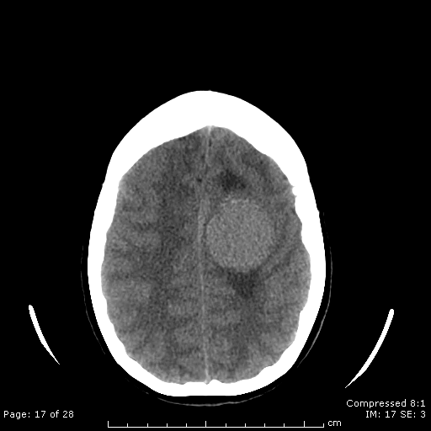
Radiological Presentations

Slide 4
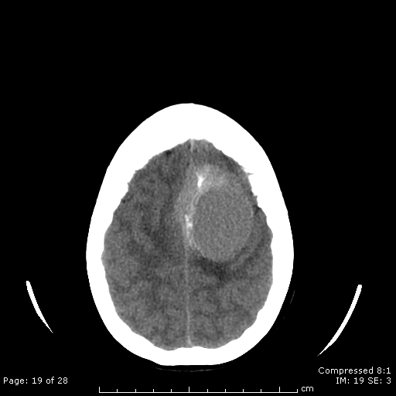
Radiological Presentations

Slide 5
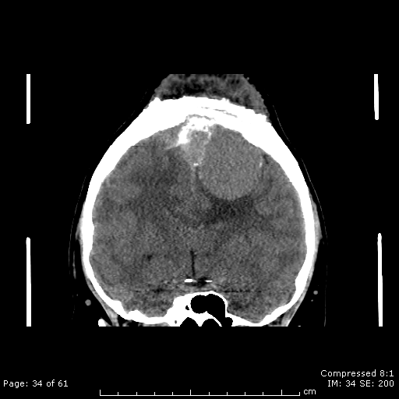
Radiological Presentations

Slide 6
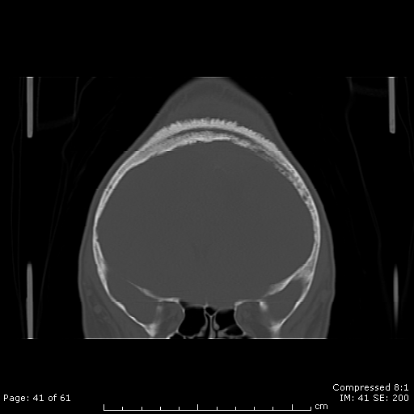
Radiological Presentations

Slide 7
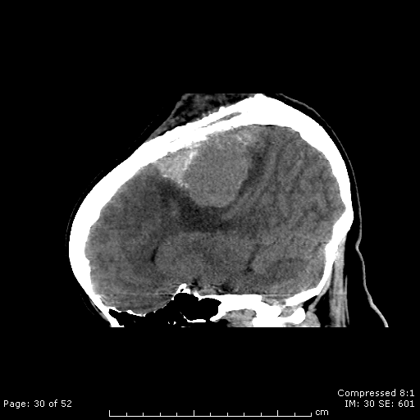
Radiological Presentations

Slide 8
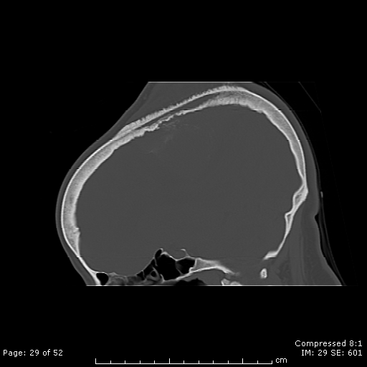
Radiological Presentations

Slide 9
Test Your Diagnosis
Which one of the following is your choice for the appropriate diagnosis? After your selection, go to next page.
Lymphoma
GBM
Lowgrade astrocytoma
Metastatic disease
Intraosseous meningioma
Fibrous dysplasia
Chronic Osteomyelitis

Slide 10
3.9 x 4.7 x 3.6 cm extra axial mass to the left of and involving the falx with mass effect upon the adjacent cortex. Calcifications seen within the mass. There is involvement of the left frontal bone with periosteal reaction and extension into the subcutaneous soft tissues and a portion of the sagital sinus.
Findings and Differentials
Findings:
Differentials:
Intraosseous meningioma
Metastatic disease
Fibrous dysplasia
Chronic osteomyelitis

Slide 11
Discussion
Meningioma
Slightly more common in females and in later decades of life.
Generally slow growing with compression of adjacent structures.
Can invade/involve and occlude the sagital sinus.
Intraosseous subtype is rare. (1-2% of meningiomas)
Associated with hyperostosis and/or osteolysis, as in this case.
Three subtypes of extradural meningiomas:
extracalvarial (type I),
purely calvarial (type II),
calvarial with extracalvarial extension (type III).

Slide 12
Discussion
Skull Metastasis
Generally older adults, >50 years of age, except in the case of metastatic pediatric malignancies such as neuroblastoma.
Our patient fell in between the common age range for most metastatic bone lesions.
Most patients have a known primary at the time of presentation.
Often signifies late stage disease.
Fibrous Dysplasia
Typically adolescents and young adults (75% before age 30).
Developmental anomaly in which the medullary space of bone is replaced by fibrous tissue.
Craniofacial bones affected 20% of the time in monostotic fibrous dysplasia.
Primarily bone involvement without significant soft tissue mass, thus making the diagnosis lees likely in our case.

Slide 13
Discussion
Chronic Osteomyelitis
Can cause sclerotic bone with thickened cortex. Can also have periosteal new bone formation and soft tissue swelling and abscess.
Brodie abscess: intraosseous abscess.
Clinical symptoms are very helpful in diagnosis.
Primary CNS malignancy
Expect an intraparenchymal mass.
Far less likely in this case given the extraxial appearance with extrinsic compression of the adjacent cortex.

Slide 14
Intraosseous Meningioma with intracranial and subcutaneous extension
Diagnosis

Slide 15
Crawford TS et al, Primary Intraosseous Meningioma Case Report, J of Neurosurgery, Nov. 1995, Vol. 83, No. 5: 912-915. Kransdorf MJ et al, Fibrous Dysplasia, Radiographics, May 1990, 10: 519-537. Stark AM et al, Skull metastases: clinical features, differential diagnosis, and review of the literature, Surgical Neurology, Sept 2003, Vol. 60, Issue 3: 219-225. Tokgoz N et al, Primary Intraosseous Meningioma: CT and MRI Appearance, AJNR, 2005, 26: 2053-2056. www.statdx.com, meningioma
References

