Slide 1
Radiological Category:
Mammography
Principal Modality (1):
Principal Modality (2):
Mammography
None
Case Report # 0896
Submitted by:
Paul J. Hannon, MD
Faculty reviewer:
Laverne Ingram, MD
Date accepted:
15 March 2012

Slide 2
Case History
Female presenting for routine mammogram

Slide 3
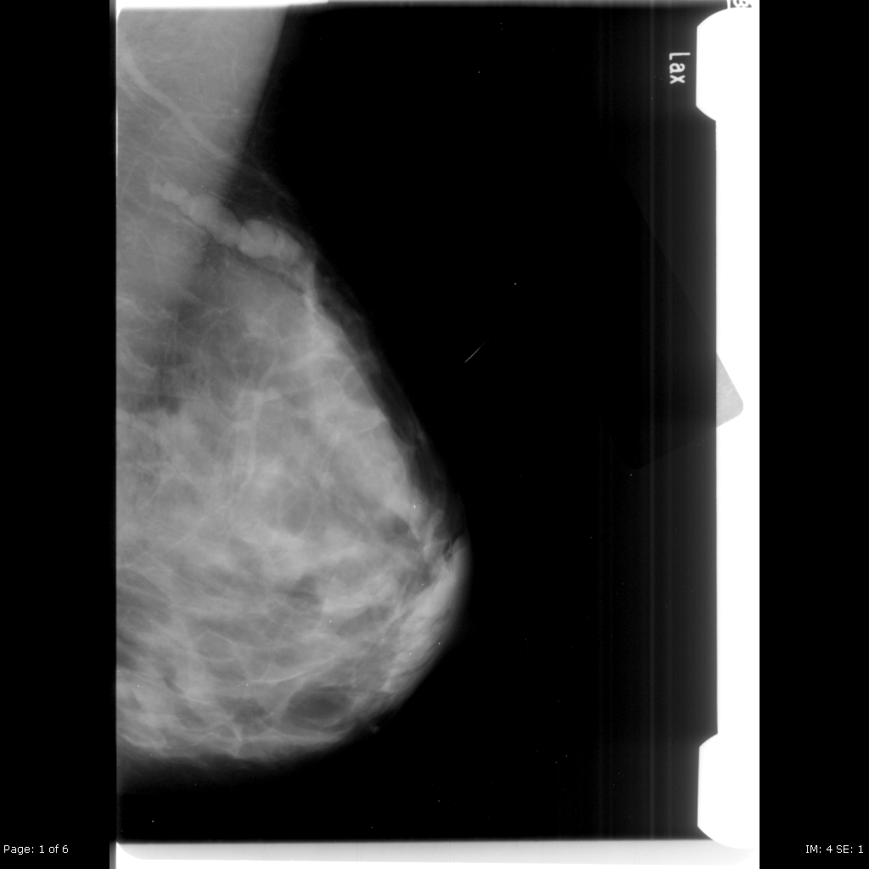
Radiological Presentations

Slide 4
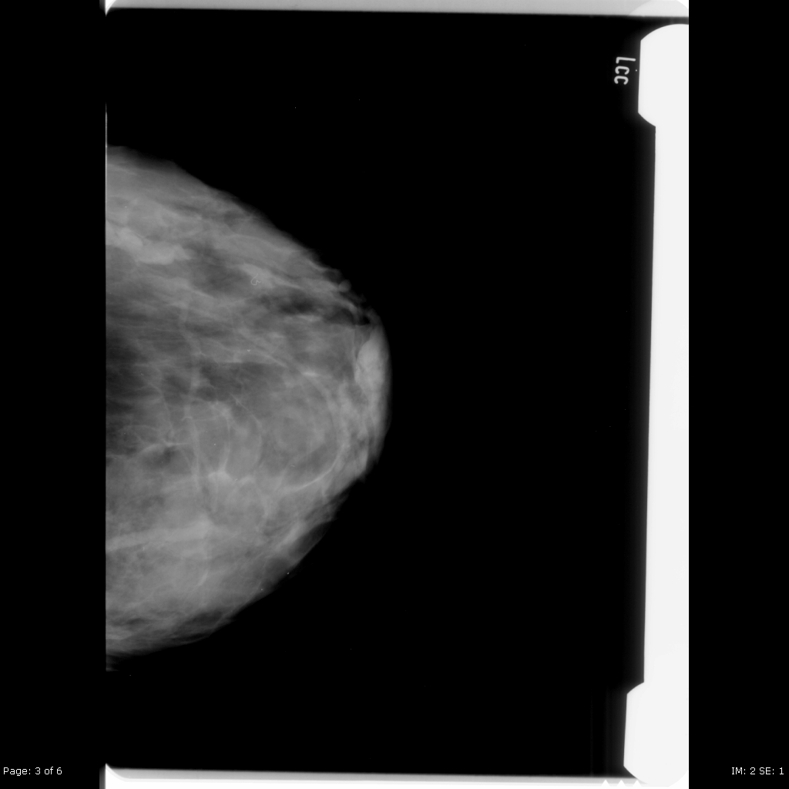
Radiological Presentations

Slide 5
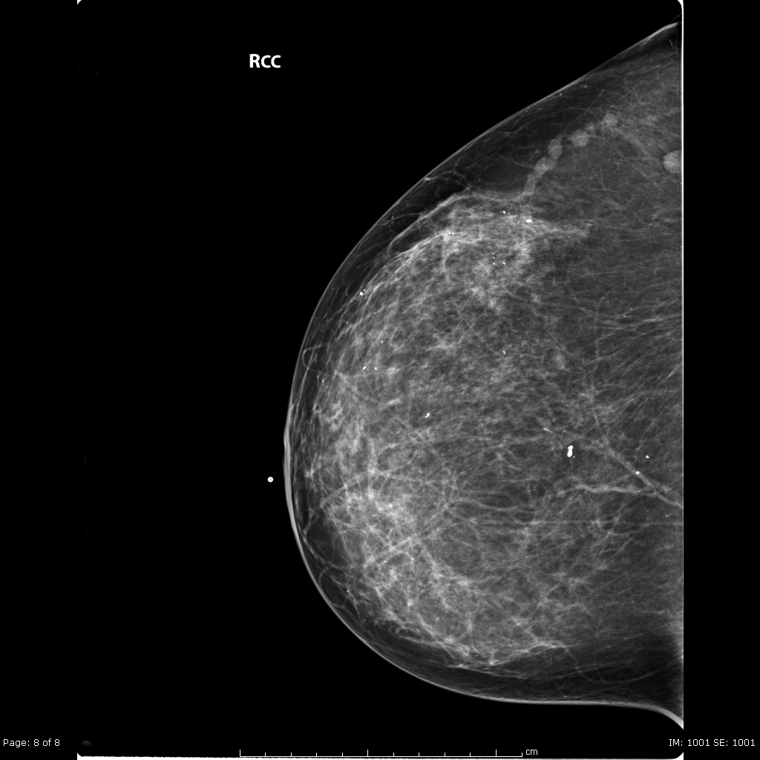
Radiological Presentations
Companion Case

Slide 6
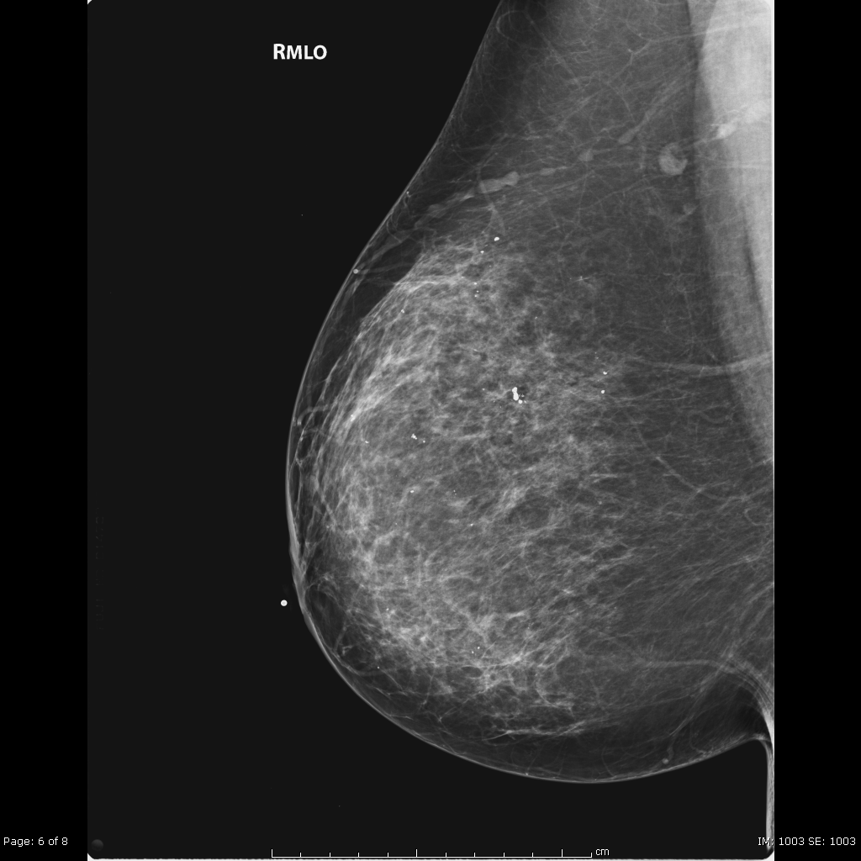
Radiological Presentations
Companion Case

Slide 7
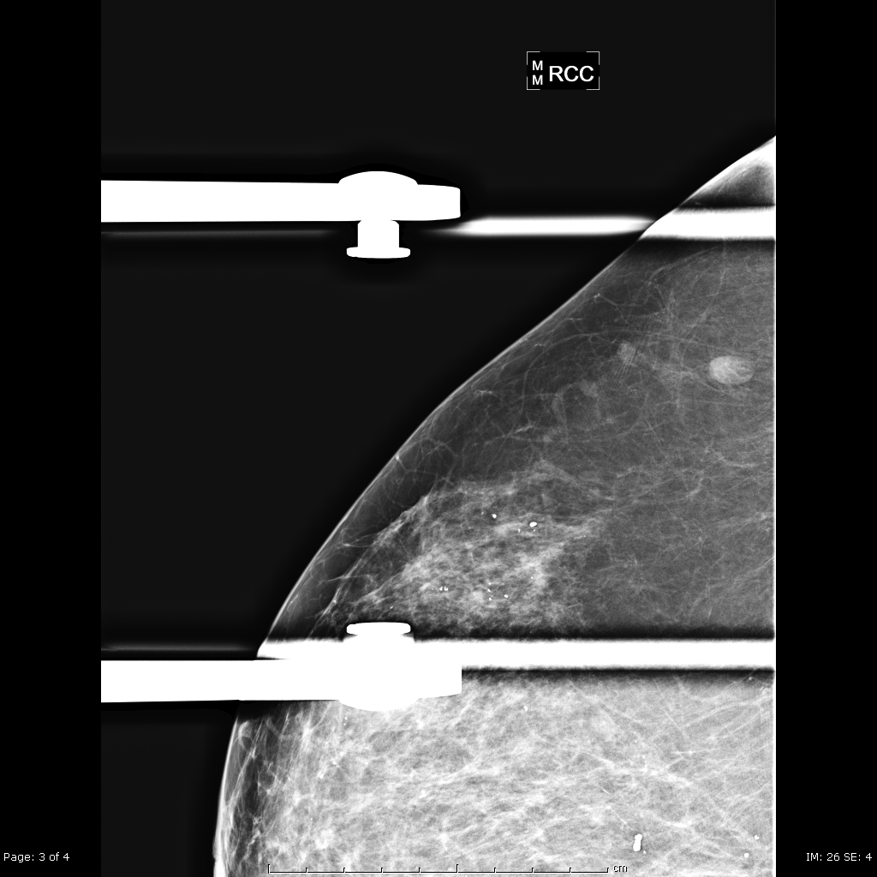
Radiological Presentations
Companion Case

Slide 8
Test Your Diagnosis
Which one of the following is your choice for the appropriate diagnosis? After your selection, go to next page.
Mondor’s Disease
Varicose vein
Dilated duct
Mastitis/Abscess

Slide 9
Well circumscribed tubular and beaded lesion in the upper/outer breast. No calcifications present. Lesion compresses out in compression view on the second case.
Findings and Differentials
Findings:
Differentials:
Mondor’s disease
Varicose vein
Dilated duct

Slide 10
Discussion
Mondor’s Disease
Also called superficial thrombophlebitis or Mondor phlebitis
Clinical diagnosis that usually presents with a palpable cord +/- pain. May be associated with skin retraction or dimpling.
Usually females, 20-40 years old.
Upper/outer or inferior breast and chest wall most commonly involved.
Benign and self limiting.
Chronic thrombosis can cause calcifications.

Slide 11
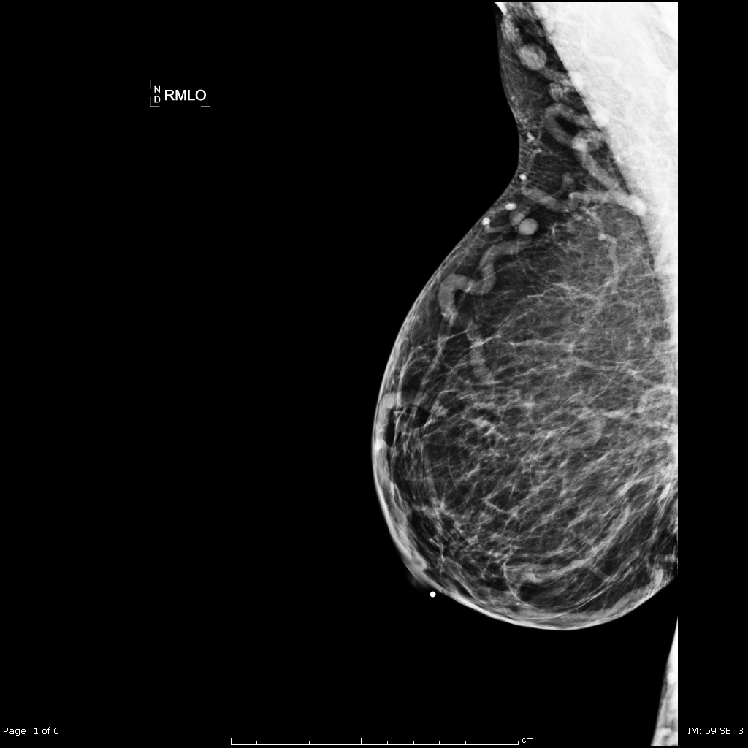
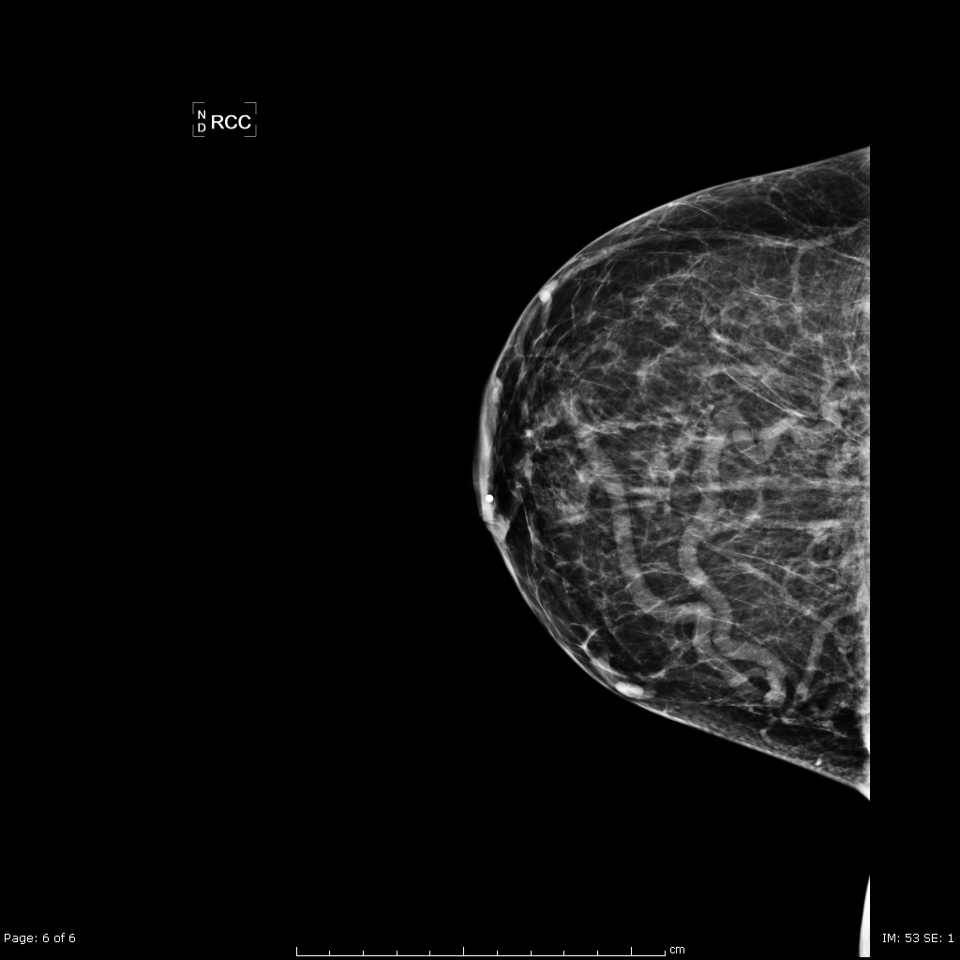
Discussion
Varicose Vein
Can present very similarly on mammogram.
Must have clinical history to help differentiate between the diagnoses.
Ultrasound can also be helpful in the diagnosis.

Slide 12
Discussion
Dilated Duct
Usually retroareolar tubular/branching radiopaque structure.
May have nipple discharge on clinical exam.
Usually no clinical concern if bilateral and asymptomatic.
Single dilated duct may require further work up, including ultrasound to exclude obstructing mass.
Mastitis/Abscess
Clinical history and exam is pertinent.
Usually presents as pain and erythema in the affected breast with fever.

Slide 13
Mondor’s Disease
Diagnosis

Slide 14
1. Ammari FF et al: Periductal mastitis. Clinical characteristics and outcome. Saudi Med J. 23(7): 819-22, 2002. 2. Huynh PT et al: Dilated duct pattern at mammography. Radiology. 204(1): 137-41, 1997. 3. Markopoulos C et al: Mondor’s disease of the breast: is there any relation to breast cancer? Eur J Gynaecol Oncol. 26(2): 213-4, 2005. 4. Shetty MK et al: Mondor’s disease of the breast: sonographic and mammographic findings. AJR Am J Roentgenol. 177(4):893-6, 2001.
References

