Slide 1
Radiological Category:
Neuro/MSK
Principal Modality (1):
Principal Modality (2):
CT
MRI
Case Report 0991
Submitted by:
Cantrell, Sarah, M.D.
Faculty reviewer:
Serlin, Scott, M.D
Date accepted:
February 14, 2014

Slide 2
Case History
59-year old man presenting with vague right-sided neck and jaw discomfort.

Slide 3
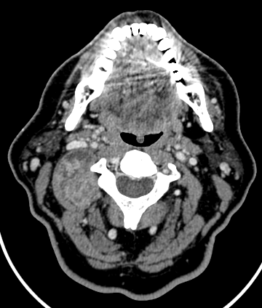
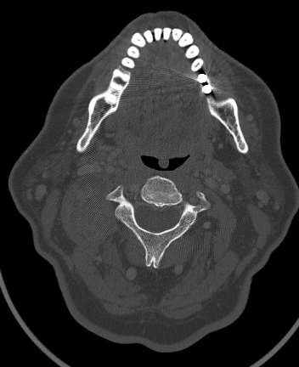
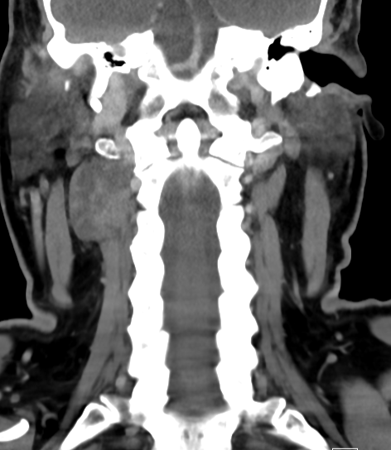
Radiological Presentations
Axial CECT of the neck, soft tissue window
Axial CECT of the neck, bone window
Coronal CECT of the cervical spine,
soft tissue window
Notes:
Contrast-enhanced CT demonstrates a heterogeneously enhancing lobulated 3.5cm right-sided paraspinal mass extending from the C1 to C3 levels without internal hemorrhage or calcification. The mass abuts the adjacent C1-2 and C2-3 neural foramina, without apparent intraforaminal extension or osseous destruction.

Slide 4
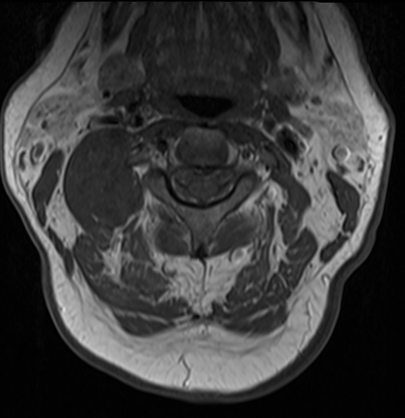
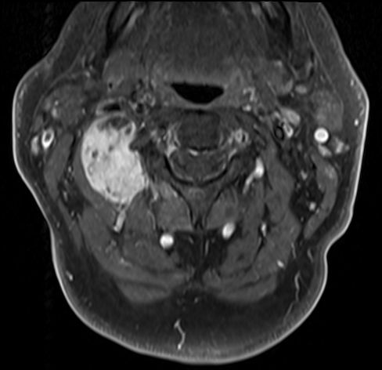
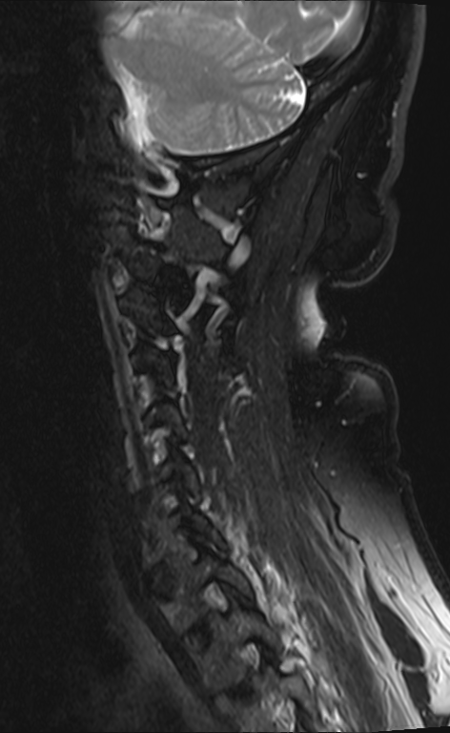
Radiological Presentations
Axial T1 noncontrast MRI of the neck
Axial T1 +C MRI of the neck
Sagittal MRI of the cervical spine
Notes:
Contrast-enhanced CT demonstrates a heterogeneously enhancing lobulated 3.5cm right-sided paraspinal mass extending from the C1 to C3 levels without internal hemorrhage or calcification. The mass abuts the adjacent C1-2 and C2-3 neural foramina, without apparent intraforaminal extension or osseous destruction.

Slide 5
Test Your Diagnosis
Which one of the following is your choice for the appropriate diagnosis? After your selection, go to next page.
Neurofibroma
Synovial Sarcoma
Meningioma
Metastases

Slide 6
Radiological Findings
Axial CECT of the neck, soft tissue window
Axial CECT of the neck, bone window
Coronal CECT of the cervical spine,
soft tissue window
Contrast-enhanced CT demonstrates a heterogeneously enhancing lobulated 3.5cm right-sided paraspinal mass extending from the C1 to C3 levels without internal hemorrhage or calcification.
The mass abuts the adjacent C1-2 and C2-3 neural foramina, without apparent intraforaminal extension or osseous destruction.
Notes:
Contrast-enhanced CT demonstrates a heterogeneously enhancing lobulated 3.5cm right-sided paraspinal mass extending from the C1 to C3 levels without internal hemorrhage or calcification. The mass abuts the adjacent C1-2 and C2-3 neural foramina, without apparent intraforaminal extension or osseous destruction.

Slide 7
Radiological Findings
Axial T1 noncontrast MRI of the neck
Axial T1 +C MRI of the neck
Pre and postcontrast axial T1 MRI of the neck demonstrate heterogeneous enhancement of the lobulated paraspinal mass seen on prior CT examination ( ).
Sagittal T2 MRI images at the level of the C2-C3 foramina demonstrate no obvious extension into the spinal canal ( ).
Sagittal MRI of the cervical spine
Notes:
Contrast-enhanced CT demonstrates a heterogeneously enhancing lobulated 3.5cm right-sided paraspinal mass extending from the C1 to C3 levels without internal hemorrhage or calcification. The mass abuts the adjacent C1-2 and C2-3 neural foramina, without apparent intraforaminal extension or osseous destruction.

Slide 8
Discussion: Neurofibroma
Definition: Histologically, these lesions contain variable amounts of fibroblasts, Schwann cells, myxoid material and peripheral nerve fibers.
Three patterns:
Solitary and sporadic (90%)
Typically <5mm without potential for malignant transformation.
Cured by surgical resection with low recurrence rate
Diffuse
Occurs in children and young adults with involvement of the subcutaneous tissues of the head and neck.
Plexiform
Pathopneumonic for NF1
Multiple bilateral multilevel paraspinal nerve involvement with potential for malignant transformation to peripheral nerve sheath tumor
High recurrence rate following resection and difficult to manage

Slide 9
Discussion: Neurofibroma
The lesion is centered on the peripheral nerve with variable involvement of the nerve root and end organs innervated by the involved nerve.
Generally, lesions are nonaggressive appearing with widening of spinal neural foramina (as opposed to osseous destruction).
Best imaging modality is MR spine with and without contrast
T1: isointense to muscle and spine
T2: “target” sign with hyperintense peripheral rim and hypointense center
T1+C: variable enhancement

Slide 10
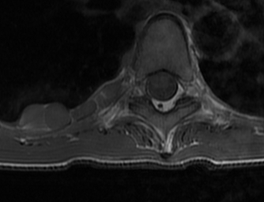
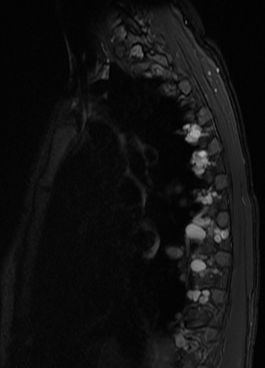
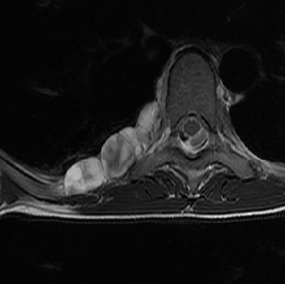
Discussion: Plexiform Neurofibroma
Axial T1 image demonstrates lobulated right paraspinal mass
Neurofibroma
Corresponding axial T2 image demonstrates peripherally hyperintense, centrally heterogeneous right paraspinal mass
Sagittal T2 postcontrast images demonstrate plexiform neurofibroma extending through multiple foramina at T4-T8

Slide 11
Discussion: Synovial Sarcoma of the Head and Neck
Definition: malignant soft tissue neoplasm with variable amounts of epithelial and mesenchymal components.
Rare entity but represents 10% or sarcomas
Younger age group, usually <30
Treatment is surgical resection and XRT, however, prognosis is generally poor.

Slide 12
Discussion: Synovial Sarcoma of the Head and Neck
Imaging appearance:
Most typically present as variably sized 2-8cm lobular non-nodal, nonmucosal soft tissue mass near the cricothyroid or cricoarytenoid joint, TMJ or deep spaces of the neck as in our patient. Appearance is typically aggressive with osseous invasion/destruction.
CECT:
mild heterogeneous enhancement with internal cystic components secondary to necrosis
calcification in up to 1/3 of cases
aggressive behavior with osseous invasion
MRI +C
T1: iso to slightly hyperintense to muscle
T2: hyperintense to muscle
T1+C: heterogeneous enhancement with cystic components

Slide 13
Discussion: Metastases
Metastases will have a varied appearance with variable enhancement characteristics, however, usually demonstrate aggressive and invasive behavior.

Slide 14
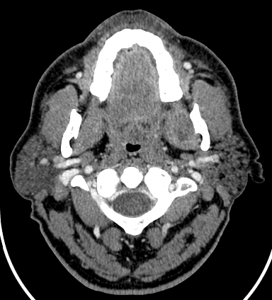
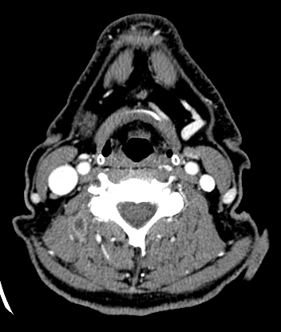
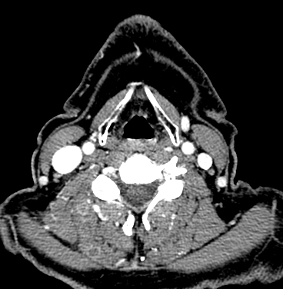
Discussion: Metastatic Renal Cell Carcinoma
Metastatic renal cell carcinoma demonstrating typical invasive nature of metastatic paraspinal neck mass with multiple intramuscular metastases noted within the medial pterygoid ( ), obliquus capitus ( ), and splenius capitus ( )

Slide 15
Discussion Meningioma
Definition: benign neoplasm originating from the dura
Location:
Meninges of the brain and spine (most common)
Rarely may be intraosseous or within the extracranial/extraspinal soft tissues
Treatment:
Most often meningiomas are WHO grade I, requiring no treatment/resection unless they exert mass effect on surrounding structures.
Rarely, atypical and anaplastic (WHO grade III) meningiomas may demonstrate aggressive behavior with multicentricity. These must be resected and most centers will treat with additional chemoradiation.

Slide 16
Discussion Meningioma
Imaging
NECT
Most often of similar attenuation to spinal cord, may be occult on NECT
Calcification in 1-5%
May see hyperostosis
No bony remodeling (e.g., foraminal enlargement)
CECT: Strong, usually homogeneous enhancement
MR Findings
T1WI: Isointense to spinal cord
T2WI
Majority isointense to cord
Hypointense if calcified
Cystic degeneration in 2-4%, hyperintense on T2WI
Very vascular meningioma may have prominent "flow voids"
T1WI C+
Prominent, diffuse enhancement
Dural tails

Slide 17
Diagnosis
Extraspinal meningioma
Extraspinal meningioma is a rare entity that may be confused with other paraspinal soft tissue masses, such as sarcoma, neurofibroma or metastases in the appropriate clinical setting.
It has been postulated that these lesions may arise from meningocytes or dural fibroblasts that accompany exiting nerve roots or from developmental cell rests.
Although our patient's lesion demonstrated no obvious extension into the adjacent neural foramina by imaging, Ibrahim et al reported attachment to the nerve root sleeve on microscopic examination following resection of extrapinal extradural meningioma . One reported case by Christopherson, et al demonstrated purely extraspinal meningioma without attachment to the dura or nerve root sleeve on microscopy .
Additional paraspinal sites mimicking neck mass include parapharyngeal location reported by Taori et al and Possanzini et al .
Correct diagnosis and tissue sampling is essential for treatment planning.

Slide 18
Why not neurofibroma? There was no obvious involvement of the neural foramina, which is key to diagnosis of neurofibroma. No target enhancement was present. Although not necessary for the diagnosis of neurofibroma, this finding is helpful when present. Why not synovial sarcoma? No aggressive behavior such as bony destruction or invasion of surrounding structures was present. Additionally, synovial sarcomas tend to occur in a younger age group. Why no metastases? No aggressive behavior such as bone destruction or invasion of adjacent structures was present. Although no primary malignancy was known, it is not unusual for patients with a clinically occult primary lesion to present with metastatic disease due to pain. In the absence of pathology confirming the etiology, search for primary malignancy, most commonly metastatic squamous cell carcinoma or adenocarcinoma should be undertaken.
Diagnosis

Slide 19
Christopherson LA, Finelli DA, Wyatt-Ashmead J et al. Ectopic extraspinal meningioma: CT and MR appearance. AJNR Am J Neuroradiol 1997; Aug;18(7):1335-7. Ibrahim AW, Satti MB, Ibrahim EM. Extraspinal meningioma: case report. J Neurosurg 1986;64:328–330. Murphey MD et al: From the archives of the AFIP. Imaging of musculoskeletal neurogenic tumors: radiologic-pathologic correlation. Radiographics. 19(5):1253-80, 1999 Nishiguchi T et al: A case of synovial sarcoma in the perivertebral space of the neck: clinical presentation, radiological findings and histopathological description. Br J Radiol. 81(963):e72-4, 2008 Possazini P, Pipolo C, Romagnoli S , et al. Primary extra-cranial meningioma of head and neck: clinical, histopathological and immunohistochemical study of three cases. Acta Otorhinolaryngol Ital 2012; Oct;32(5):336-8 O'Sullivan PJ et al: Radiological features of synovial cell sarcoma. Br J Radiol. 81(964):346-56, 2008 Sehgal VN et al: Solitary plexiform neurofibroma(s): role of magnetic resonance imaging. Skinmed. 6(2):99-100, 2007 Taori K, Kundaragi NG, Disawal A, et al. Imaging features of extra cranial parapharyngeal space meningioma: case report. Iran J Radio, 2011; Nov;8(3):176-81.
References

