Slide 1
Radiological Category:
Neuro
Principal Modality (1):
Principal Modality (2):
MRI
CT
Case Report 0992
Submitted by:
Cantrell, Sarah, M.D.
Faculty reviewer:
Serlin, Scott, M.D
Date accepted: February 20, 2014

Slide 2
Case History
52 year old female with history of nasopharyngeal carcinoma treated with chemotherapy and radiotherapy 13 years prior with bouts of severe sinusitis since completion of treatment and headache.

Slide 3
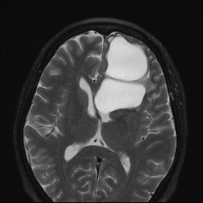
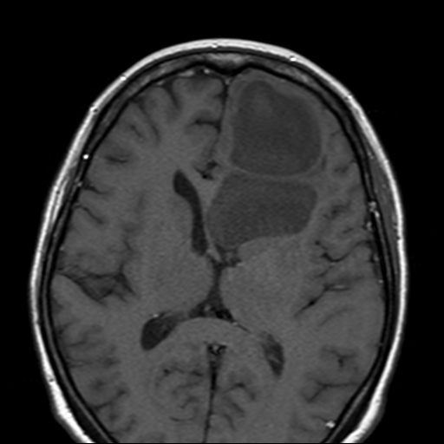
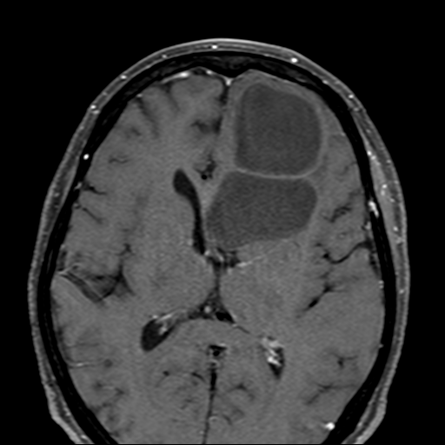
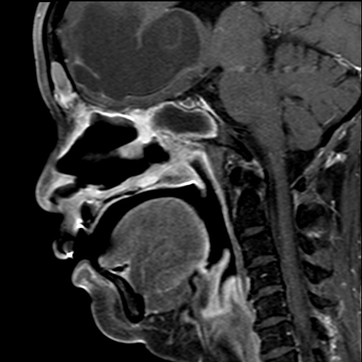
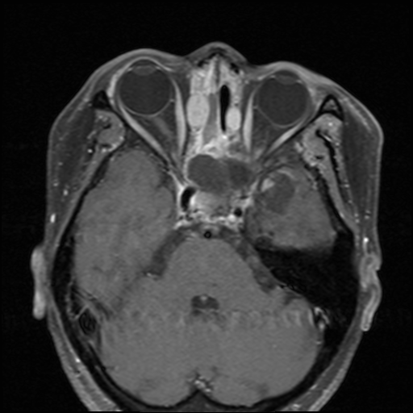
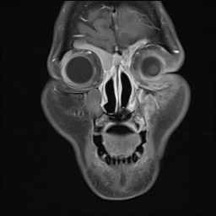
Radiological Presentations
Axial T2 precontrast
Axial T1 precontrast
Axial T1 postcontrast
Sagittal T1+ C Dixon
Coronal T1+C Dixon
Axial T1+C Dixon

Slide 4
Test Your Diagnosis
Which one of the following is your choice for the appropriate diagnosis? After your selection, go to next page.
Arachnoid Cyst
Epidermoid
Mucocele
Recurrent Nasopharyngeal Carcinoma

Slide 5
Radiological Findings
Axial T2 precontrast
Axial T1 precontrast
Axial T1 postcontrast
Axial T2 MRI image demonstrates large T2 hyperintense cystic lesion which exerts mass effect on the frontal horn of the left lateral ventricle resulting in rightward midline shift.
Axial pre and postcontrast T1 images demonstrate hypointense signal within the intracranial cyst without enhancing internal solid components.

Slide 6
Radiological Findings
Sagittal T1+ C Dixon
Coronal T1+C Dixon
Axial T1+C Dixon
Sagittal, coronal and axial postcontrast images demonstrate hyperintense secretions within the frontal and ethmoid sinuses. These were also hyperintense on T1 precontrast images suggestive of proteinaceous secretions ( ).
There is expansion of the sphenoid sinus with hypointense secretions suggestive of mucocele formation ( )

Slide 7
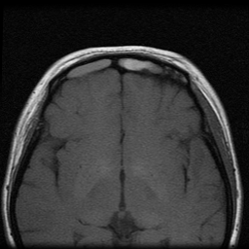
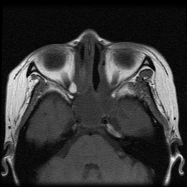
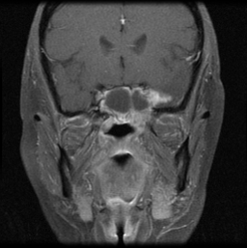
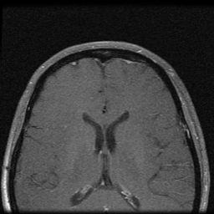
Radiological Findings
MRI following obtained 6 years following treatment of nasopharyngeal carcinoma reveals that no intracranial cystic lesion was present 6 years post-treatment.
Prior examination was remarkable only for post treatment change and high secretions within the frontal sinus with minimal expansion and mucocele formation within the sphenoid sinus.
Thus, the lesion developed in the interval of 6 years post-treatment and now.
Axial T1 precontrast
Axial T1 precontrast
Coronal T1 precontrast
Axial T1 postcontrast

Slide 8
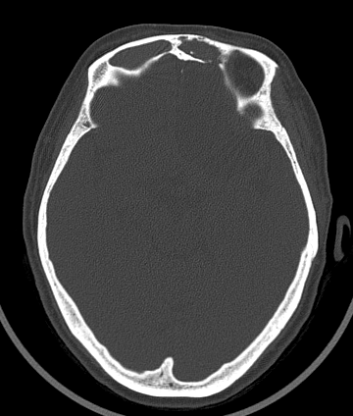
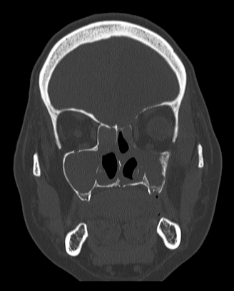
Radiological Findings
Axial CT in bone windows demonstrates dehiscence of the posterior frontal sinus wall, a potential site of communication with the intracranial cyst ( ).
Coronal CT in bone windows demonstrates dehiscences of the left ethmoid roof including the lateral lamella and fovea ethmoidalis ( ).
Notes:
High-resolution imaging through the sinonasal region is best appreciated on series 102 (soft tissue window) and series 301 (bone window). The imaging demonstrates multiple dehiscence along the sinus walls. For example, there is a dehiscence along the posterior wall of the left frontal sinus as seen on series 301, image 359 and on the corresponding soft tissue images, series 102, image 383. This may be a potential site of commination of the sinus cavity with the intracranial cyst. This is also seen on series 104, image 89; on the sagittal view.

Slide 9
Discussion: Arachnoid Cyst
Definition: Benign developmental CSF containing extraaxial cyst without communication with the ventricular system.
Location: most commonly within the middle cranial fossa
Imaging: Arachnoid cysts demonstrate isointensity to CSF on all imaging series and may exert mass effect on surrounding structures
CECT:
hypointense without internal enhancement
MRI:
T1: isointense to CSF
T2: hyperintensity similar to CSF
T1+C: no internal enhancement
DWI: no restricted diffusion
Treatment: Often these lesions are left alone unless they exert significant mass effect on the surrounding parenchyma, in which case endoscopic resection/marsupialization may be performed.

Slide 10
Discussion: Epidermoid
Definition: developmental ectodermal inclusion cyst
Location: Most commonly intradural at the cerebellopontine angle
Imaging: Epidermoids are isointense to CSF on all sequences except that they restrict diffusion. They insinuate between and encase neurovascular structures.
CECT
Isointense to CSF
MRI:
T1: isointense to CSF
T2: hyperintensity similar to CSF
T1+C: no internal enhancement. Enhancing internal solid components suggests malignant degeneration.
DWI: + restricted diffusion
Treatment: Due to small risk of malignant degeneration to squamous cell carcinoma, these are resected and may have recurrence if incompletely resected. CSF seeding and implantation may also occur.

Slide 11
Discussion: Mucocele
Definition: Benign collection of sinus secretions, most often resulting from obstruction of the sinus ostium. These are classified into internal and external mucoceles:
Internal mucoceles may herniate into the submucosal tissue adjacent to the sinus wall
External mucoceles may herniate through the bone wall with extension to the subcutaneous tissue or intracranial cavity. Ethmoid mucoceles are the most likely to extend to orbit. Sphenoid mucoceles are most likely to extend to the intracranial cavity.
Imaging:
CECT:
opacification of the sinus with no enhancement vs. peripheral rim enhancement.
bony remodeling of the sinus walls with expansion and thinning
MRI:
T1: variable T1 hyperintensity depending on amount of proteinaceous contrast within the secretions
T2: variable T1 hyperintensity depending on amount of proteinaceous contrast within the secretions
T1+C: opacification of the sinus with no enhancement vs. peripheral rim enhancement.

Slide 12
Discussion: Recurrent Nasopharyngeal Carcinoma
Definition: recurrence of tumor within the post treatment bed including the fossa of Rosenmuller and adjacent structures with prior tumor involvement.
With the advent of salvage treatment with radiosurgery and brachytherapy, patients with residual and recurrent disease may have long term survival following salvage surgery and thus detection and monitoring of disease is essential.
Evaluation of recurrent is complex and most authors recommend a combination of MR imaging to evaluate local recurrent/residual disease and FDG PET/CT for evaluation of nodal and distant metastases. Both exams are fraught with false positive results due to scarring and inflammatory change following treatment. However, most authors report that MR and FDG PET are complimentary for monitoring of these patients.
MR: Nodular enhancement within the tumor bed is worrisome for recurrent disease. Several studies demonstrate the utility of dynamic contrast enhanced MRI in differentiating recurrent disease from fibrosis.
FDG PET/CT: useful for detecting nodal disease and distant metastases as NPC is highly FDG avid

Slide 13
Large intracranial Mucocele Due to extensive sinusitis following successful treatment of nasopharyngeal carcinoma and treatment effect itself, the patient had multiple dehiscences of the sinus walls allowing for intracranial extension of the mucocele. Ultimately, the lesion was marsupialized by head and neck surgery and neurosurgery and careful inspection of the dura was performed to ensure no viable connection between the intracranial compartment and the sinuses.
Diagnosis

Slide 14
Why not arachnoid cyst? Sequela of extensive sinusitis with mucocele formation within the sphenoid and osseous destruction are more suggestive of mucocele. Why not epidermoid? Most epidermoids will restrict diffusion. Additionally, location and history are atypical for epidermoid. Why not recurrent nasopharyngeal carcinoma? Although nasopharyngeal carcinoma typically presents late with skull base and intracranial invasion, isolated recurrence to the frontal lobe would be atypical and recurrence in the tumor bed is more likely. Additionally, no enhancing solid components were present.
Diagnosis

Slide 15
Andre E et al: MR spectroscopy in sinus mucocele: N-acetyl mimics of brain N-acetylaspartate. AJNR Am J Neuroradiol. 27(10):2210-3, 2006 Dutt SN et al: Radiologic differentiation of intracranial epidermoids from arachnoid cysts. Otol Neurotol. 23(1):84-92, 2002 Fu CH et al: The difference in anatomical and invasive characteristics between primary and secondary paranasal sinus mucoceles. Otolaryngol Head Neck Surg. 136(4):621-5, 2007 Guttal KS et al: Trigeminal neuralgia secondary to epidermoid cyst at the cerebellopontine angle: case report and brief overview. Odontology. 97(1):54-6, 2009 Gosalakkal JA: Intracranial cysts in children: a review of pathogenesis, clinical features, and management. Pediatr Neurol. 26(2):93-8, 2002 Herndon M et al: Presentation and management of extensive fronto-orbital-ethmoid mucoceles. Am J Otolaryngol. 28(3):145-7, 2007 Jolapara M et al: Diffusion tensor mode in imaging of intracranial epidermoid cysts: one step ahead of fractional anisotropy. Neuroradiology. 51(2):123-9, 2009
References

Slide 16
References
Khong JJ et al: Endoscopic sinus surgery for paranasal sinus mucocoele with orbital involvement. Eye. 18(9):877-81, 2004
Praveen KS et al: Calcified epidermoid cyst of the anterior interhemispheric fissure. Br J Neurosurg. 23(1):90-1, 2009
Lee TJ et al: Extensive paranasal sinus mucoceles: a 15-year review of 82 cases. Am J Otolaryngol. 30(4):234-8, 2009
Li F et al: Hyperdense intracranial epidermoid cysts: a study of 15 cases. Acta Neurochir (Wien). 149(1):31-9; discussion 39, 2007
Nicollas R et al: Pediatric paranasal sinus mucoceles: etiologic factors, management and outcome. Int J Pediatr Otorhinolaryngol. 70(5):905-8, 2006
Sadiq SA et al: Ophthalmic manifestations of paranasal sinus mucocoeles. Int Ophthalmol. 29(2):75-9, 2009
Sautter NB et al: Paranasal sinus mucoceles with skull-base and/or orbital erosion: is the endoscopic approach sufficient? Otolaryngol Head Neck Surg. 139(4):570-4, 2008
Statdx.com

