Slide 1
Radiological Category:
Neuro
Principal Modality:
CT
Case Report 01006
Submitted by:
J. Caleb Richards, M.D.
Faculty reviewer:
Scott Serlin, M.D
University of Texas Medical School at Houston
Date accepted:
9 February 2014

Slide 2
Case History
13 year old male with back pain

Slide 3
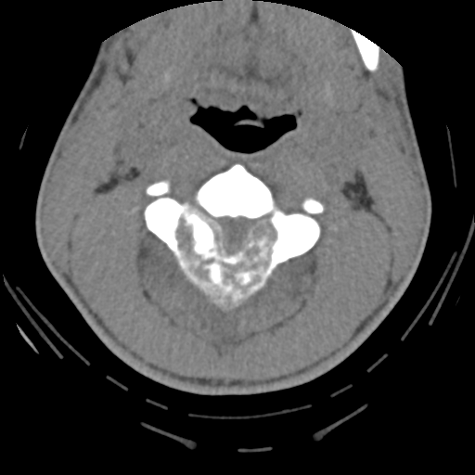
CT

Slide 4
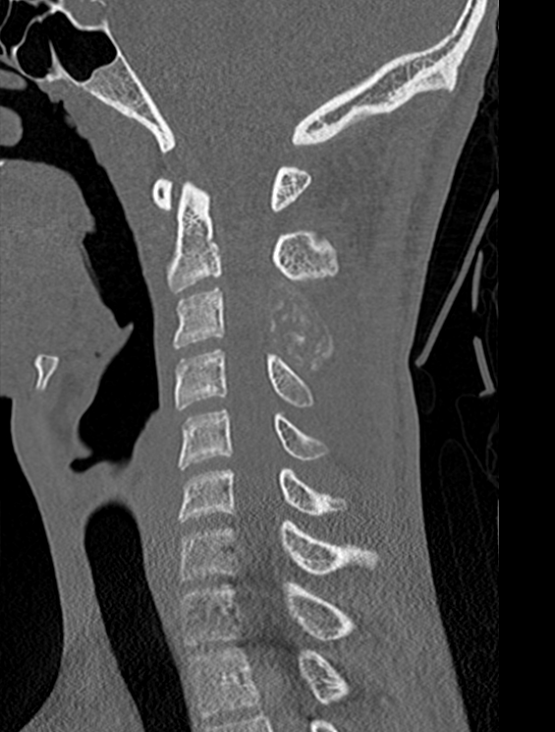
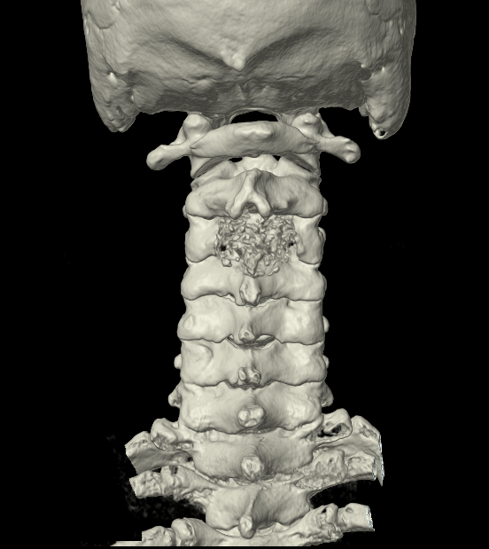
CT

Slide 5
Test Your Diagnosis
Which features are present?
Involvement of the posterior elements
Blastic lesion
Lytic lesion

Slide 6
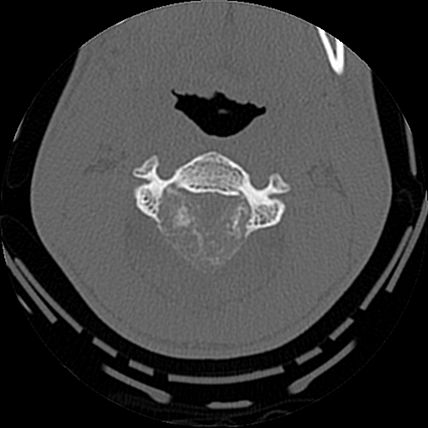
Findings
CT shows an expansile, lytic lesion involving the posterior elements of C3, specifically the lamina and spinous process
The lesion has well defined margins with osteoid matrix deposition

Slide 7
MR
T1
STIR

Slide 8
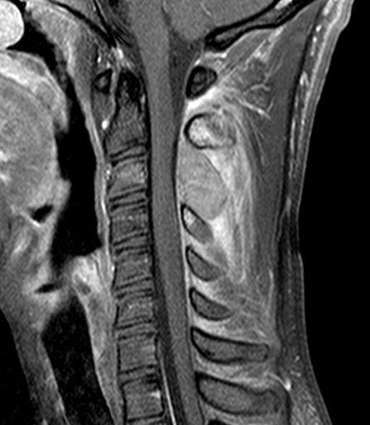
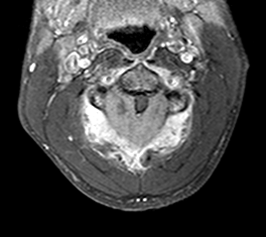
MR
Post Contrast
Post Contrast

Slide 9
Test Your Diagnosis
Which features are present?
Cord compression
Cord transection
Cord hematoma

Slide 10
Test Your Diagnosis
What is the most likely diagnosis?
Osteoblastoma
Spondylodiscitis
Hemangioma

Slide 11
Findings
MR shows enhancement of the expansile lesion involving the posterior elements of C3
There is obliteration of CSF space at this level with increased cord signal on T2WI consistent with cord compression
Increased T2 signal and enhancement of the adjacent paraspinal soft tissues is secondary to inflammation
T1
STIR
Post Contrast

Slide 12
Discussion
Osteoblastoma
Benign osteoid producing tumor, differentiated from osteoid osteoma grossly by size > 1.5 cm
90% occur within 2nd-3rd decade
Can present with dull, aching back pain, painful scoliosis, or neurologic symptoms if nerve or cord compression
Radiographic findings include an expansile, lytic lesion with osteoid matrix production with predilection for the posterior elements
Due to prostaglandin release, can have inflammatory response of the adjacent soft tissues, mimicking infection or malignancy
Narrow zone of transition with sclerotic rim
Treatment is curretage with bone graft or methylmethacrylate placement
Differential diagnosis: osteoid osteoma, chordoma, aneurysmal bone cyst, metastasis

Slide 13
Diagnosis
Osteoblastoma

Slide 14
References
Chew, F et al. Cervical Spine Osteoblastoma. AJR 1998;171:1
Shaikh, M et al. Spinal osteoblastoma: CT and MR imaging with pathological correlation. Skeletal Radiology. January 1999, Volume 28, Issue 1, 33-40

