Slide 1
Radiological Category:
Body Imaging
Principal Modality (1):
Principal Modality (2):
CT
MR
Case Report 01009
Submitted by:
Tina Sprouse, MD
Faculty reviewer:
Catherine Devine, MD
Date accepted: 03/10/2014

Slide 2
Case History
61 year old female with remote history of colostomy for severe vaginal laceration which occurred during the birth of her second child. Patient eventually had colostomy take-down approximately 30 years ago, however has had persistent pelvic pain since that time.

Slide 3
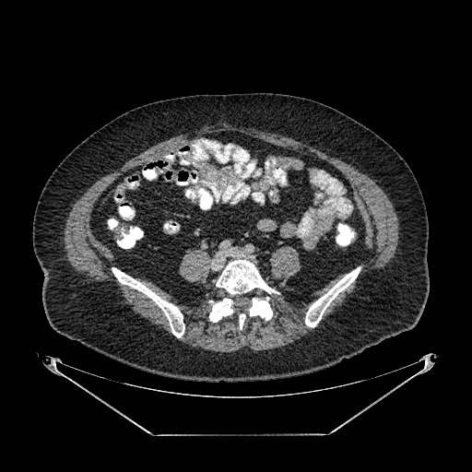
Radiological Presentations

Slide 4
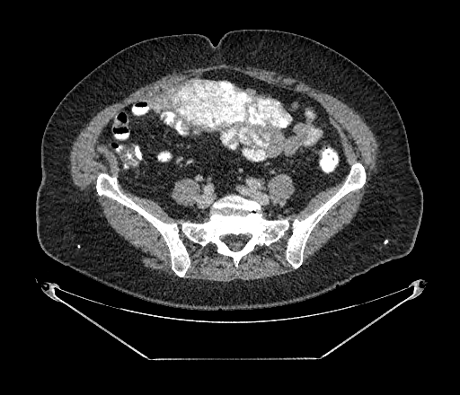
Radiological Presentations
Axial contrast enhanced CT

Slide 5
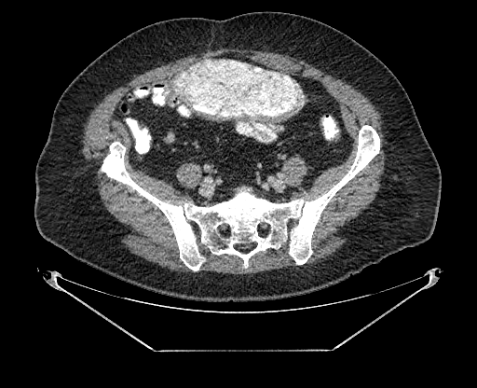
Radiological Presentations
Axial contrast enhanced CT

Slide 6
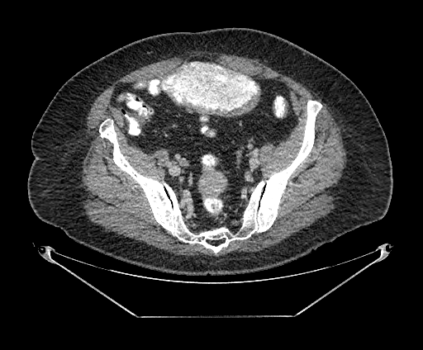
Radiological Presentations
Axial contrast enhanced CT

Slide 7
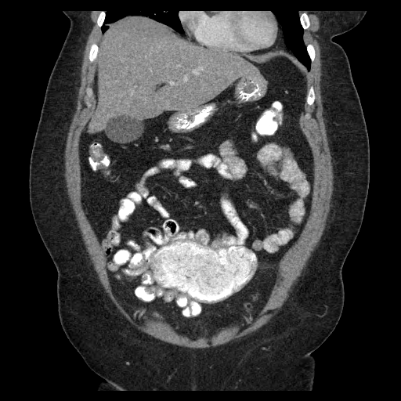
Radiological Presentations
Coronal contrast enhanced CT

Slide 8
Radiological Presentations
Four axial contrast enhanced images through the pelvis and a single coronal contrast enhanced image through the abdomen and pelvis demonstrate a large, well-circumscribed, hyperdense mass within the anterior upper pelvis displacing small bowel. The hyperdense mass does not appear to connect to bowel lumen. There is no ascites nor lymphadenopathy.

Slide 9
Test Your Diagnosis
Which one of the following is your choice for the appropriate diagnosis? After your selection, go to next page.
Metastatic disease
Carcinoid
Lymphoma
Sarcoma
Foreign body

Slide 10
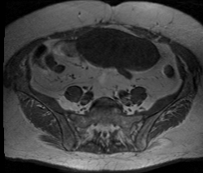
Radiological Presentations
T1 Weighted Pre-Contrast

Slide 11
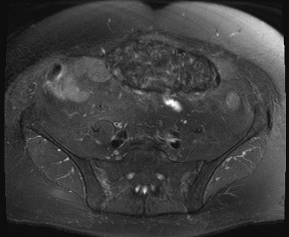
Radiological Presentations
T2 Weighted Fat Saturated

Slide 12
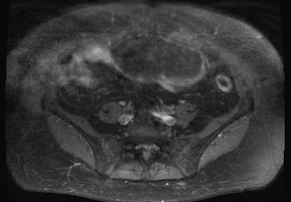
Radiological Presentations
T1 Post Contrast Fat Saturated

Slide 13
Radiological Presentations
Additional imaging with pelvic MRI was obtained. T1W and T2W images demonstrate the mass as hypointense. Peripheral enhancement is demonstrated on the post contrast, fat saturated T1W images. No internal enhancement is demonstrated within the mass.

Slide 14
CT: Hyperdense intraperitoneal mass within the upper pelvis not connecting to the bowel lumen. MR: T1 hypointense, T2 hypointense intraperitoneal mass without internal contrast enhancement
Findings and Differentials
Findings:
Differentials:
Metastatic disease
Foreign body

Slide 15
Discussion
The high density on CT imaging of the mass may be related to contrast, calcification or foreign material. MR of the pelvis with and without contrast demonstrates low T1 and T2 signal, suggesting a fibrous or calcified mass. Additionally there is no internal contrast enhancement within the mass. Thus, carcinoid tumor, lymphoma and sarcoma are determined to be unlikely due to the typical avid contrast enhancement of those tumors. However, a calcifying metastatic process may still be considered, which would explain the high density on CT imagining and low intensity on T1 and T2 weighted imaging. Calcifying metastatic disease would include mucinous adenocarcinomas, serous ovarian carcinomas and osteosarcomas.
A gossypiboma is a term to describe a mass of cotton matrix left within a body cavity during an operation.
Two types of responses occur to gossypibomas: exudative and aseptic fibrous. An exudative reaction is typically seen early in the post-operative period and is resultant from bacterial contamination of the cotton matrix. A complication of an exudative reaction is fistula formation,the risk of which is proportional to the time of gossypiboma retention. Aseptic fibrous reactions may cause adhesions and eventually progress to granuloma formation.

Slide 16
Discussion
The most frequent site of gossypibomas is the intrabdominal cavity. However, gossypibomas have been diagnosed in the chest, extremities and even in the breast. Gossypibomas are a rare complication of surgery occurring in 1 in every 1,000 to 1,500 laparotomies.
Clinical symptoms of patients with an aseptic fibrous reaction to a gossypiboma are variable and depend on the location of the gossypiboma. Patients may be asymptomatic. Those with intra-abdominal gossypibomas may complain of abdominal pain, distension, nausea, or palpable mass.
The imaging characteristics of gossypibomas are also variable and depends on the type of retained cotton matrix, the duration of retention and the type of foreign body reaction that has taken place. Gossypibomas detected by CT most often appear as a spongiform mass with air bubbles. They may however also appear as a low density mass with a thin enhancing capsule or calcifications deposited in the network of the surgical sponge or towel. CT may also demonstrate a metallic density towel marker. MR findings are also variable, but typically gossypibomas demonstrate low T1 and mixed whorled T2 signal with lack central enhancement. However, at least one case of pathologically proven gossypiboma demonstrated heterogeneous uniform enhancement on MR imaging.

Slide 17
Gossypiboma (retained green surgical towel)
Diagnosis

Slide 18
Manzella A et al. Imaging of Gossypibomas: Pictorial Review. American Journal of Roentgenolology. 2009; 193: S94-S101 Kim CT et al. Gossypiboma in Abdomen and Pelvis: MRI Findings in Four Patients. American Journal of Roentgenology. 2007; 189(4): 814-817 Hunter TB et al. Foreign Bodies. Radiographics. 2003;23(3):731-757
References

