Slide 1
Radiological Category:
Genitourinary
Principal Modality (1):
Principal Modality (2):
Ultrasound
MRI
Case Report # 0852
Submitted by:
Pooja Thakrar, M.D.
Faculty reviewer:
Verghese George, M.D.
Date accepted:
15 January 2012

Slide 2
Case History
22-year-old lady with longstanding history of brownish vaginal discharge presents to the emergency department with acute pelvic pain and fever.

Slide 3
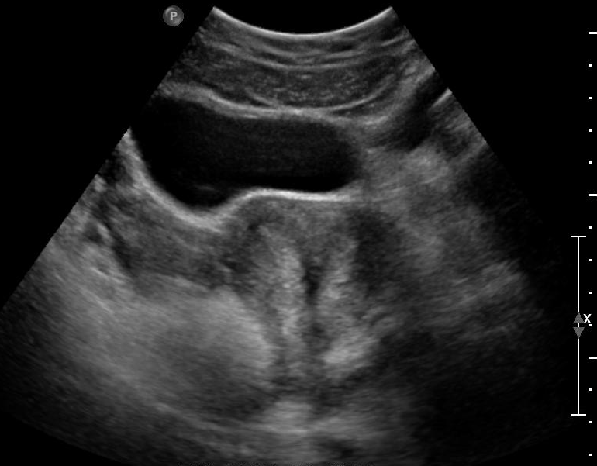
Radiological Presentations
Transverse transabdominal ultrasound image of the uterus.

Slide 4
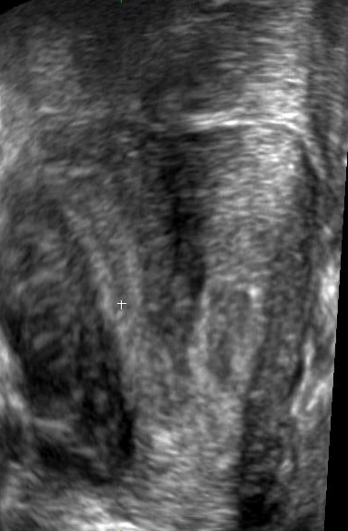
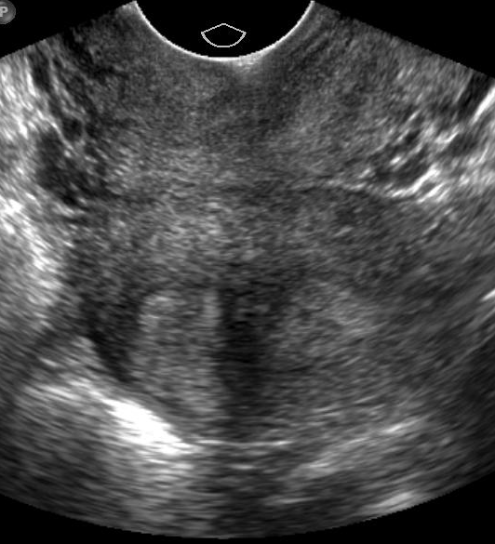
Radiological Presentations
Coronal reconstructed ultrasound image of the uterus, left, and transverse transvaginal ultrasound image of the uterine body, right.

Slide 5
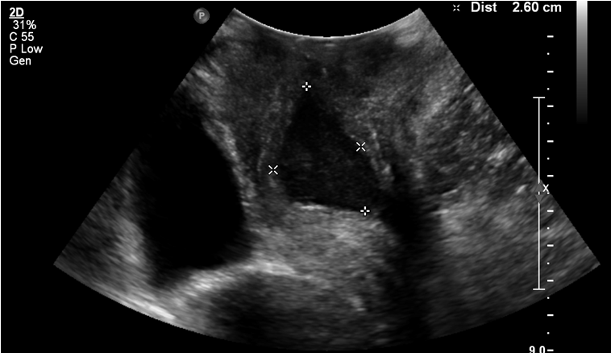
Radiological Presentations
INFERIOR
ANORECTUM
ANTERIOR
POSTERIOR
BLADDER
SUPERIOR
Longitudinal translabial ultrasound image.

Slide 6
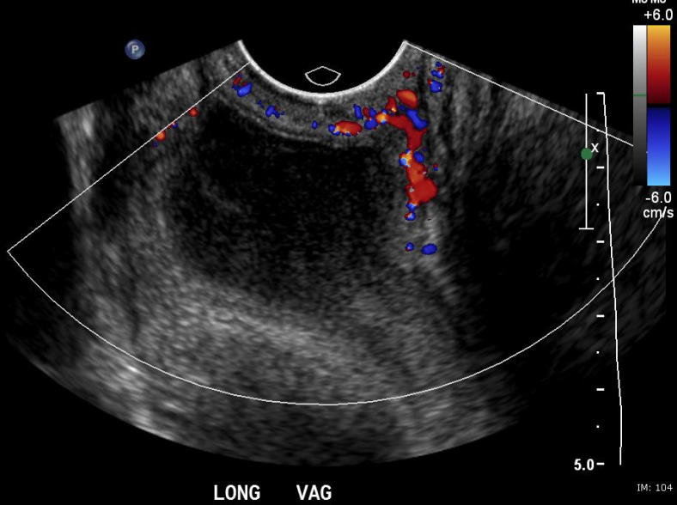
Radiological Presentations
Longitudinal transvaginal color Doppler ultrasound image at the vaginal level.

Slide 7
Radiological Presentations
Clockwise from top left: Superior to inferior axial T2-weighted images through the pelvis after a minor surgical procedure was performed in the emergency department.

Slide 8
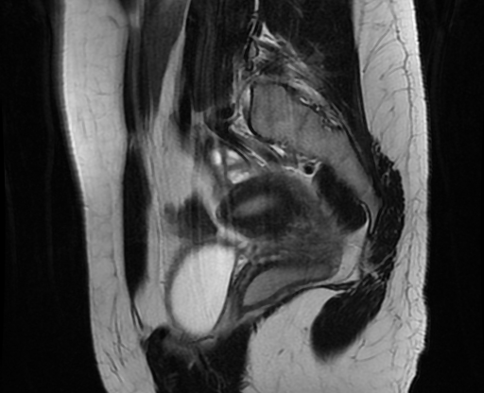
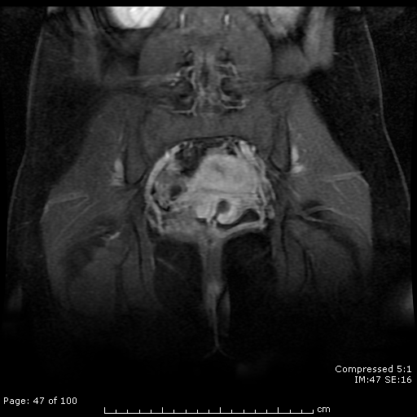
Radiological Presentations
Top: Anterior to posterior coronal T2-weighted images. Bottom: Left parasagittal T2 and coronal postcontrast T1-weighted images from the same MRI.

Slide 9
Test Your Diagnosis
Which one of the following is your choice for the appropriate diagnosis? After your selection, go to next page.
Endometritis and abscess in setting of uterus didelphys
Endometritis and abscess in setting of septate uterus
Endometritis and abscess in setting of bicornuate uterus
Hematocolpos in setting of uterus didelphys
Infected hematocolpos in setting of septate uterus with longitudinal vaginal septum
Infected hematocolpos in setting of septate uterus with vaginal duplication

Slide 10
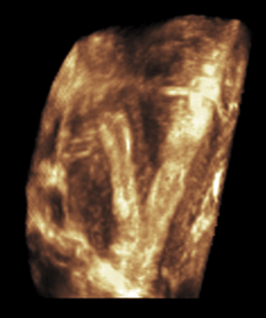
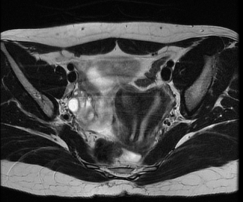
Ultrasound (left) demonstrates a septate uterus with a septum (white arrow) which extends at least to the internal cervical os. MRI (right) shows that the configuration is completely septate; the septum also bisects the cervical canal (red arrow).
Findings and Differentials
Findings:

Slide 11
Ultrasound (left) demonstrates a complex, tubular left paravaginal fluid collection (white arrow). Peripheral hyperemia is apparent. MR images (middle, right) were obtained after a Foley catheter had been placed into the fluid collection (white arrow) in the emergency department. The Foley balloon (green arrow) is clearly seen. The catheter (red arrow) passes through the vagina (blue arrow). Enlarged pelvic lymph nodes (yellow arrow) are present.
Findings and Differentials
Findings:

Slide 12
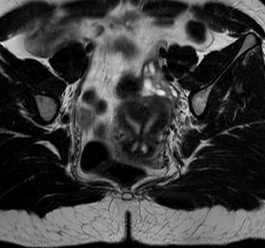
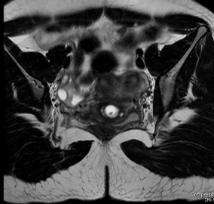
MR images demonstrate communication of the right hemicervix (red arrow) with the patient’s vagina (blue arrows). The left hemicervix (purple arrow) communicates with the collection (white arrows). The catheter balloon (green arrows) is again seen within the collection. The collection is blind-ending inferiorly but communicates with the vagina through a narrow orifice.
Findings and Differentials
Findings:

Slide 13
Findings and Differentials
Differentials:
Infected hematocolpos in setting of septate uterus with incomplete vaginal duplication
Infected hematocolpos in setting of septate uterus with longitudinal vaginal septum
Due to the relatively fleshy nature of the septum intervening between the two vaginal lumina, this is thought to more likely represent partial (blind-ending) vaginal duplication, rather than extension of the uterine septum into the vagina.

Slide 14
Discussion
A quick refresher on congenital uterine abnormalities (a spectrum of Müllerian duct anomalies):
During embryogenesis, paired Müllerian (paramesonephric) ducts develop into the fallopian tubes, uterus, cervix, and upper two-thirds of the vagina. (The ovaries and lower third of the vagina develop separately.) This involves three phases—organogenesis, fusion, and septal resorption. Failure of any of these steps results in a corresponding uterine anomaly.

Slide 15
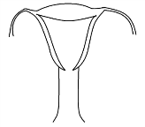
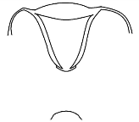
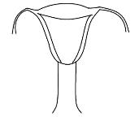
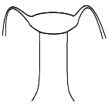
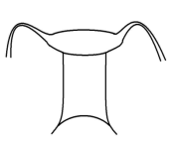
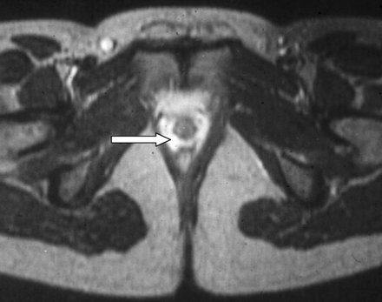
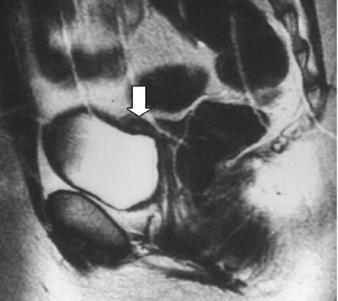
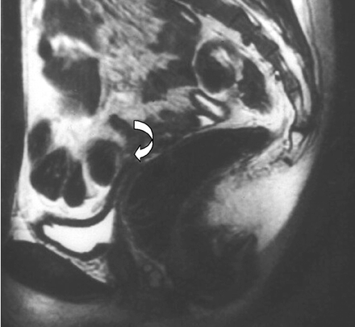
Discussion
1. Organogenesis: If neither Müllerian duct develops fully, the result is uterine agenesis or hypoplasia.
Top, left to right: Schematics of normal uterus, vaginal agenesis, cervical atresia, fundal agenesis, and uterine hypoplasia. Bottom, left to right: MR images of vaginal agenesis, uterine hypoplasia, and uterine agenesis.

Slide 16
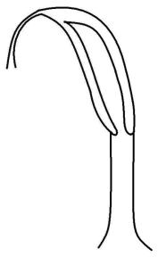
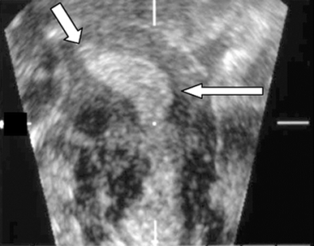
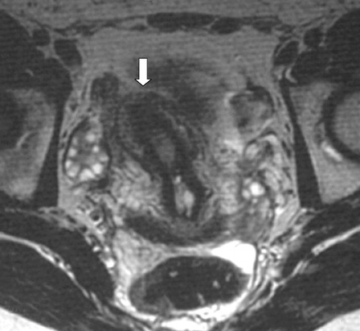
Discussion
1. Organogenesis: Failure of one Müllerian duct to develop fully results in a unicornuate uterus.
Left to right: Schematic, ultrasound image, and MR image of unicornuate uterus.

Slide 17
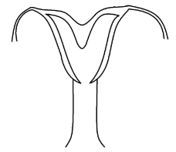
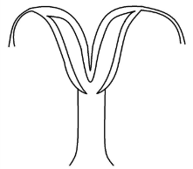
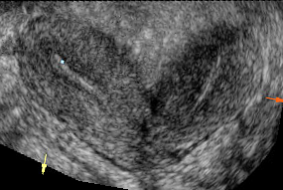
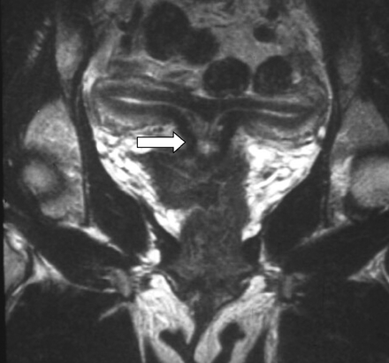
Discussion
2. Fusion: “Lateral fusion” refers to the process during which the lower segments of the Müllerian ducts fuse to form the uterus, cervix, and upper two-thirds of the vagina. Failure of lateral fusion results in bicornuate uterus (partial or complete) or uterus didelphys.
Clockwise from top left: Partial bicornuate uterus schematic, complete bicornuate uterus schematic, complete bicornuate uterus ultrasound image, and complete bicornuate uterus MR image.

Slide 18
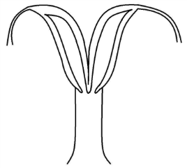
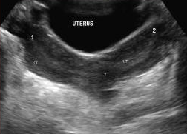
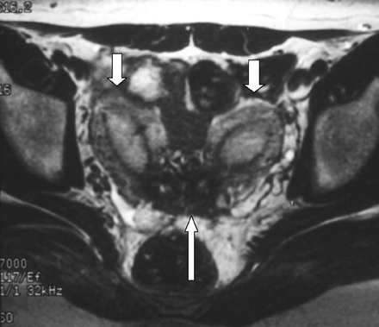
Discussion
2. Fusion: “Lateral fusion” refers to the process during which the lower segments of the Müllerian ducts fuse to form the uterus, cervix, and upper two-thirds of the vagina. Failure of lateral fusion results in bicornuate uterus (partial or complete) or uterus didelphys.
Clockwise from top left: Didelphic uterus schematic, transverse ultrasound image of uterus didelphys, transverse ultrasound image demonstrating two cervices, and MR image of uterus didelphys.

Slide 19
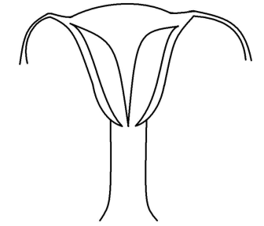
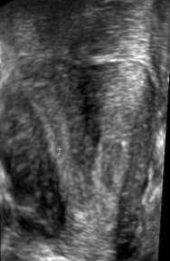
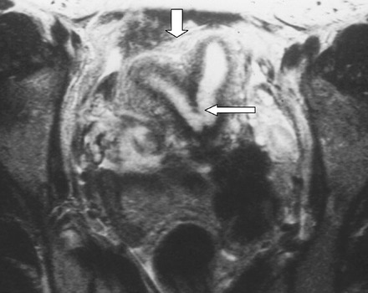
Discussion
3. Septal resorption: Fusion of the lower segments of the Müllerian ducts results in a central septum which must subsequently be resorbed to yield a single uterine cavity and cervix. Failure of resorption results in a septate or subseptate uterus, depending on the length of septum resorbed.
Left to right: Schematic of septate uterus and ultrasound MR images of subseptate uterus.

Slide 20
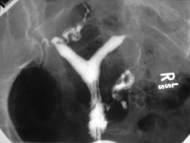
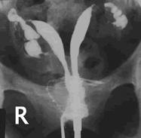
Discussion
Hysterosalpingography can be a useful tool for evaluation of the endometrial canal and can suggest the presence of a Müllerian duct anomaly.
However, complete evaluation requires assessment of the external uterine fundal contour. Hence, a hysterosalpingogram alone is generally inadequate for complete assessment.

Slide 21
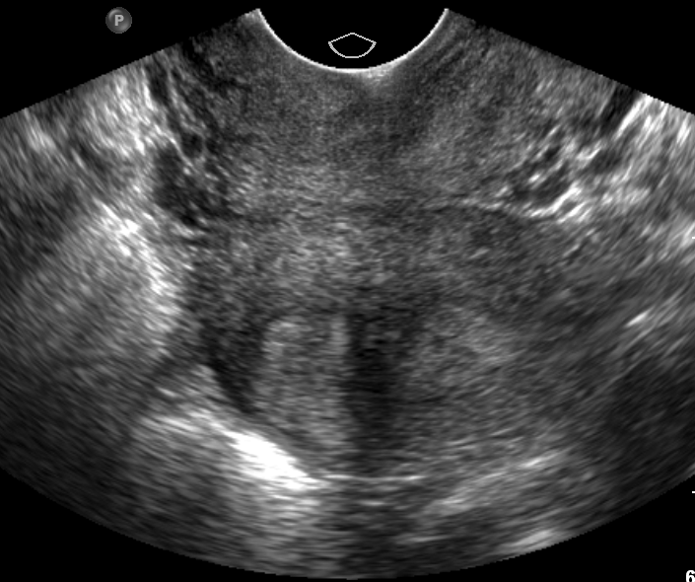
Discussion
The orientation of the uterus can make evaluation of Müllerian duct abnormalities by ultrasound challenging. The shape of the endometrial cavity can be difficult to evaluate using only the transverse (left) and longitudinal (right) planes.
Three-dimensional reconstructions in the coronal plane (below) can make such anomalies much more apparent.

Slide 22
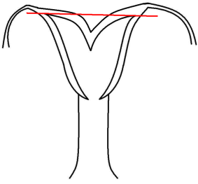
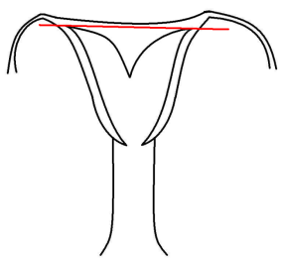
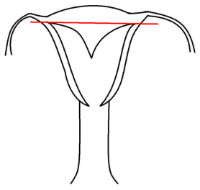
Discussion
In order to distinguish between a bicornuate and a septate uterus on ultrasound, one must draw a straight line between the tubal ostia. If the apex of the external uterine fundal contour occurs below this line or up to 5 mm above it, the uterus is bicornuate. If the apex is more than 5 mm above this line, the uterus is septate.
Bicornuate uterus
Bicornuate uterus
Septate uterus

Slide 23
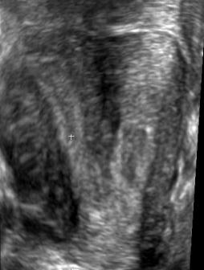
Discussion
In our patient, the external uterine fundal contour extends more than 5 mm above a line drawn through the tubal ostia. This indicates that lateral fusion was completed. The shadowing soft tissue between two endometrial cavities in the uterus therefore represents a fibromuscular septum.

Slide 24
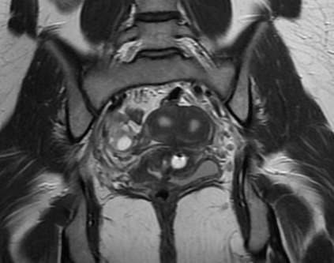
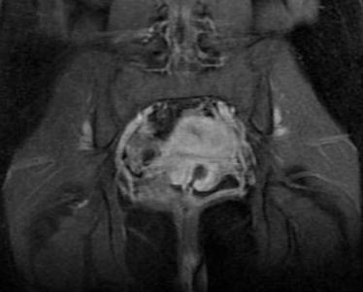
Discussion
Following her ultrasound, the patient had a drain placed through the vagina into the paravaginal fluid collection. MR imaging of the patient’s pelvis was then performed to further evaluate her anatomy.
The “paravaginal” collection is seen to represent complex fluid (sloughed endometrium) within a partial vaginal duplication. The patient’s recurrent vaginal discharge is explained by a tiny ostium (small arrow) allowing communication between the left-sided duplication and the functioning vagina.

Slide 25
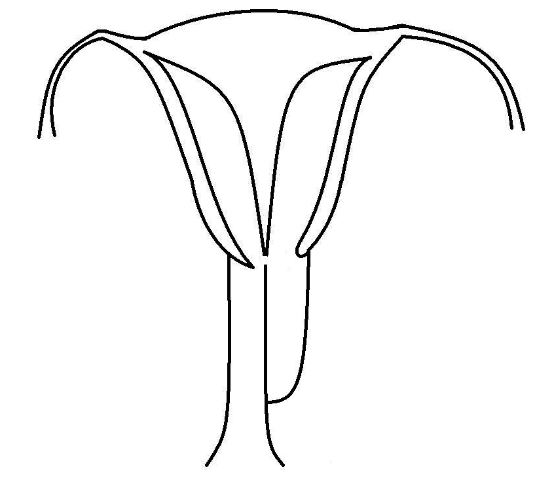
Discussion
Diagnosis of hematocolpos in an adult is unusual, as girls typically present in adolescence with delayed onset of menses. In our patient, however, a patent vagina is present on the right, rendering her blind-ending, left-sided duplication less clinically apparent, resulting in the development of the unilateral hematocolpos. The tiny communicating ostium (see below) contributed to the history of chronic brownish discharge.
At the time of presentation, the collection was obviously infected, as evidenced by its peripheral hyperemia, the presence of pelvic lymphadenopathy, and the patient’s clinical symptoms.
ostium allowing
communication
between left
and right sides
uterine
septum
blind-ending left vaginal duplication
patent right vagina

Slide 26
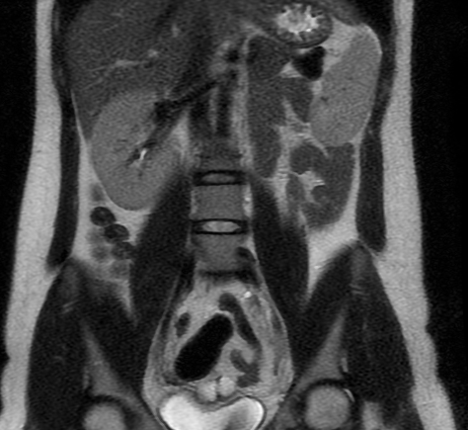
Discussion
MR imaging of the abdomen demonstrates agenesis of the left kidney. Because the urinary and genital systems arise from a common ridge of mesoderm along the dorsal body wall, abnormalities of the mesonephric and paramesonephric systems can be associated with ipsilateral anomalies of the kidneys. The most common of these is ipsilateral renal agenesis, which is seen in our patient.
Coronal (left) and axial (top) MR images through the abdomen of the index patient demonstrating left renal agenesis.

Slide 27
Complete septate uterus with partial vaginal duplication and infected unilateral hematocolpos.
Diagnosis

Slide 28
References
Troiano RN, McCarthy SM. Müllerian duct anomalies: imaging and clinical issues. Radiology 2004;233: 19 – 34.
Syed I, Lin EC. Imaging in Mullerian duct abnormalities. Emedicine 2011.
Yoder IC, Pfister RC. Unilateral hematocolpos and ipsilateral renal agenesis: report of two cases and review of the literature. American Journal of Roentgenology 1976;127: 303 – 08.

