Slide 1
Radiological Category:
Neuroradiology
Principal Modality (1):
Principal Modality (2):
MRI
none
Case Report # 0874
Submitted by:
Justin Smith, M.D.
Faculty reviewer:
Leo Hochhauser, M.D
Date accepted:
February 2012

Slide 2
Case History
22 year old female with 4 day history of blurry vision.

Slide 3
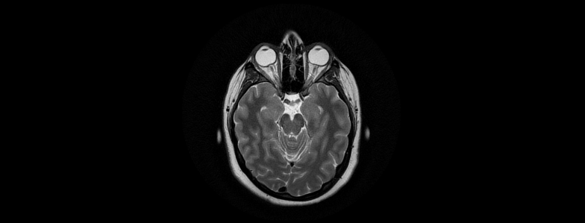
T2 weighted MRI Brain

Slide 4
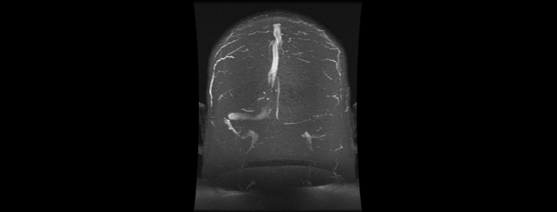
MRV

Slide 5
MRV

Slide 6
Test Your Diagnosis
Which one of the following is your choice for the appropriate diagnosis? After your selection, go to next page.
Pseudotumor Cerebri / Idiopathic Intracranial Hypertension
Dural Venous Sinus Thrombosis
Idiopathic/Post-inflammatory optic nerve atrophy

Slide 7
-Increased fluid surrounding the optic nerves/distention of subarachnoid space -Optic nerve papilla protruding into the globes -Hypoplastic left transverse sinus (no thrombosis) -Flattening of the sclera
Findings and Differentials
Findings:
Differentials:
Pseudotumor Cerebri / Idiopathic Intracranial Hypertension
Dural Venous Sinus Thrombosis
Idiopathic / Post-inflammatory optic nerve atrophy

Slide 8
Discussion
Pseudotumor Cerebri / IIH
– IIH is a headache syndrome characterized by raised CSF pressure in the absence of an intracranial mass or ventricular dilatation. CSF composition is normal and with the exception of universal papilledema, the neurologic exam is most often normal.
Obese woman age 20-44 years with headache and papilledema is the most common presentation
- Pediatric population: A retrospective study of 27 patients by Dr. Butler of UTHSC revealed that presentation of IIH in children is more dependent on raised opening pressures, as papilledema was only present in 50% of children and obesity in only 30%.

Slide 9
Discussion
Pseudotumor Cerebri / IIH (continued)
-The key to MR imaging is to exclude other pathologic causes of increased intracranial pressure such as mass lesion, hydrocephalus and dural venous sinus thrombosis
Lateral decubitus position ICP by lumbar puncture are considered abnormal if above 200 mm H₂O in normal-weight individuals and 250 mm H₂O in obese individuals
Restoration of visual acuity and resolution of papilledema constitute the primary goals of management . Treatment is usually conservative with weight loss and medications such as acetazolamide and occasionally corticosteroids.
Gastric bypass surgery was associated with remittance of symptoms in all but 1 of 19 adult patients with a history IIH in 1 study

Slide 10
Discussion
Dural Venous Sinus Thrombosis
DVST has been implicated as a causative factor for venous outflow obstruction and a secondary cause of IIH. MR venography is more routinely being used in the evaluation of suspected cases of IIH. Additionally there is ongoing debate as to the role of dural venous sinus stenosis (particularly sagittal sinus stenosis) as a causative versus secondary sign relating to IIH.
MR findings may be similar to IIH with the obvious exception of either stenosis or thrombosis of the cerebral venous system.

Slide 11
Pseudotumor Cerebri / Idiopathic Intracranial Hypertension
Diagnosis

Slide 12
Suzuki H et al. MR imaging of idiopathic intracranial hypertension. AJNR Am J Neuroradiol. 22(1):196-9, 2001 Degnan AJ, Levy LM. Pseudotumor cerebri: brief review of clinical syndrome and imaging findings. AJNR Am J Neuroradiol. 2011;32(11):1986-93 Faz G, Butler I, Koenig M. Incidence of Papilledema and Obesity in Children Diagnosed With Idiopathic “Benign” Intracranial Hypertension: Case Series and Review. J Child Neurol. 2010 November; 25(11): 1389-1392
References

