Slide 1
Radiological Category:
Pediatrics
Principal Modality (1):
Principal Modality (2):
CT
General Radiography
Case Report # 0881
Dentigerous Cyst
Submitted by:
Robert E. Klinglesmith, M.D., Psy.D.
Faculty reviewer:
Lawrence H. Robinson, M.D
Date accepted:
November 08, 2011

Slide 2
Case History
An eleven year old caucasian male presented to an outside facility with a history of facial pain and swelling. A single panorex was followed by a maxillofacial CT with 3D reconstruction. He was subsequently transferred to MHH for definitive management.

Slide 3
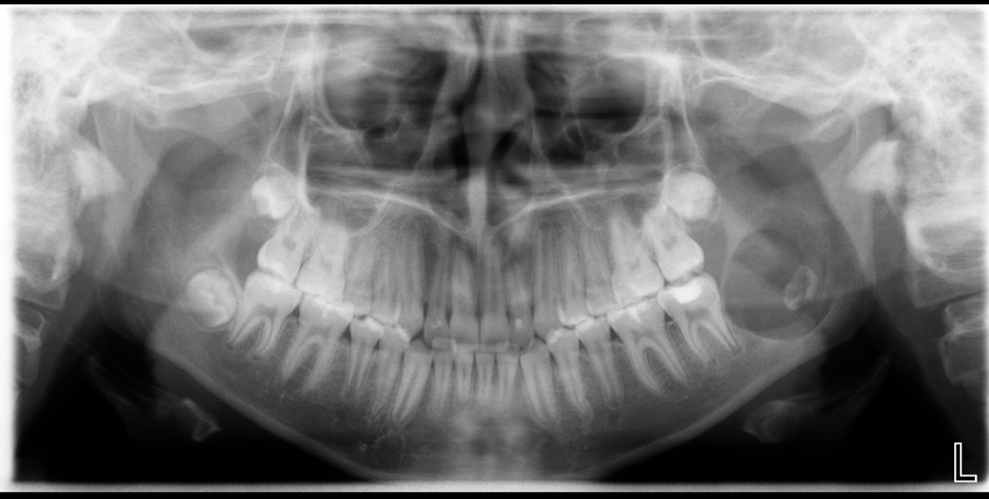
Radiological Presentations
Single Panorex view

Slide 4
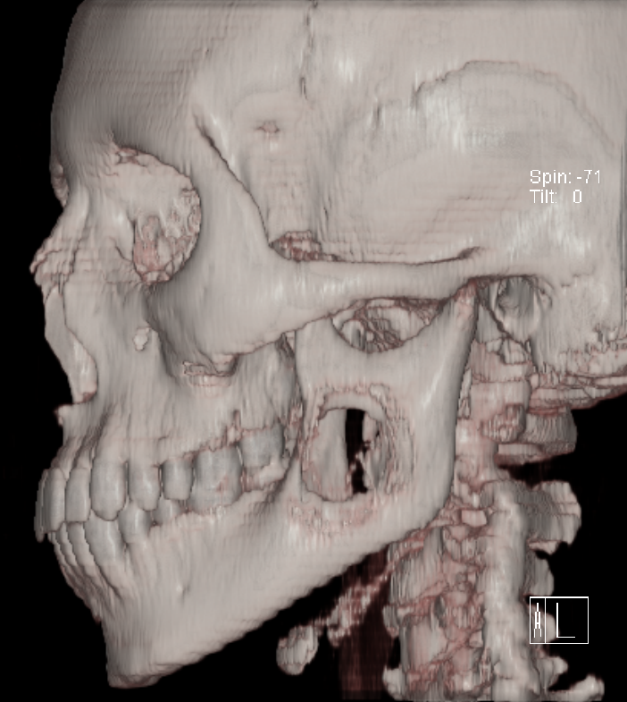
Radiological Presentations
3-D volume-rendered reconstruction

Slide 5
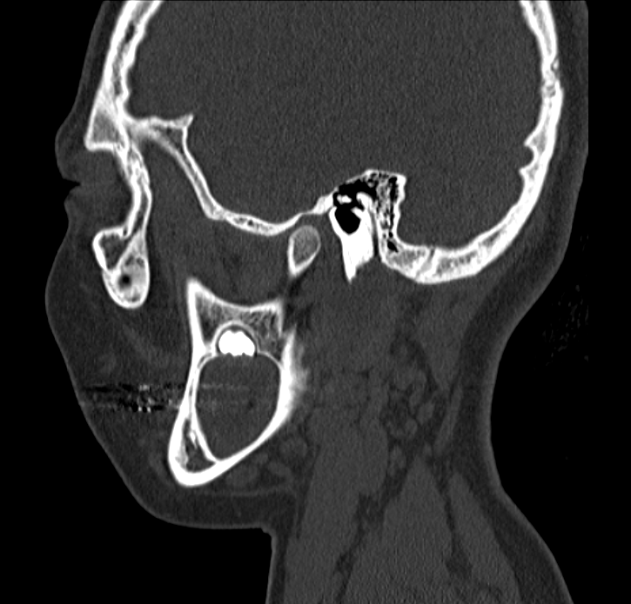
Radiological Presentations
Sagittal CT image of different patient with same presentation

Slide 6
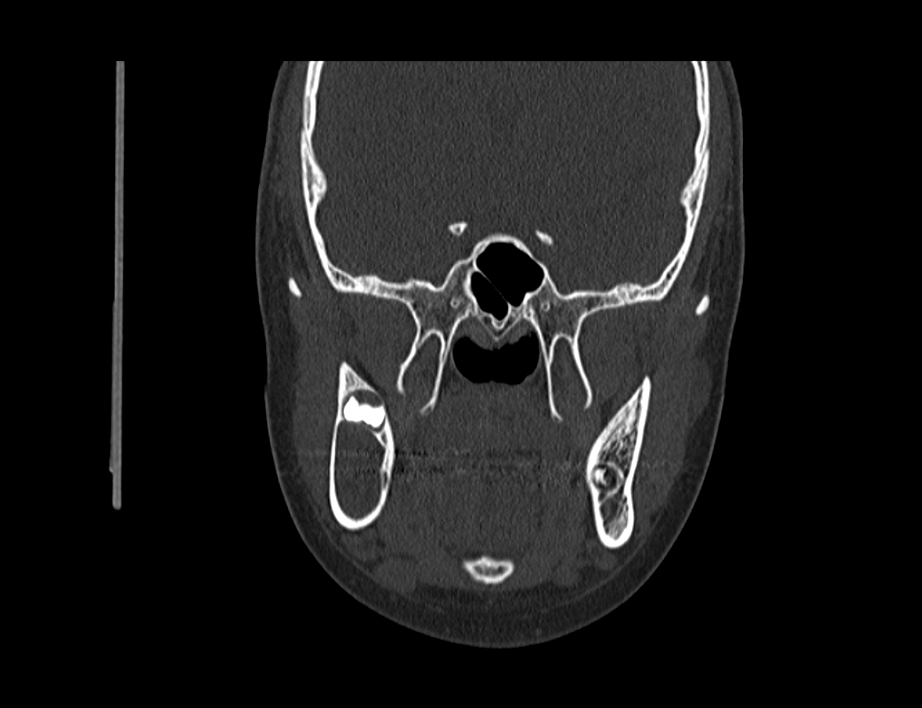
Radiological Presentations
Coronal CT image of different patient with same presentation

Slide 7
Radiological Presentations
Axial CT image of different patient with same presentation

Slide 8
Test Your Diagnosis
Which one of the following is your choice for the appropriate diagnosis? After your selection, go to next page.
Ameloblastoma
Dentigerous cyst
Odontogenic keratocyst
Aneurysmal bone cyst

Slide 9
Panorex: A large, round, well-demarcated osteolytic lesion associated with a malformed tooth. 3D Volume rendered maxillofacial CT (combined findings of two cases): Hypoattenuating cystic lesion with sclerotic border is associated with the crown of the third molar.
Findings and Differentials
Findings:
Differentials:
Ameloblastoma
Dentigerous cyst
Odontogenic keratocyst
Aneurysmal bone cyst

Slide 10
Discussion
Ameloblastomas are histologically benign but locally aggressive. They have an extremely high rate of recurrence. Etiologies include trauma, tooth extraction and in some series, an increased prevalance of HPV found in peripheral lesions [1].
Ameloblastoma is usually unilocular that occasionally includes an enhancing mural nodule within the cyst. An associated, enchancing soft tissue mass is nearly always noted on contrast enhanced CT [2].
A dentigerous cyst surrounds the crown of an unerupted tooth. Treatment is excision [3]. Incomplete excision can result in re-occurance and potential neoplastic transformation to an ameloblastoma or squamous cell carcinoma.
These present on imaging as unilocular cystic structures near an impacted third molar tooth. Contrast enhanced CT will show no enhancement of the tissue within or around the cyst [2].

Slide 11
Discussion
The odontogenic keratocyst, unlike the dentigerous cyst, is locally aggressive. They may produce uni- or mulitlocular cystic structures and are more common in males. High rates of recurrance are seen in case of incomplete excision. Multiple odontogenic keratocysts are associated with Gorlin (Basal cell nevus) syndrome [3].
At imaging, the odontogenic keratocyst is a lucent osseous lesion with round or oval shape. The margins are frequently scalloped and distinct. Up to 40% are associated with an unerupted tooth. These features are shared with dentigerous cysts, requiring pathologic diagnosis.[4]. Recurrence is avoided with total excision. Enucleation is insufficient.
An aneurysmal bone cyst is most commonly a multilocular, multiseptated cyst within the madible [2]. Fluid/fluid levels and periosteal reactions are also frequently seen [5]. The lytic lesion is also expansile, most common in the posterior spine and in patients under the age of 30. [6]

Slide 12
Discussion
The ameloblastoma may be associated with an unerupted tooth. However, there is no evidence of mural nodules or soft tissue masses. The examination is not contrast enhanced, but the lack of masses make the absence of this finding irrelevant.
Although associated with an unerupted tooth, the current cases do not demonstrate the scalloped margins expected in an odontogenic keratocyst.
The lesion is lucent, but not expansile. No septations or fluid/fluid levels are seen, making aneurysmal bone cyst incorrect.
A dentigerous cyst involves the crown of an unerupted tooth and is typically unilocular, as demonstrate in the current cases.

Slide 13
Diagnosis: Dentigerous cyst
Diagnosis

Slide 14
1. Correnti M, Rossi M, Avila M Perrone M, Rivera H. Human papillomavirus in ameloblastoma. Oral Surg Oral Med Oral Pathol Oral Radiol Endod 2010 Sep; 110(3): e20-4. 2. Castillo, M. Basal cell nevus syndrome. In: Osborn AG, Blaser SI, Salzman KL, et al eds. Diagnostic Imaging: Brain 1st Ed. Salt Lake City, UT: Amirsys, Inc., 2004: I-1 100-103 3. Lingen MW. Odontogenic cysts and tumors. In Kumar V, Abbas AK, Fausto N, Aster JC. Eds. Robbins and Cotran’s pathological basis for disease 8th ed. Philadelphia, PA: Saunders Elselvier 2010, online edition. 4. Mendes RA, Carvalho JF, van der Waal I. Characterization and management of the keratocystic odontogenic tumor in relation to its histopathological and biological features. Oral Oncol 2010 Apr;46(4):219-25. Epub 2010 Feb 26.
References

Slide 15
5. Stoller DW, Tirman PFJ, Bredella MA. Aneurysmal bone cyst. In: Stoller DW, Tirman PFJ, Bredella MA, Beltran S, Branstetter RM, Blease SC, eds. Diagnostic Imaging: Orthopaedics 1st Ed. Salt Lake City, UT: Amirsys, Inc., 2004: 8-66 – 69. 6. Helms CA. Benign cystic bone lesions. In: Brant WE & Helms CA eds. Fundamentals of diagnostic imaging 3rd ed Lippincott Williams and Wilkins 2006 1063-1085.
References

