Slide 1
Acknowledgements: Thank you to Dr. Michael Redwine, Dr. Susan Greenfield and Dr Caleb Richards for providing images Thank you to Dr. Brian Stewart, UT Department of Pathology, for providing histologic evaluation and images
Radiological Category:
Chest Radiology
Principal Modality (1):
Principal Modality (2):
Radiograph
MRI, CT, MIBG
Case Report # 0887
Submitted by:
Cantrell, Sarah M.D.
Faculty reviewer:
Ferguson, Emma M.D.
Date accepted:
15 March 2012

Slide 2
Case History
1 month-old with tachypnea and wheezing

Slide 3
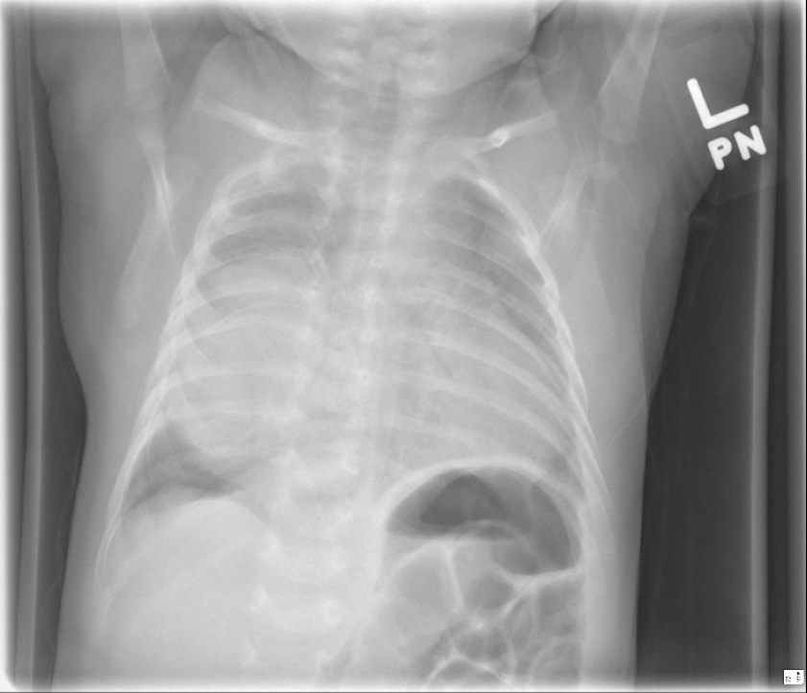
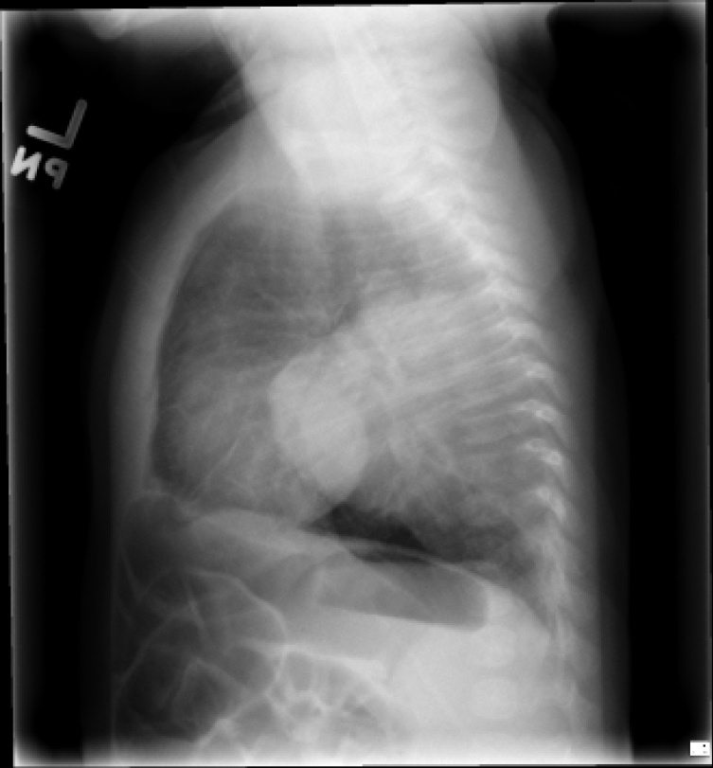
Radiological Presentations
A
B
(A) PA and (B) lateral chest radiographs

Slide 4
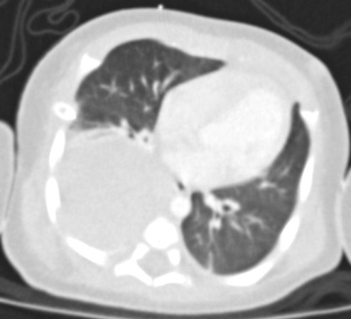
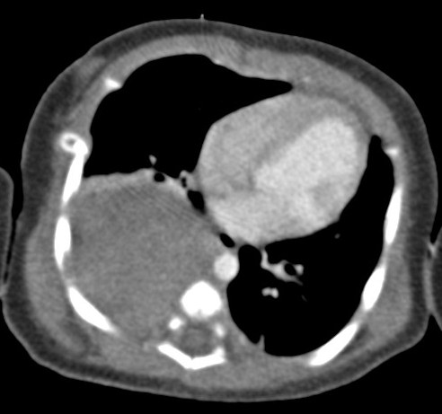
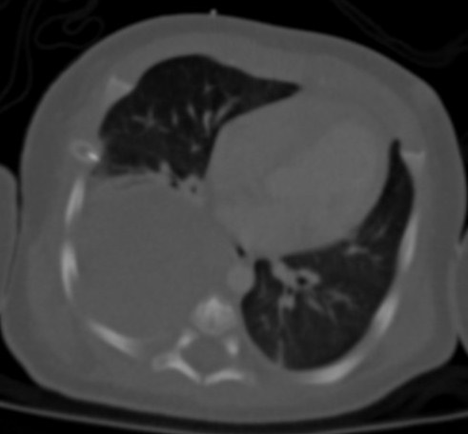
Radiological Presentations
A
B
C
Axial CT of thorax in (A) lung, (B) mediastinal and (C) bone windows

Slide 5
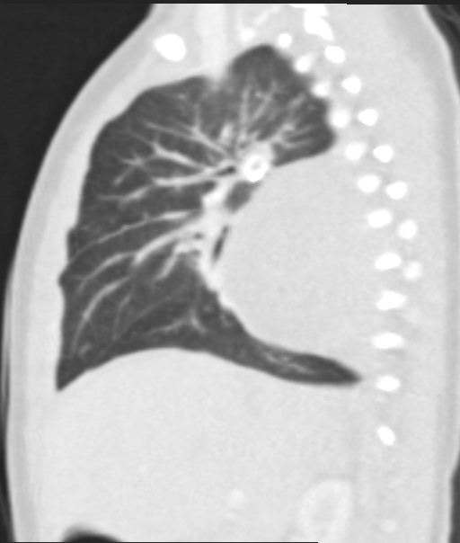
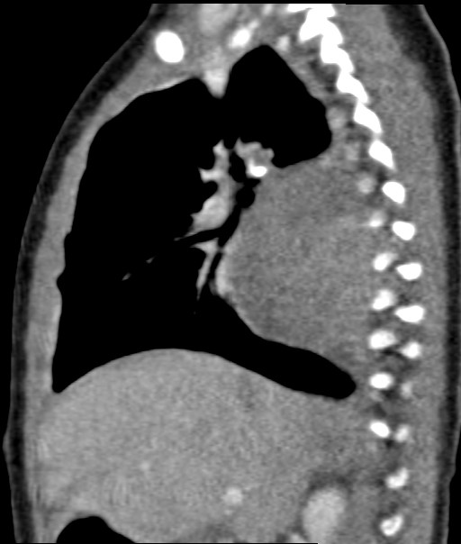
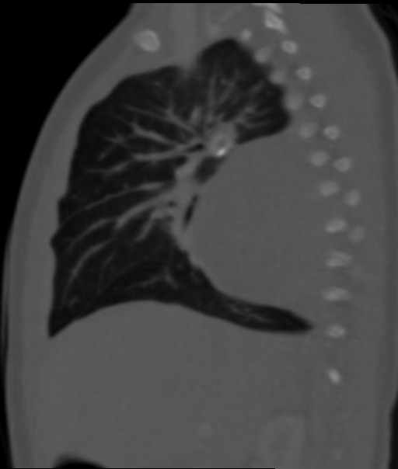
Radiological Presentations
A
B
C
Sagittal CT of thorax in (A) lung, (B) mediastinal and (C) bone windows

Slide 6
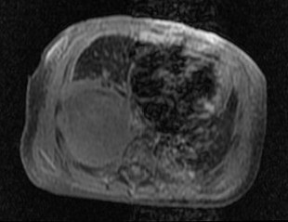
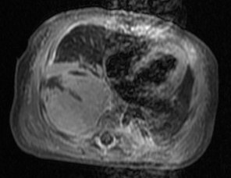
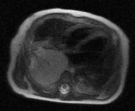
Radiological Presentations
A
B
C
(A)T1, (B)T1 post contrast and (C) T2 axial MRI of thorax

Slide 7
Test Your Diagnosis
Which one of the following is your choice for the appropriate diagnosis? After your selection, go to next page.
Round pneumonia
Bronchogenic cyst
Extralobar sequestration
CPAM
Neuroblastoma

Slide 8
Findings
PA and lateral radiographs demonstrate a well defined right sided extraparenchymal posterior chest mass without air bronchograms.

Slide 9
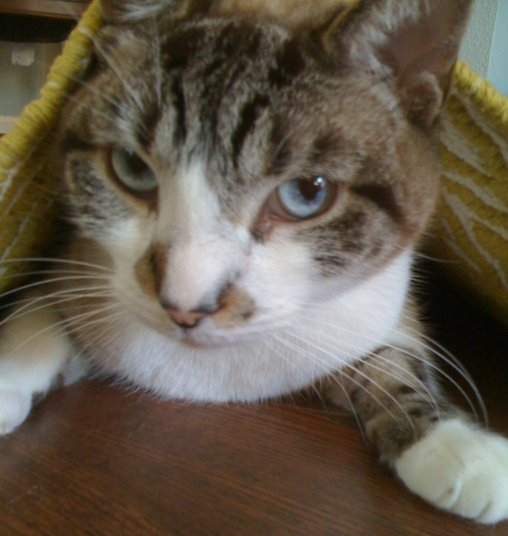
Findings
The lateral radiograph shows a well defined extraparenchymal mass in the posterior chest without air bronchograms.
The mass demonstrates a “cat under the rug” appearance.
The mass forms obtuse angles with the chest wall, suggesting an extraparenchymal location.

Slide 10
Findings
A
B
C
Contrast enhanced axial CT images demonstrate a well-defined, extraparenchymal mass in the posterior right hemithorax of low attenuation measuring 50 Hounsfield units without definite internal enhancement or extrathoracic extension.

Slide 11
Findings
A
B
C
Sagittal contrast enhanced CT images confirm the extraparenchymal location of the mass in the posterior chest, which demonstrates low attenuation measuring 50 Hounsfield units without definite internal enhancement or extrathoracic extension.

Slide 12
Findings
A
B
C
Axial T1 MR image shows a well circumscribed, extraparenchymal mass with heterogenously low T1 signal in the right posteroinferior hemithorax
Axial T1 MR postcontrast image reveals heterogenous enhancement
Axial T2 MR image shows scattered foci of T2 hyperintensity

Slide 13
Differential Diagnosis
Differential diagnosis for posterior chest/mediastinal mass in a child <3 years old includes:
Round pneumonia
Bronchogenic cyst
Extralobar sequestration
CPAM
Neuroblastoma

Slide 14
Discussion
Neuroblastoma
Definition:
Malignant tumor of neural crest cells
Demographics:
Children <2 years
Location
Adrenal neuroblastoma is most common, though neuroblastoma may occur anywhere along the sympathetic chain
Thoracic neuroblastoma involves the sympathetic chain in the posterior mediastinum
Invasive:
Neuroblastoma characteristically invades neural foramina to spread to the spinal canal where it encases vessels and nerves

Slide 15
Discussion
Neuroblastoma
Radiograph:
Solid well circumscribed posterior mediastinal mass without air bronchograms
CT:
Calcification common
Heterogenous appearance with hemorrhage, necrosis
MRI:
Useful for detecting invasion of neural foramina and spinal canal
Heterogenous enhancement
TWI1: low signal intensity
T2WI: high signal intensity
Nuclear MIBG:
70% of neuroblastomas produce catecholamines and are MIBG avid
Useful for surveillance and evaluation of progression

Slide 16
Discussion
Neuroblastoma
Clinical course
Patient went to surgery at age 4 weeks and underwent resection of the right chest mass
Postsurgical pathology showed
Poorly differentiated neuroblastoma
Positive margins
Vascular invasion
Intermediate mitosis karyorrhexis index
No n-myc amplification

Slide 17
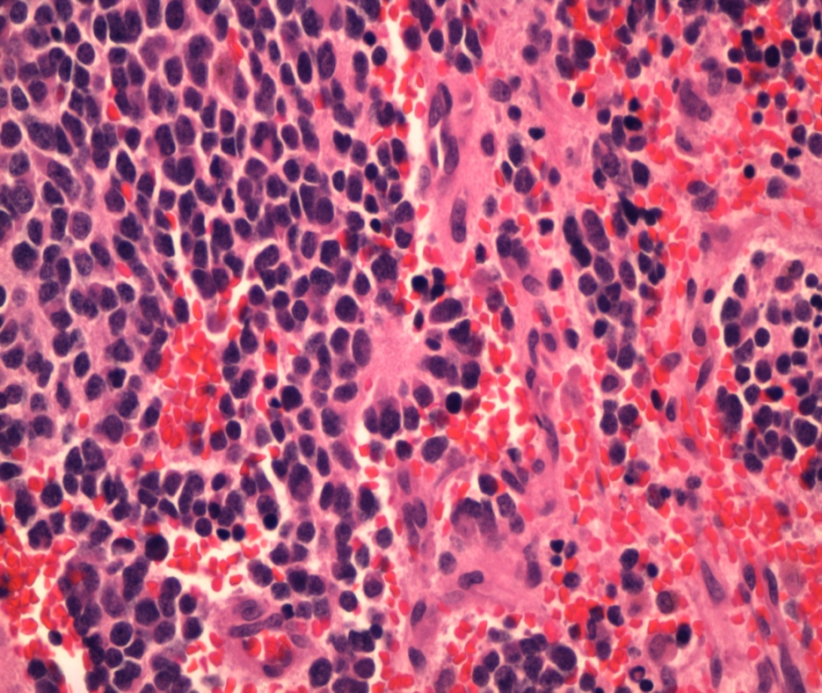
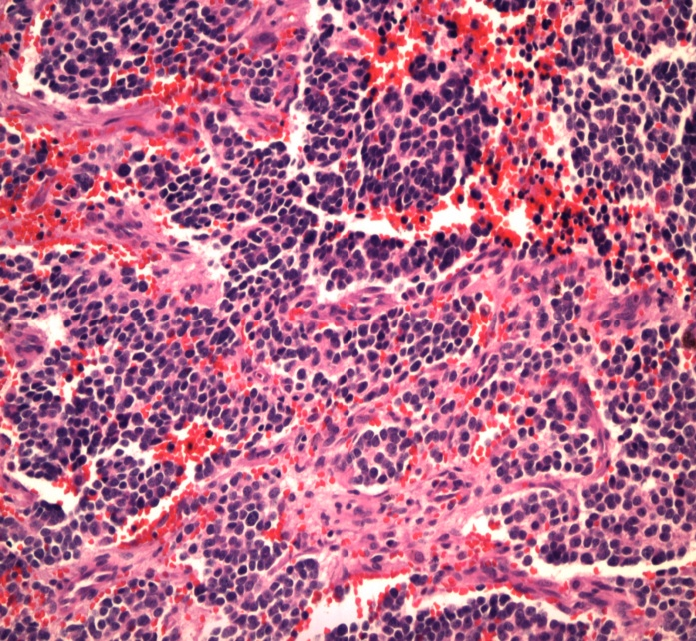
Discussion: poorly differentiated neuroblastoma
Homer Wright Rosette
Characteristic of sympathetic nervous system tumors including neuroblastomas and medulloblastomas
Composed of halo-like clusters of cells in each rosette surrounding a central area of fiber-rich neuropil
Central neuropil
Halo-like cluster of cells
Surgical pathology status post excision of right chest mass demonstrates a neuroblastoma with favorable histology indicated by age <1.5 years, low to intermediate MKI (<196/ 5000 cells) and poorly differentiated to dedifferentiated histology.
Thank you to Dr Brian Stewart, pathology, for providing slides and images

Slide 18
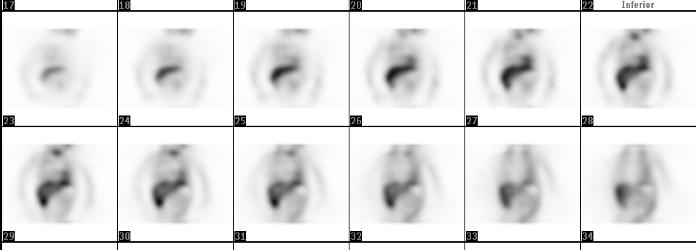
Discussion
Neuroblastoma
Prior to surgery, urine HVA (homovanillic acid, a catecholamine produced by neuroblastoma) was elevated at 99.0 mg/g Cr (normal <35 mg/g Cr), indicating that urine HVA and MIBG would provide an effective method for surveillance
Coronal whole-body images from MIBG tumor localization performed 2 weeks following surgery demonstrate:
No focal increased activity in the adrenal bed or midline
Physiologic activity in the myocardium

Slide 19
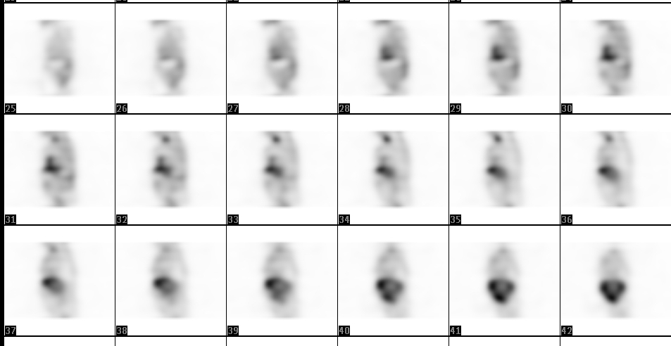
Discussion
Neuroblastoma
Prior to surgery, urine HVA (homovanillic acid, a catecholamine produced by neuroblastoma) was elevated at 99.0 mg/g Cr (normal <35 mg/g Cr), indicating that urine HVA and MIBG would provide an effective method for surveillance
Sagittal whole-body images from MIBG tumor localization performed 2 weeks following surgery demonstrate:
No focal increased activity in the adrenal bed or midline
Physiologic activity myocardium

Slide 20
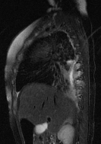
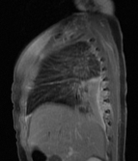
Discussion
Neuroblastoma
Saggital T2
T2WI demonstrates increased signal within right 6-8th intercostal spaces
However, 8 weeks following surgery HVA began to slowly rise
HVA increased from 28 mg/g Cr postop to 52 mg/g at 16 weeks following resection
MRI was performed and demonstrated
small foci of residual tumor along the posterior 6th through 8th intercostal spaces
Postcontrast T1WI demonstrates increased enhancement within right 6-8th intercostal spaces
Saggital T1 post

Slide 21
Differential Diagnosis
Differential diagnosis for posterior chest/mediastinal mass in a child <3 years old includes:
Round pneumonia
Bronchogenic cyst
Extralobar sequestration
CPAM
Neuroblastoma

Slide 22
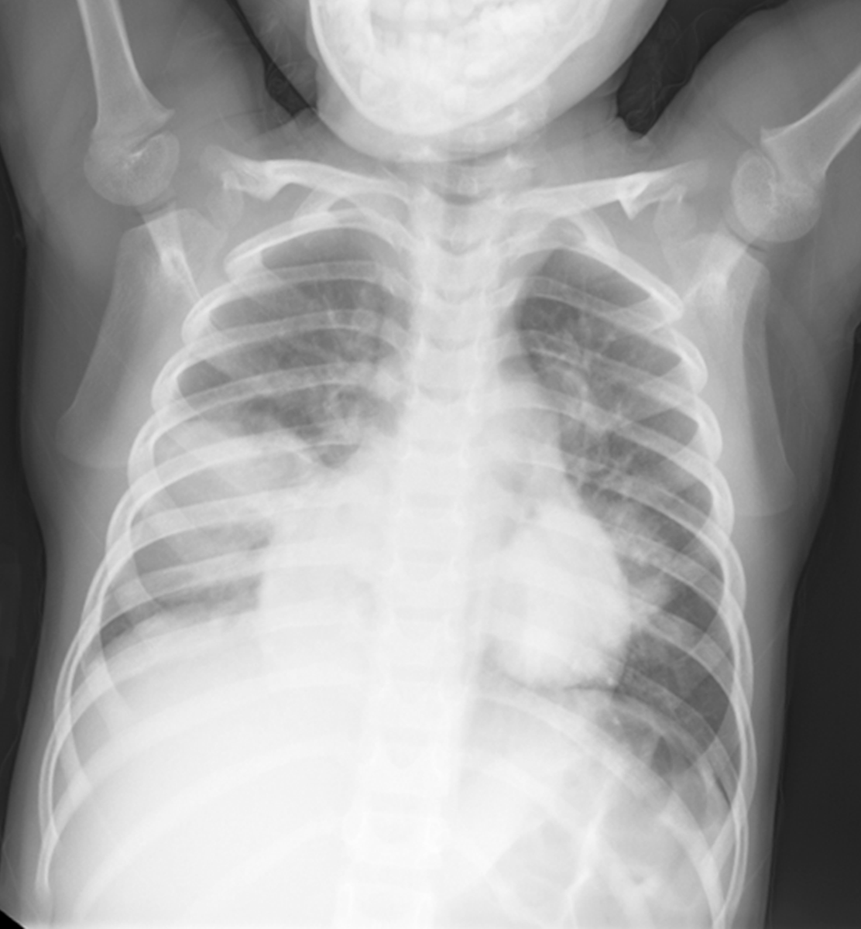
Discussion
Round pneumonia
Children <8 years
Signs/symptoms of pneumonia (fever, cough, tachypnea)
Location: most common, superior segment of lower lobes
Radiography:
Air bronchograms on radiograph
Conform to lobar anatomy
CT:
CT usually not performed
Enhancing vessels may course through parenchymal opacity, however, fluid filled alveoli will not demonstrate enhancement
Acute angles with chest wall
Bilateral round pneumonias:
Opacities are intraparenchymal as evidenced by:
Acute angles with chest wall
Completely surrounded by aerated lung parenchyma

Slide 23
Discussion Round Pneumonia v. Neuroblastoma
Round pneumonia
Neuroblastoma
Radiograph: Intraparenchymal opacity with air bronchograms
CT: Intraparenchymal opacity which may contain enhancing vessels coursing through it
Radiograph: extraparenchymal opacity without air bronchograms
CT
Extraparenchymal opacity that displaces vessels and parenchyma
Heterogenous content, may contain calcium and necrosis
May demonstrate internal enhancement
May demonstrate bony destruction

Slide 24
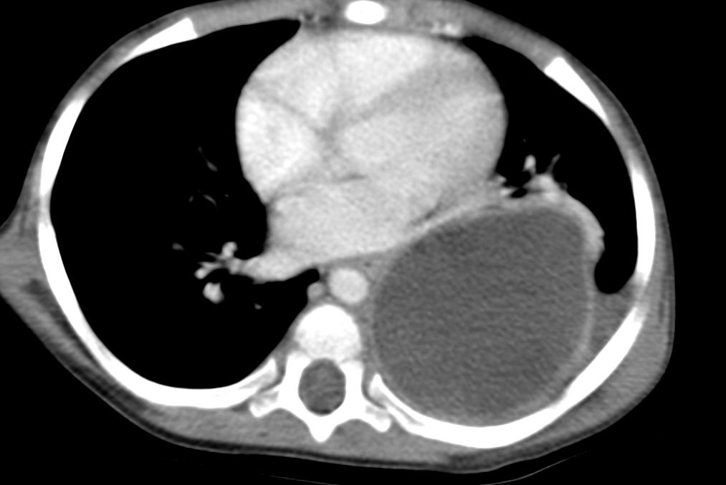
Discussion
Bronchogenic Cyst
Foregut duplication cysts
Other foregut duplication cysts include neuroenteric and enteric cysts
Result from abnormal ventral budding of the tracheobronchial tree between 26th-40th weeks of gestation
Location: middle mediastinum, subcarinal most common
Mediastinal (majority)-middle mediastinal (hilar, subcarinal)
Intraparenchymal
Usually do not communicate with airway. Presence of air suggests infection.
Thank you to Dr Susan Greenfield for providing images

Slide 25
Discussion Bronchogenic cyst v. Neuroblastoma
Bronchogenic cyst
Neuroblastoma
Middle mediastinum
CT
Homogenous internal content
May contain proteinaceous fluid but 50% have uniform fluid density
No internal enhancement
MRI
TWI1: uniform low T1 signal
T2WI: uniform high T2 signal
No internal enhancement
Posterior mediastinum
CT
Heterogenous content, may contain calcium and necrosis
May demonstrate internal enhancement
May demonstrate bony destruction
MRI
Heterogenous content and enhancement
T1WI: low signal intensity
T2WI: high signal intensity

Slide 26
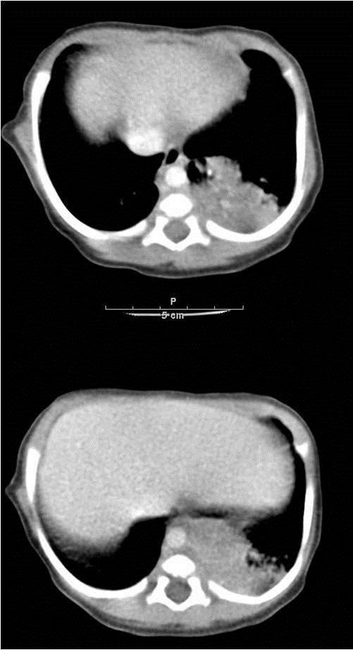
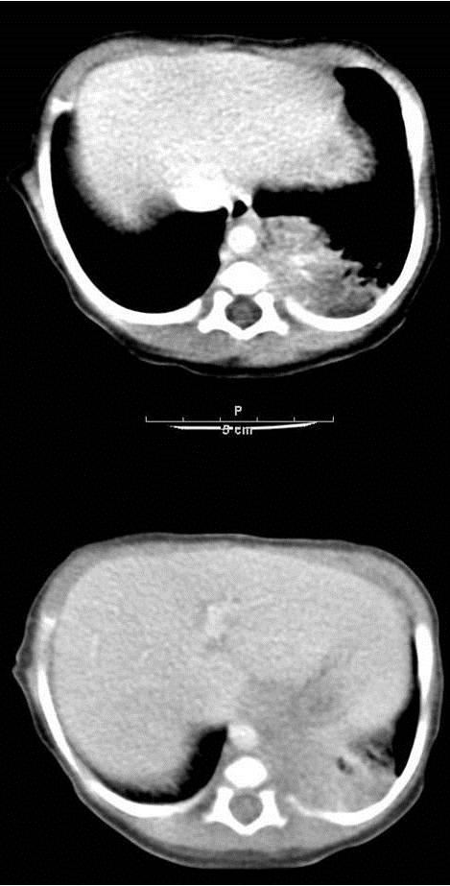
Discussion
Pulmonary Sequestration
Abnormal lung parenchyma which does not communicate with the tracheobronchial tree
Arterial supply from systemic arteries (descending thoracic aorta, abdominal aorta)
Most commonly lower lobe
Extralobar (10%) | Intralobar (90%)
Early childhood presentation Systemic venous drainage (azygous, IVC) Separate pleural covering Other associated congenital lesions (CPAM) | Late childhood presentation Drains to inferior pulmonary vein Visceral pleural covering No other associated congenital lesions
Thank you to Dr Susan Greenfield for providing images

Slide 27
Discussion: Pulmonary Sequestration v. Neuroblastoma
Pulmonary sequestrum
Neuroblastoma
CT
Systemic arterial supply, from thoracic aorta or abdominal aorta
Calcium uncommon
May contain heterogenous cystic/air filled spaces if extralobar sequestration and CPAM are concurrent
No bony destruction
CT
Heterogenous content, may contain hemorrhage and necrosis
Calcium common
May demonstrate internal enhancement
May demonstrate bony destruction

Slide 28
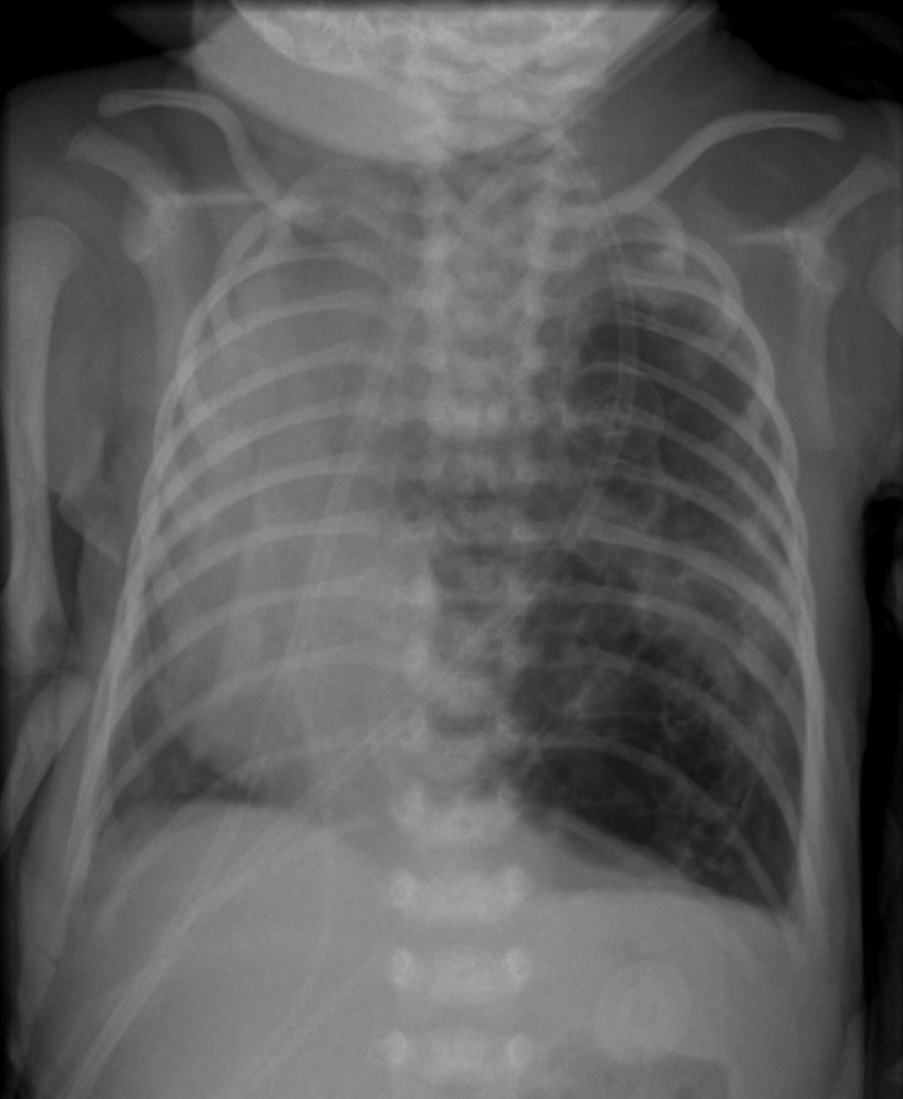
Discussion
Congenital Pulmonary Airway Malformation
Dysplastic lung tissue with various degrees of cystic change
Radiograph: Type I, most common
Unilateral lucency with thin-walled cysts
Expansile, may compress/shift adjacent lobes/mediastinum
CT
Multiple cysts which may be fluid or air filled with thin or thick septa
May displace adjacent structures
Arterial/venous supply from pulmonary artery and vein
Thank you to Dr. Caleb Richards for providing images
Multiple air filled cysts within the left hemithorax which shift the mediastinum rightward and exert mass effect on the left upper lobe.
Notes:
Dysplastic lung tissue with various degrees of cystic change

Slide 29
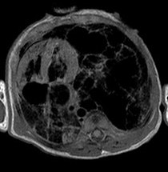
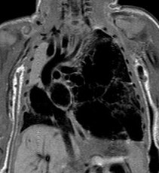
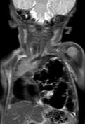
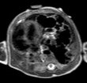
Discussion
Congenital Pulmonary Airway Malformation
Axial T1
Coronal T1
Coronal single shot T2
Axial and coronal T1WI, axial and coronal single shot T2WI demonstrate multiple air filled cysts with minimal fluid within the left lower lobe which displace the mediastinum rightward and exert mass effect on the left upper lobe.
Coronal single shot T2
Thank you to Dr Caleb Richards for providing images
Notes:
Axial T1, axial ss T2,

Slide 30
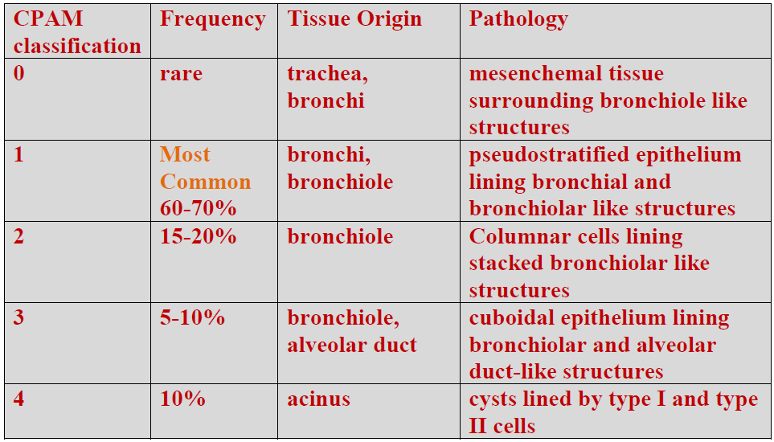
Discussion
Congenital Pulmonary Airway Malformation

Slide 31
Discussion CPAM v. Neuroblastoma
CPAM
Neuroblastoma
Radiograph: intraparenchymal opacity with multiple air filled cysts
CT
Multiple thin walled cysts with air or fluid
-Calcium uncommon
No bony destruction
Radiograph: solid extraparenchymal lesion
CT
Solid lesion
Heterogenous content, may contain hemorrhage and necrosis
Calcium common
May demonstrate bony destruction

Slide 32
References
Biyyam DR, Chapman T, Ferguson MR, Deutsch G, Dighe MK. Congenital lung abnormalities: embryologic features, prenatal diagnosis and postnatal radiologic pathologic correlation. Radiographics. 2010 Oct;30(6):1721-38.
Berrocal T, Madrid C, Novo S, Gutiérrez J, Arjonilla A, Gómez-León N. Congenital anomalies of the tracheobronchial tree, lung, aand mediastinum: embryology, radiology and pathology. Radiographics. 2004 Jan-Feb;24(1):e17. Epub 2003 Nov 10.
David R, Lamki N, Fan S, Singleton EB, Eftekhari F, Shirkhoda A, Kumar R, Madewell JE. The many faces of neuroblastoma. Radiographics. 1989 Sep;9(5):859-82.
Donnelly LF: Fundamentals of Pediatric Radiology. Phildelphia W.B. Saunders, 2001.
Fitch SJ, Tonkin IL, Tonkin AK. Imaging of foregut duplication cysts. Radiographics. 1986 Mar;6(2):189-201.
Jeung MY, Gasser B, Gangi A, Bogorin A, Charneau D, Wihlm JM, Dietemann JL, Roy C. Imaging of cystic masses in the mediastinum. Radiographics. 1990 Nov;10(6):1055-79.

Slide 33
References
Kao SW, Zuppan CW, Young LW. AIRP best cases in radiologic-pathologic correlation: type 2 congenital cystic adenomatoid malformation (type 2 congentital pulmonary airway malformation. Radiographics. 2011 May-Jun;31(3):743-8.
Kawashima A, Fishman EK, Kuhlman JE, Nixon MS. CT of posterior mediastinal masses. Radiographics. 1991 Nov;11(6):1045-67.
Kawashima A, Fishman EK, Kuhlman JE, Nixon MS. CT of posterior mediastinal mass. Radiographics. 1993 Mar;13(2):425-41.
Lee EY, Boiselle PM, Cleveland RH. Multidetector evaluation of congenital lung anomalies. Radiology. 2008 Jun;247(3):632-48.
Mata JM, Cáceres J, Lucaya J, García-Conesa JA. CT of congenital malformations of the lung. Radiographics. 1990 Jul;10(4):651-74.

Slide 34
References
Panicek DM, Heitzman ER, Randall PA, Groskin SA, Chew FS, Lane EJ Jr, Markarian B. The continuum of pulmonary developmental anomalies. Radiographics. 1987 Jul;7(4):747-72.
Raider L, Landry BA, Brogdon BG. The retrotracheal triangle. Radiographics. 2002 Oct;22 Spec No:S79-93.
Rosado-de-Christenson ML, Stocker JT. Congenital cystic adenomatoid malformation. Radiographics. 1991 Sep;11(5):865-86.
Rosado-de-Christenson ML, Frazier AA, Stocker JT, Templeton PA.
Radiographics. 1991 Nov;11(6):1045-67. From the archives of AFIP: Extralobar sequestration: radiologic pathologic correlation.
Rozovsky K, Koplewitz BZ, Krausz Y, Revel-Vilk S, Weintraub M, Chisin R, Klein M. Added value of SPECT/CT for correlation of MIBG scintigraphy and diagnostic CT in neuroblastoma and pheochromocytoma. AJR Am J Roentgenol. 2008 Apr;190(4):1085-90.

Slide 35
References
Shady K, Siegel MJ, Glazer HS. CT of focal pulmonary masses in childhood. Radiographics. 1992 May;12(3):505-14.
Tateishi U, Gladish GW, Kusumoto M, Hasegawa T, Yokoyama R, Tsuchiya R, Moriyama N. Chest wall tumors: radiologic findings and pathologic correlation part 2: malignant tumors. Radiographics. 2003 Nov-Dec;23(6):1491-508.
Tsuchiya T et al: Bronchopulmonary foregut malformation diagnosed by three-dimensional CT. Pediatr Radiol. 33(12):887-9, 2003
Winer-Muram HT, Kauffman WM, Gronemeyer SA, Jennings SG. Primitive neuroectodermal tumors of the chest wall (Askin tumors): CT and MR findings. AJR Am J Roentgenol. 1993 Aug;161(2):265-8.
.

