Slide 1
Radiological Category:
Mammography
Principal Modality (1):
Principal Modality (2):
Mammography
Ultrasound
Case Report # 0897
Submitted by:
Tina Lee, M.D.
Faculty reviewer:
Laverne Ingram, M.D
Date accepted:

Slide 2
Case History
54 year old female with pain undergoing mammography. Additional history withheld.

Slide 3
Current Mammography
RMLO
LMLO

Slide 4
Current Mammography

Slide 5
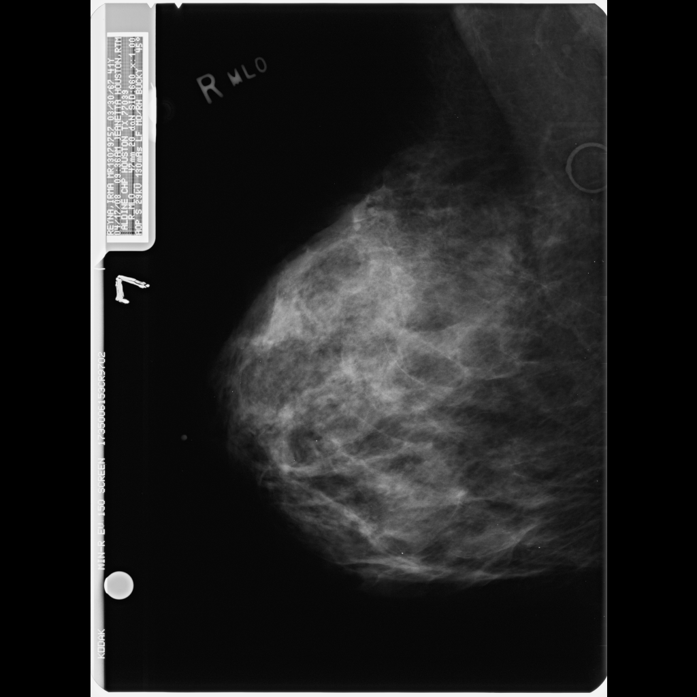
Mammography Performed
3 years prior
LMLO

Slide 6
Mammography Performed
3 years prior
RCC
LCC

Slide 7
Test Your Diagnosis
Which one of the following is your choice for the appropriate diagnosis? After your selection, go to next page.
Interval breast reduction surgery.
Interval significant weight loss.
Interval menopause and hormonal atrophy.
Invasive lobular carcinoma.

Slide 8
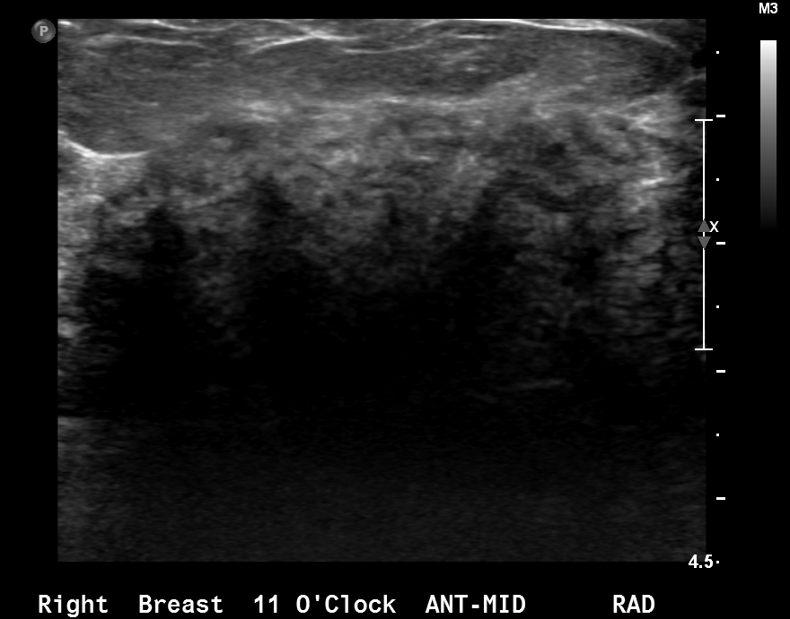
Further Evaluation

Slide 9
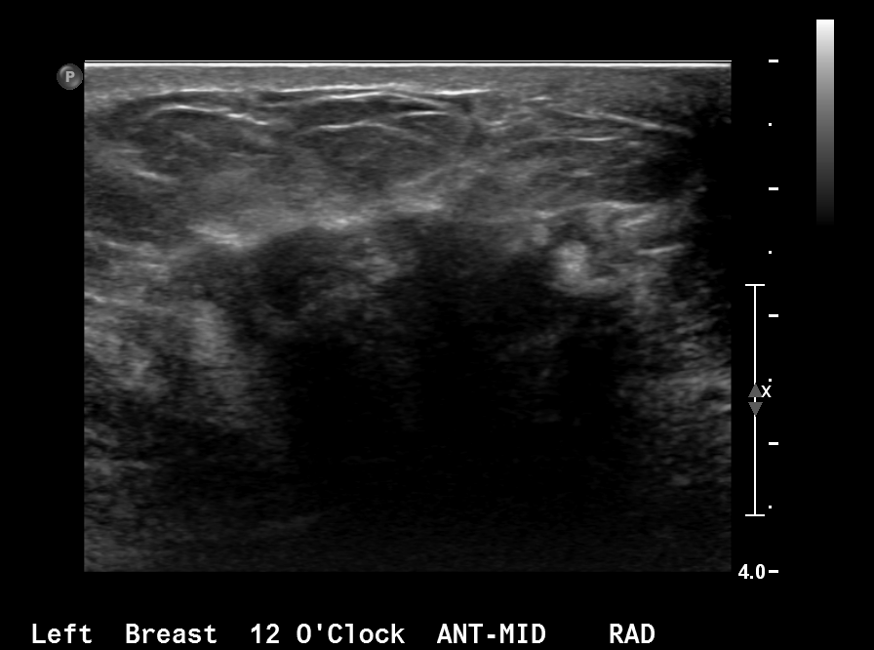
Further Evaluation

Slide 10
Current mammographic findings demonstrate no significant mammographic abnormalities. When compared to patient’s prior mammogram 3 years ago, it is evident that there has been significant decrease in the size of the breasts bilaterally. Further evaluation with breast ultrasound demonstrates irregular masses with posterior acoustic shadowing.
Findings and Differentials
Findings:
Differentials:
Invasive lobular carcinoma.
Metastatic disease.
Leukemic breast infiltrates.

Slide 11
Discussion
Approximately 5 - 10 percent of invasive breast cancers are invasive lobular carcinomas. Invasive lobular carcinomas have a greater tendency to be multicentric and bilateral when compared to the invasive ductal carcinomas.
Invasive lobular carcinomas (ILC) grow in sheets of single layers of cells along the ligamentous structures of the breast. Due to this pattern of growth ILCs are often difficult to detect on mammograms and on physical examination. Breast thickening, skin and nipple retraction are the most common clinical findings.
On ultrasound ILC tend to be hypoechoic, irregular, a spiculated or ill defined mass which may or may not demonstrate acoustic shadowing. MRI appearance is a spiculated mass with variable enhancement patterns.

Slide 12
Discussion
On mammogram, focal asymmetry (3 - 25%) and architectural distortion (10 - 25%) are the most common findings of ILC. ILC may also present as an equal or high density mass. Adequate compression is important in detecting the subtle findings of asymmetry and architectural distortion. Thus, these findings are more commonly seen on the craniocaudal views -- in general greater compression is achieved on CC views when compared to MLO views.
An unusual and typically late mammographic presentation of invasive lobular carcinoma is the shrinking breast. The shrinking breast is a mammographic finding, and change in breast size on physical exam is not apparent. The decrease in size of the breasts, nipple to pectoralis line, on mammogram is thought to be resultant of the decreased compliance in the breast which then results in decreased compression on mammographic examination and the breast appears smaller.

Slide 13
Bilateral invasive lobular carcinoma presenting as shrinking breast on mammogram.
Diagnosis

Slide 14
Ikeda DM. The Requisites: Breast Imaging. Philadelphia, PA : Elsevier 2011 Harvey JA, Fechner RE, Moore MM. Apparent ipsilateral decrease in breast size at mammography: a sign of infiltrating lobular carcinoma. Radiology 2000 Mar; 214 : 883-889 Harvey JA Unusual breast Cancers: Useful Clues to Expanding the Differential Diagnosis. Radiology 2007 Mar; 242 : 683-694 Jafri NF, Slanetz PJ. The shrinking breast: an unusual mammographic finding of invasive lobular carcinoma. Radiology Case Reports [ Online] 2007; 2:94
References

