Slide 1
Radiological Category:
Pediatrics
Principal Modality:
US
Case Report 01005
Submitted by:
J. Caleb Richards, M.D.
Faculty reviewer:
Scott Serlin, M.D
University of Texas Medical School at Houston
Date accepted:
9 February 2014

Slide 2
Case History
3 year old female with urinary hesitancy and hematuria

Slide 3
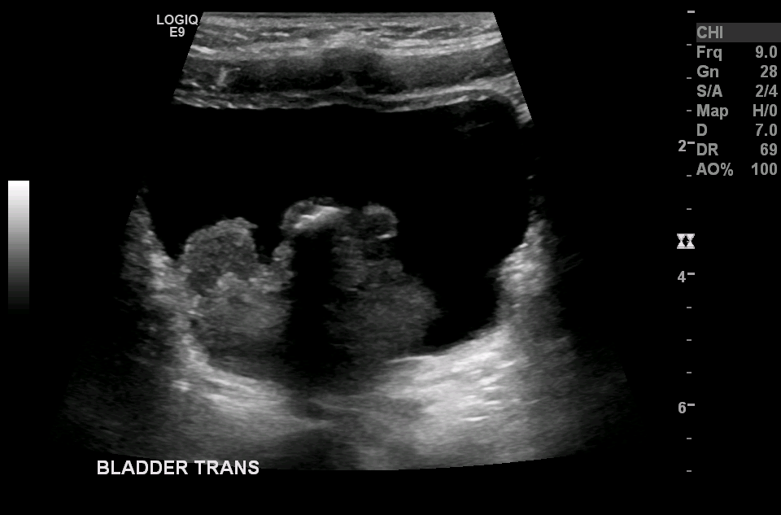
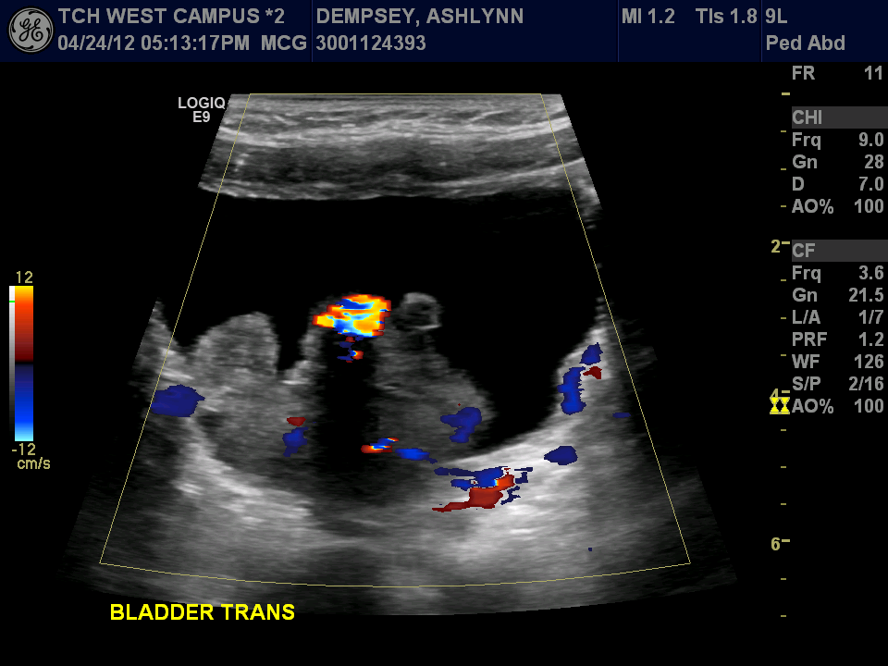
Ultrasound

Slide 4
Test Your Diagnosis
Which artifact is present on the color images?
Twinkling artifact
Ring down artifact
Side lobe artifact
Reverberation artifact

Slide 5
Ultrasound
Answer:
Twinkling

Slide 6
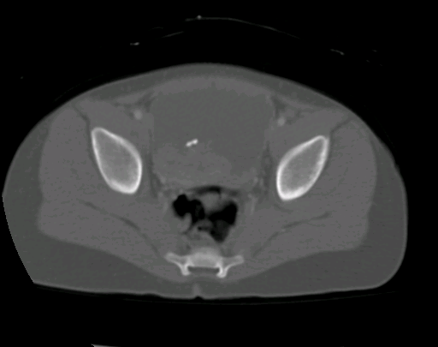
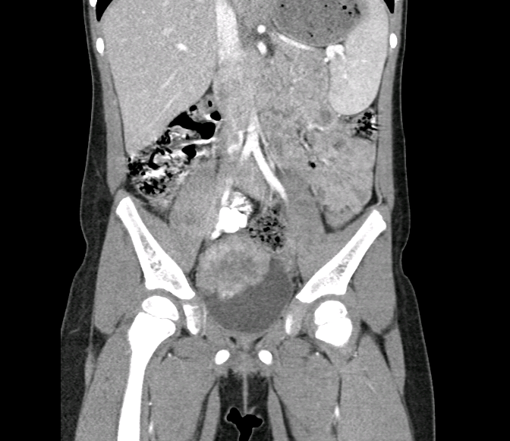
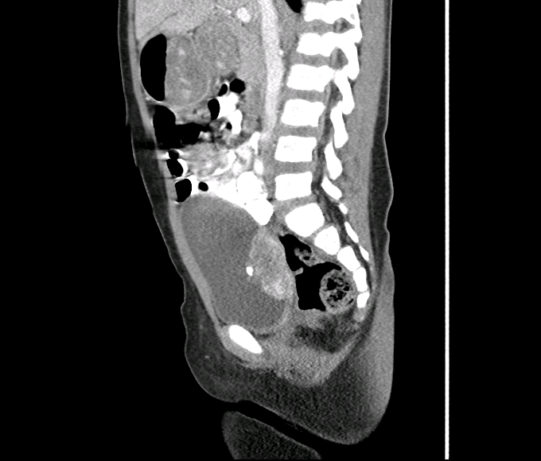
CT

Slide 7
Test Your Diagnosis
What is the diagnosis?
Rhabdomyosarcoma
Blood Clot
Urothelial Cell Carcinoma
Leiomyoma

Slide 8
Findings
Ultrasound shows a large bladder mass with flow on color images demonstrating the vascularity of the lesion
Calcification within the mass shows posterior acoustic shadowing on gray scale images and twinkling artifact on color images

Slide 9
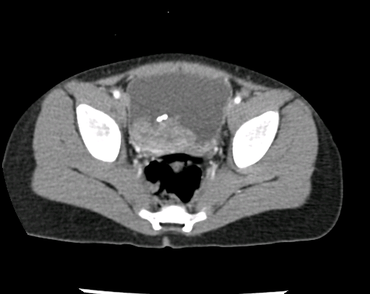
Findings
CT further depicts the mass with calcification

Slide 10
Discussion
Bladder Rhabdomyosarcoma
The most common neoplasm of the genitourinary tract in children
Median age of presentation is at 7 years
Slightly more common in males
More prevalent in white children than black children by 3:1
Clinically, patients can present with bladder outlet obstruction, abdominal pain, dysuria, and/or hematuria
10-20% have metastasis at the time of diagnosis, with the common sites being lung, cortical bone, and lymph nodes
Ultrasound, the screening study of choice for children with an abdominal or pelvic mass, will show a heterogeneous mass with vascularity and occasional calcifications
CT or MR better depicts local invasion and lymphadenopathy

Slide 11
Diagnosis
Bladder Rhabdomyosarcoma

Slide 12
References
Agrons, G et al. From the Archives of the AFIP: Genitourinary Rhabdomyosarcoma in Children: Radiologic-Pathologic Correlation. Radiographics 1997; 17:919-937
Choyke, P et al. Hereditary Renal Cancers. Radiology 2003; 226:33–46
Hirsch, M. et al. Color doppler twinkling artifact: A misunderstood and useful sign. Revista Chilena de Radiologia 2011; Vol 17 N 2:82-84

