Slide 1
Radiological Category:
Body
Principal Modality (1):
Principal Modality (2):
CT
None
Case Report 01010
Submitted by:
Tina Sprouse, MD
Faculty reviewer:
Tara Sagebiel, MD
Date accepted: 03/13/2014

Slide 2
Case History
67 year old female with multiple cancer history including melanoma, clear cell ovarian carcinoma and papillary thyroid carcinoma undergoing routine surveillance imaging.

Slide 3
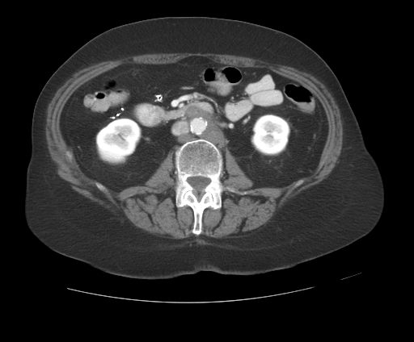
Radiological Presentations
Axial CT with IV contrast

Slide 4
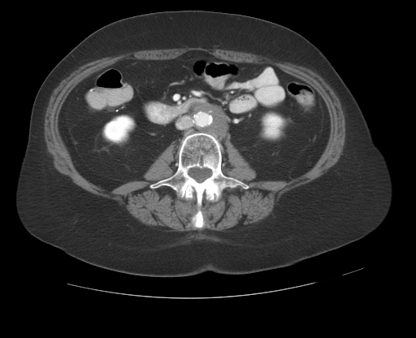
Radiological Presentations
Axial CT with IV contrast

Slide 5
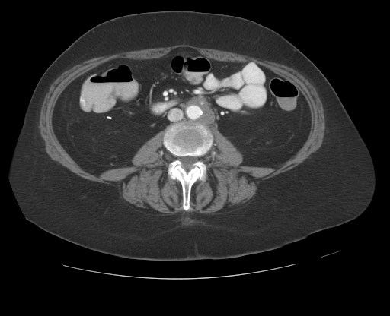
Radiological Presentations
Axial CT with IV contrast

Slide 6
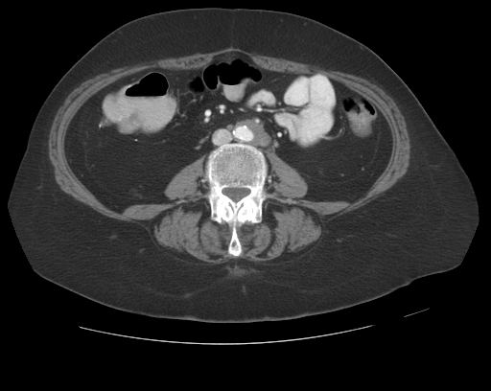
Radiological Presentations
Axial CT with IV contrast

Slide 7
Test Your Diagnosis
Which one of the following is your choice for the appropriate diagnosis? After your selection, go to next page.
Retroperitoneal lymphangioma
Retroperitoneal fibrosis
Lymphoma
Metastatic disease

Slide 8
Axial contrast enhanced images through the abdomen just below the level of the kidneys demonstrates a low attenuation lobulated mass surrounding the aorta and encasing the inferior mesenteric artery. Though the mass appears to be low in attenuation, it measures approximately 60 HU internally.
Findings and Differentials
Findings:
Differentials:
Retroperitoneal fibrosis
Lymphoma
Metastatic disease

Slide 9
Discussion
Lymphangiomas are rare, benign tumors of the lymphatic system. They are congenital and occur due to the failure of the developing lymphatic tissue to connect to the lymphatic system. The most common location for lymphangiomas is the head and neck. Intra-abdominal lymphangiomas account for approximately 5% of all lymphangiomas. The retroperitoneal location is the second most common location for intra-abdominal lymphangiomas after the small bowel mesentery. Lymphangiomas by CT appear as cystic thin walled masses with internal attenuation near fluid or fat. In our case, evaluation of the peri-aortic retroperitoneal mass suggests a cystic nature, however upon measurement it is found to be soft tissue density at 60 HU. Thus, lymphangioma is unlikely.
Retroperitoneal fibrosis is an inflammatory condition which can be idiopathic or secondary. Idiopathic retroperitoneal fibrosis accounts for over two thirds of cases, has a male predilection, tends to occur in middle age (40-65 years old) and has prevalence of 1.3 per 100,000. Secondary retroperitoneal fibrosis can occur due to a myriad of reasons including drugs, malignancy, infection, radiation therapy and trauma. CT imaging of retroperitoneal fibrosis typically reveals a well delineated mantle of peri-aortic soft tissue which lies anterior and lateral to the aorta without aortic displacement. The soft tissue mass is often caudal to the renal hilum. A common associated finding is medial deviation of the ureters and hydronephrosis, due to the fibroinflammatory involvement of one or more ureter.

Slide 10
Discussion
Lymphoma is a malignancy arising from lymphocytes or lymphoblasts. Lymphoma in the retroperitoneum may present as multiple discrete enhancing masses or may mimic retroperitoneal fibrosis and appear as a peri-aortic mantle of soft tissue. Lymphoma has a propensity to displace normal structures, and may lift the aorta way from the spine.
Clear cell ovarian carcinoma is an uncommon histologic type of ovarian carcinoma that tends to present at an early stage but tends to recur. Clear cell carcinoma may arise within an endometrioma and is seen more frequently in patients with endometriosis. Clear cell carcinoma often appears as a unilocular cystic ovarian mass with mural nodularity or peripheral solid component. Clear cell carcinoma may spread through direct extension, intraperitoneal implantation or through lymphatic dissemination.

Slide 11
Biopsy proven clear cell ovarian carcinoma metastases.
Diagnosis

Slide 12
Bhavsar T et al. Retroperitoneal cystic lymphangioma in an adult: A case report and review of the literature. World Journal of Gastrointestinal Pathophysiology 2010; 1(5):171-176 Yang DM et al. Retroperitoneal Cystic Masses: CT, Clinical, and Pathologic Findings and Literature Review. Radiographics 2004; 24(5): 1353-1365 Cronin CG et al. Retroperitoneal Fibrosis: A Review of Clinical Features and Imaging Findings. American Journal of Roentgenology 2008; 191(2): 423-431 Caiafa RO et al. Retroperitoneal Fibrosis: Role of Imaging in Diagnosis and Follow Up. Radiographics 2013; 33(2): 535-552 Takano M et al. Clear cell carcinoma of the ovary: a retrospective multicentre experience of 254 patients with complete surgical staging. British Journal of Cancer 2006; 94(10): 1369-1374 Jung SE et al. CT and MR Imaging of Ovarian Tumors with Emphasis on Differential Diagnosis. Radiographics 2002; 22(6): 1305-1325
References

